Slide 1
Value and 3-Dimensional Effect

Slide 2
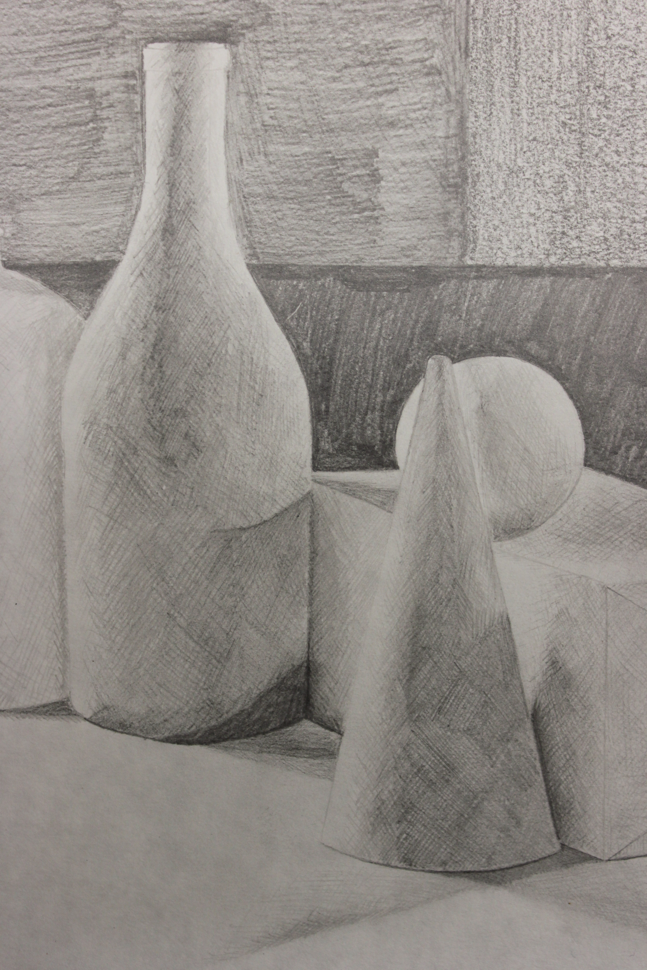

Slide 3
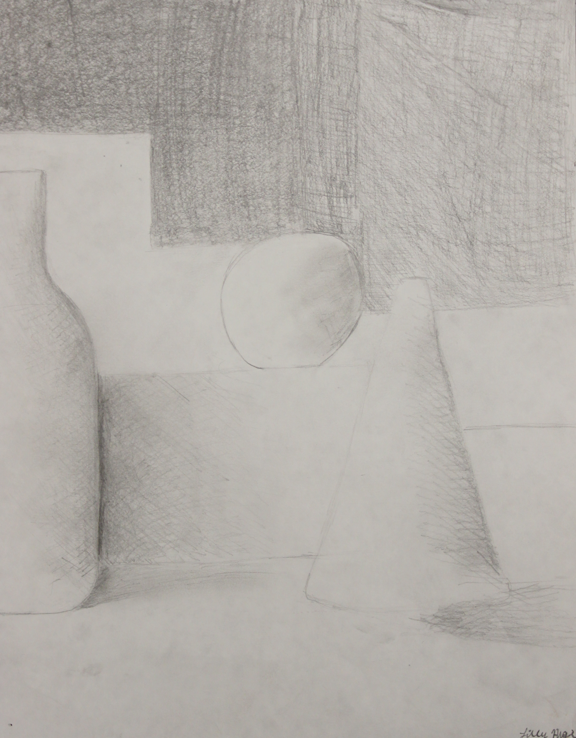

Slide 4
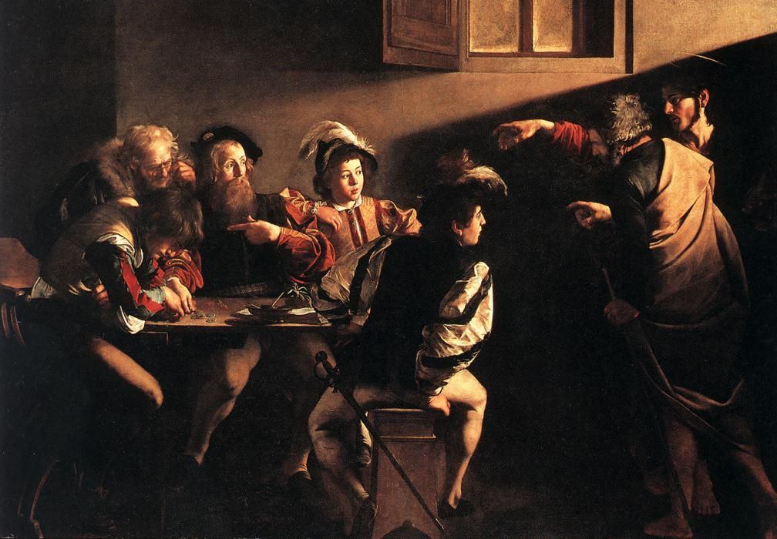

Slide 5
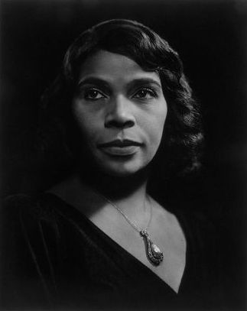
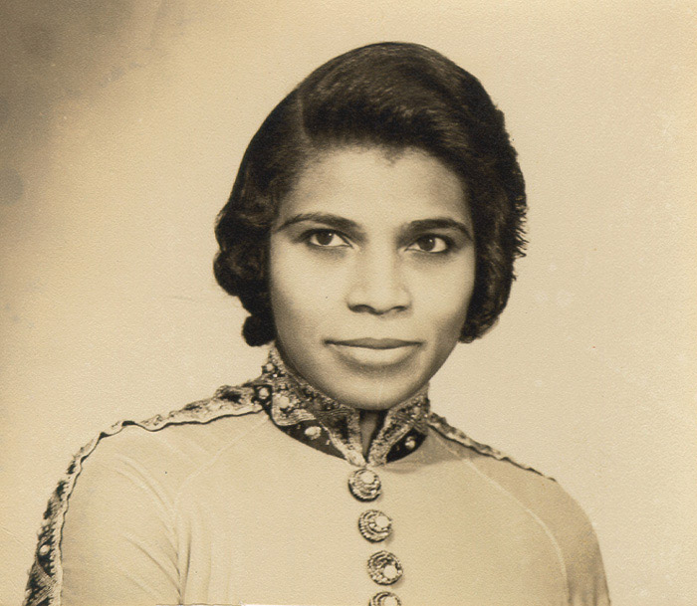

Slide 6
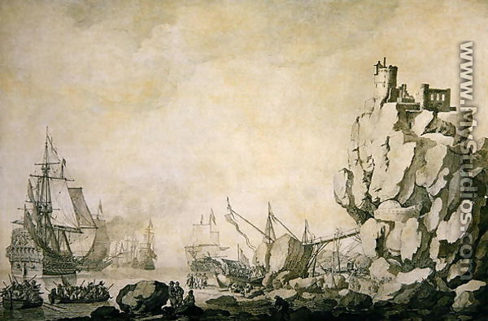
Notes:
Willem Van der Veld
Ships and Militia by a Rocky Shore

Slide 7
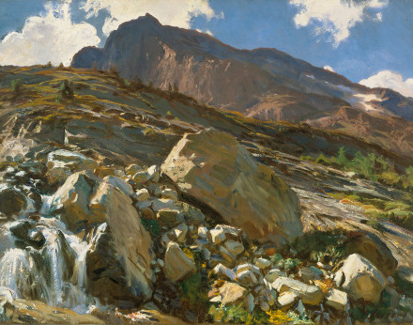
Notes:
John Singer Sargent
Simplon Pass 1911

Slide 8
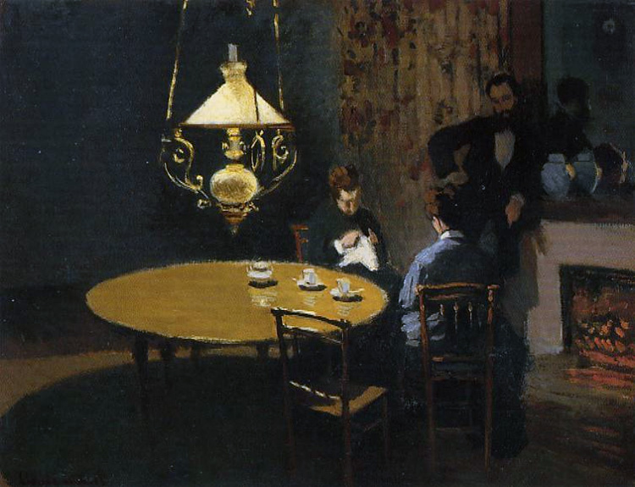
Notes:
Monet
Interior, After Dinner

Slide 9
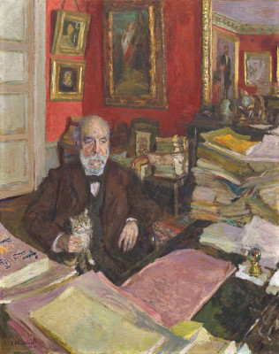
Notes:
Vuillard
Theodore Duret, 1912

Slide 10
Notes:
Vuillard
Theodore Duret, 1912

