Slide 1
Cartoon Character

Slide 2
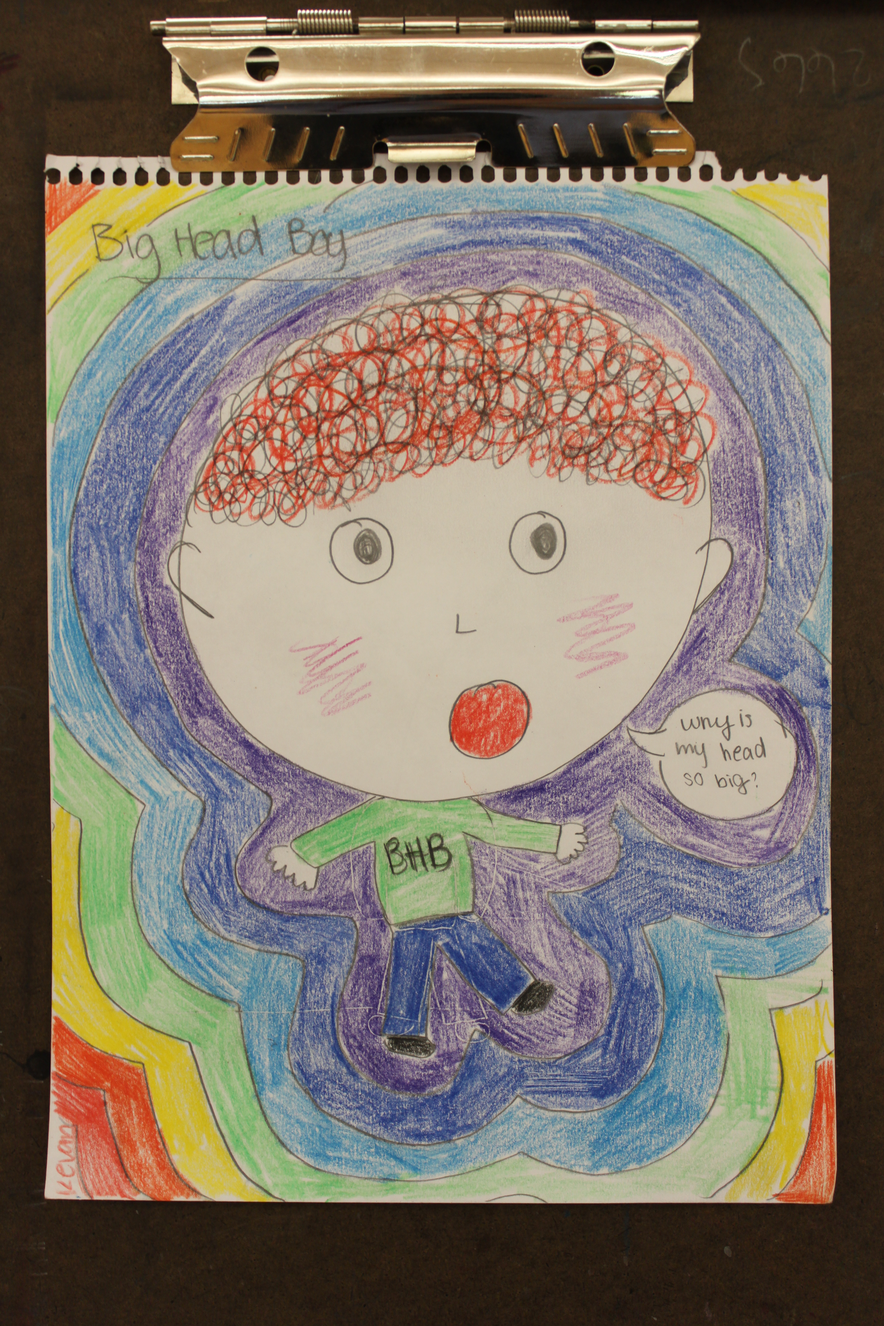

Slide 3
