Slide 1
Rhythm

Slide 3
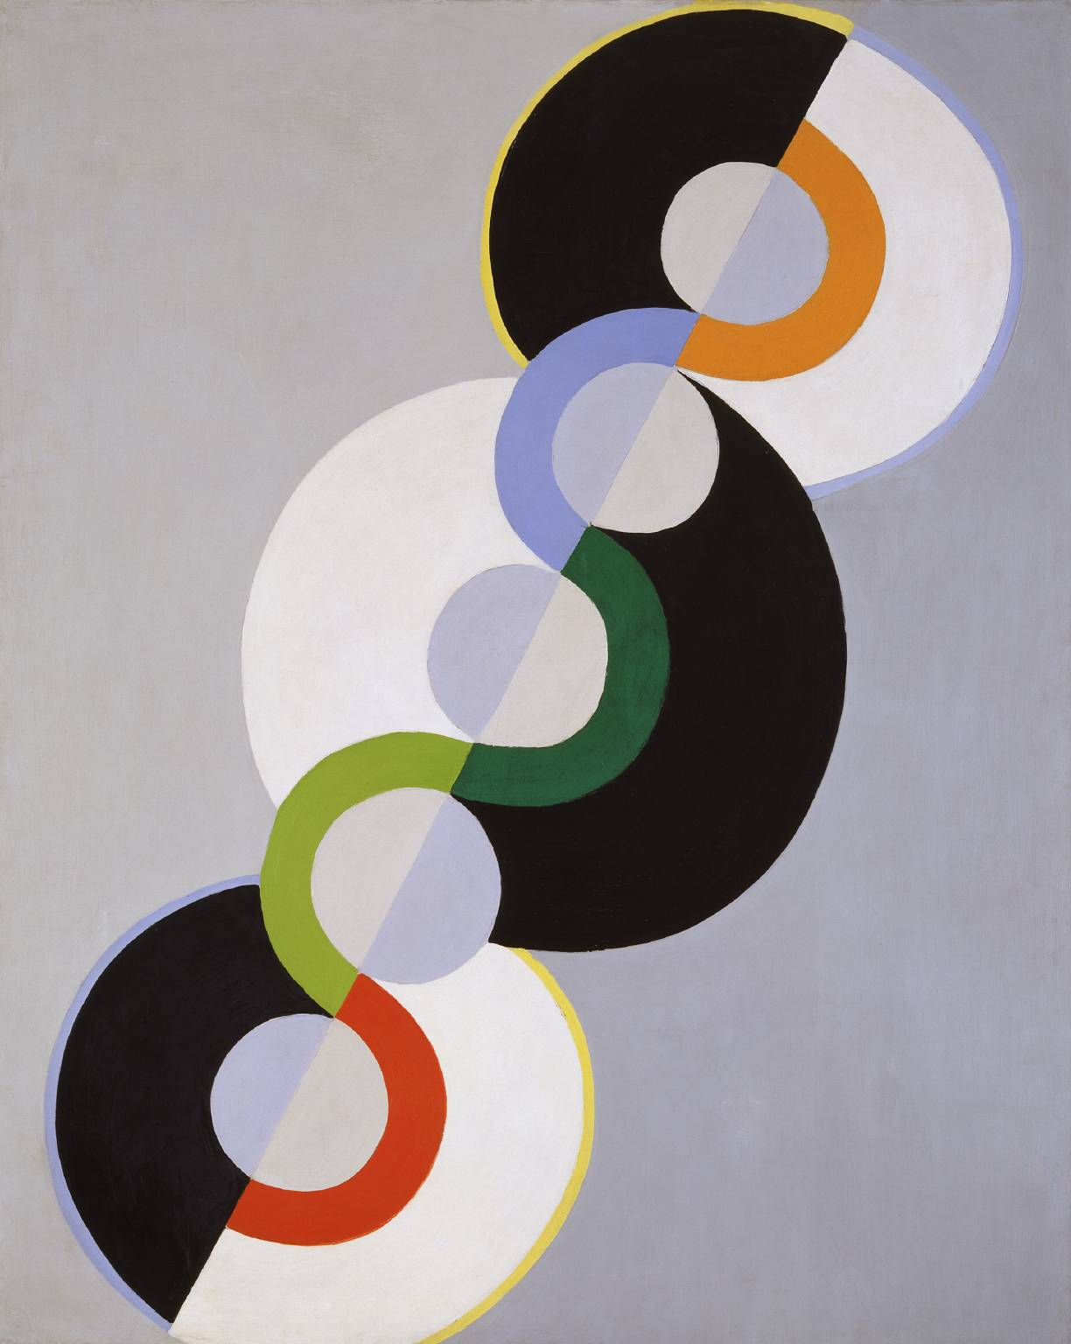

Slide 4
