Slide 1
Non Representational Illustration

Slide 2
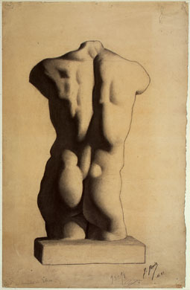
Notes:
Picasso, Study of a torso done when he was 12, 1893

Slide 3
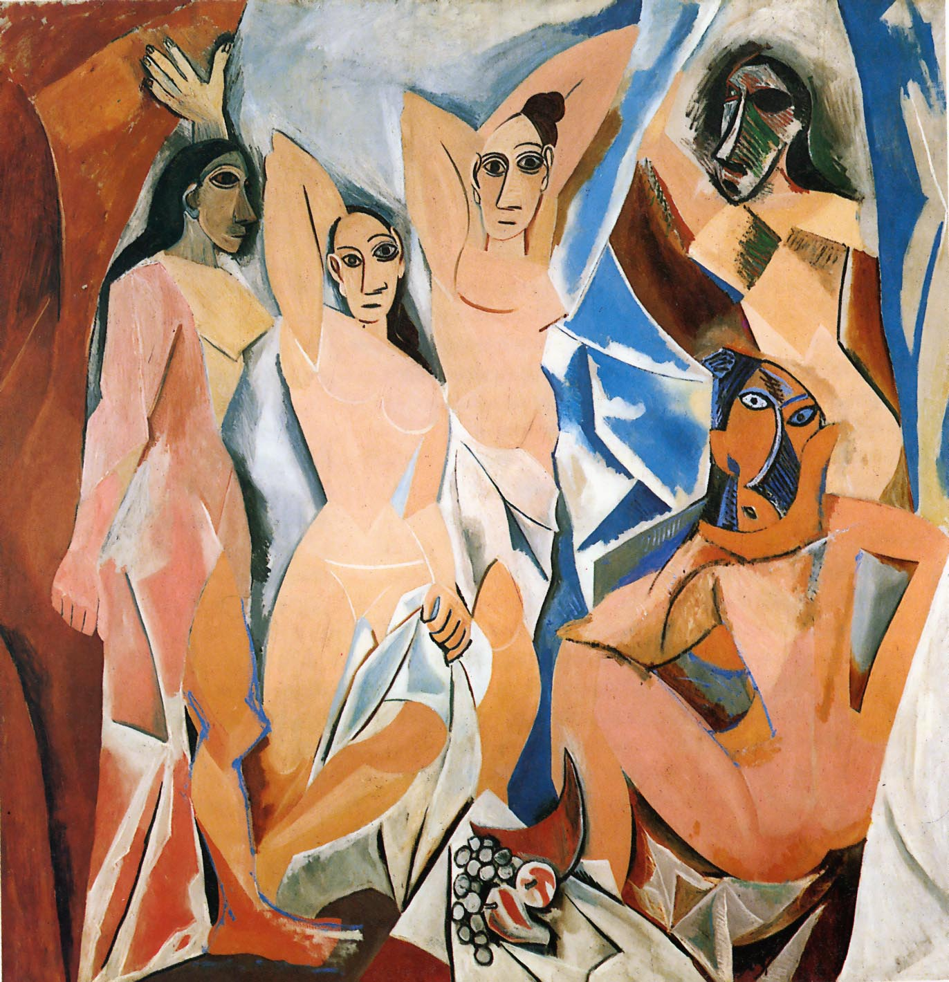
Notes:
Picasso, Les Demoiselles d'Avignon, 1907

Slide 4
Notes:
Picasso, Les Demoiselles d'Avignon, 1907

Slide 5
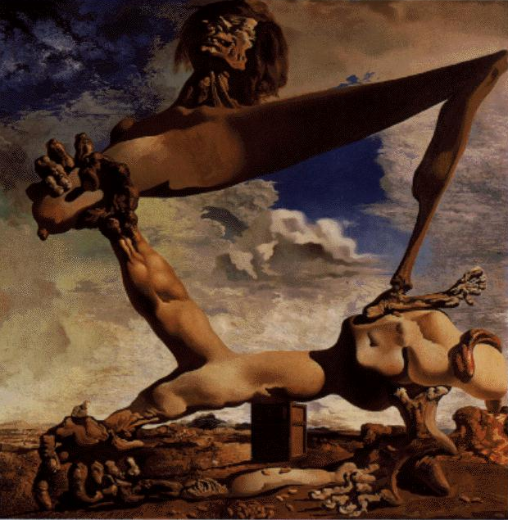
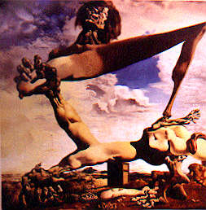
Notes:
Dali, Soft Construction w Boiled Beans (Premonition of Civil War), 1936

Slide 6
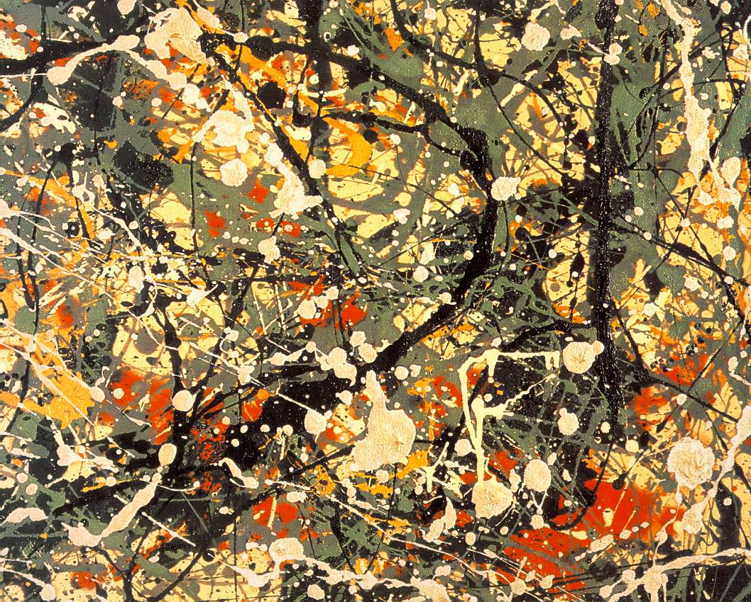
Notes:
Pollock, det of Painting Number 8, 1949

Slide 7
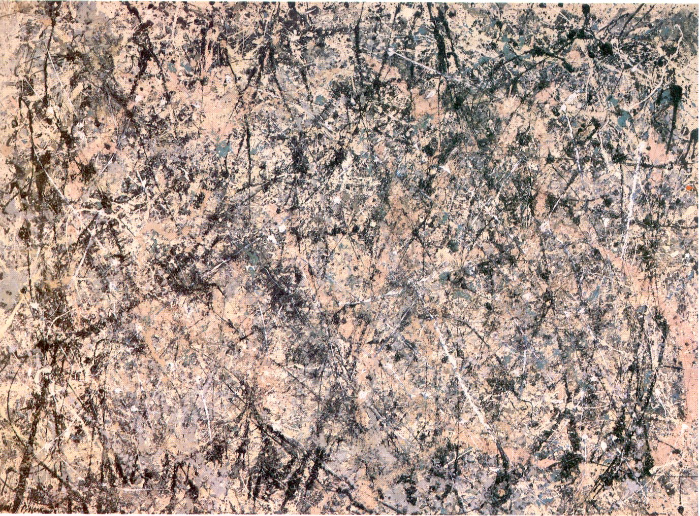
Notes:
Pollack, Lavender Mist Number 1, 1950

Slide 8
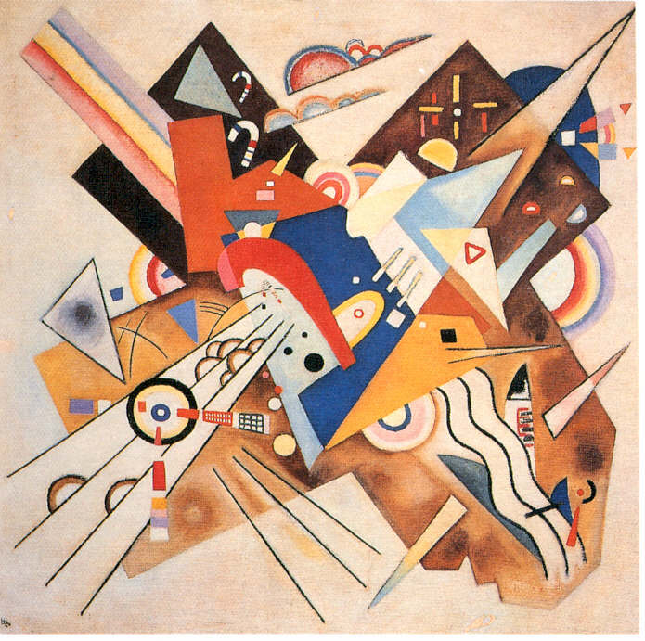
Notes:
Kandinsky, Accented Corners, No 247, 1923

Slide 9
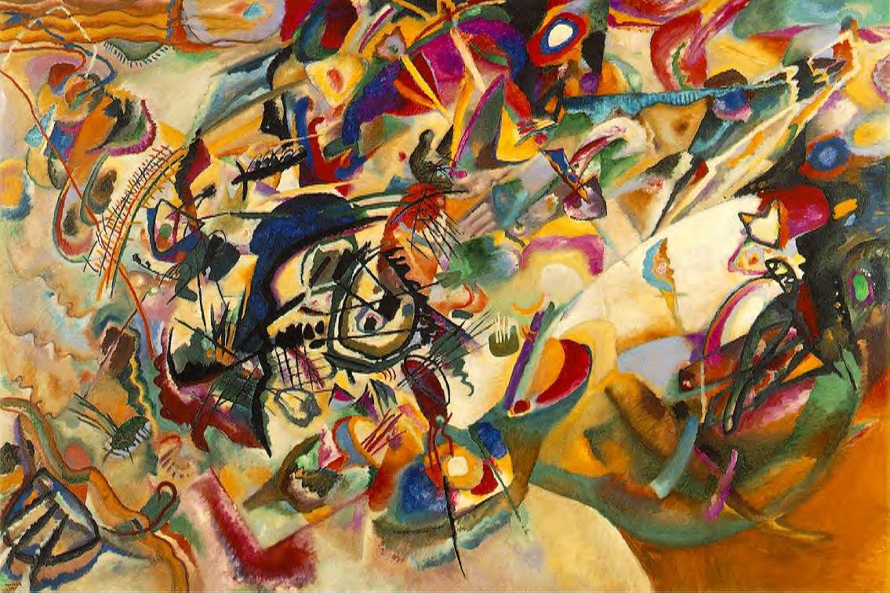
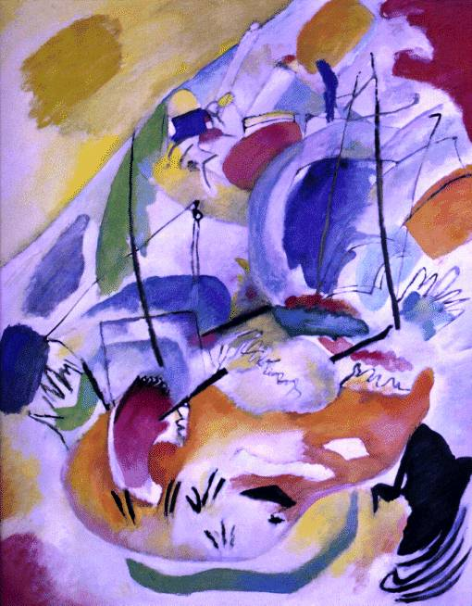
Notes:
Kandinsky, Composition VII, 1913; Kandinsky, Improvisation 31 (Sea Battle), 1913, NatlGall

Slide 10
Notes:
Louis, Morris, Alpha-Pi, 1960

Slide 11
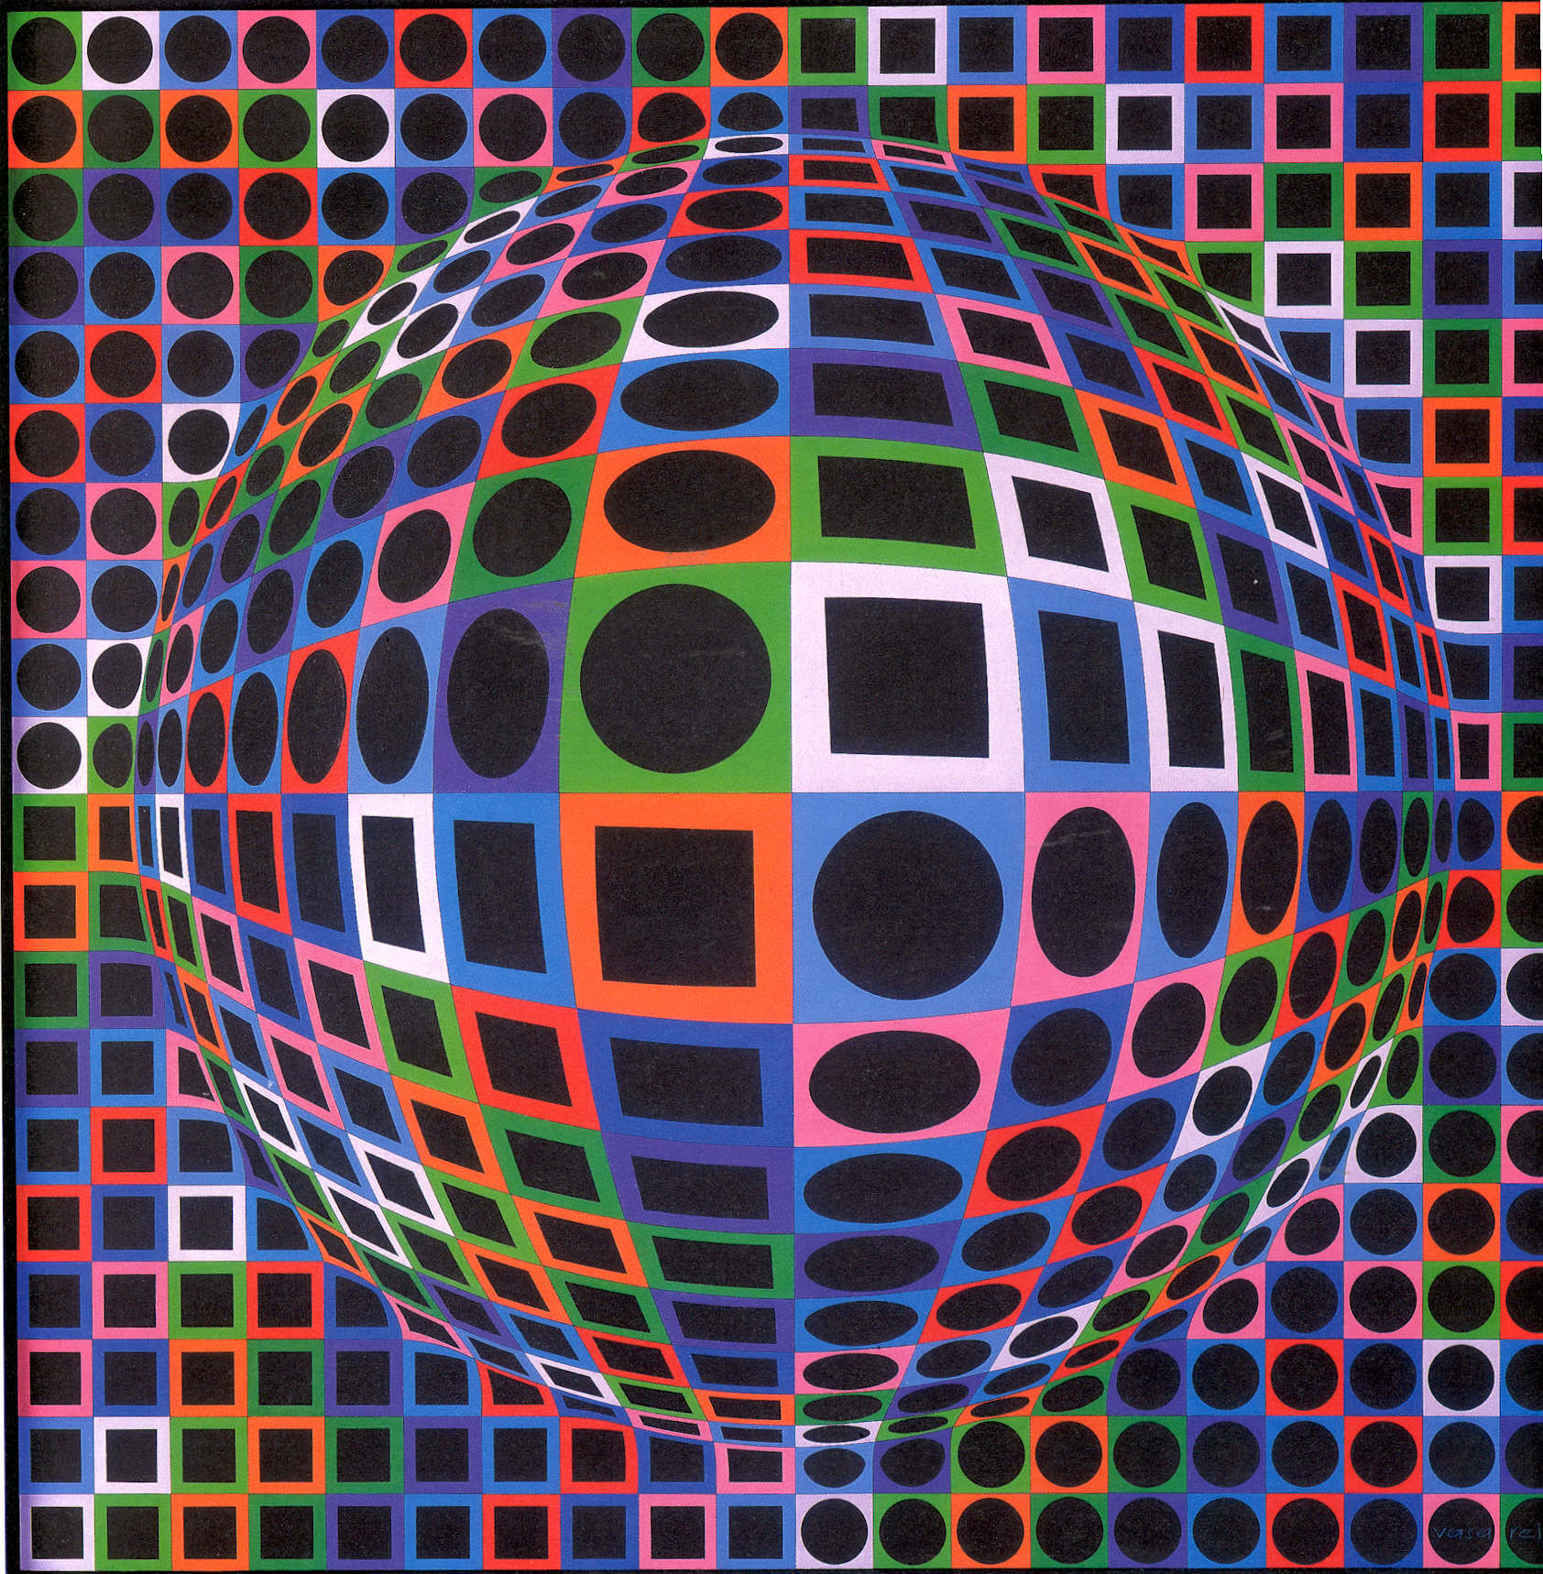
Notes:
Vasarely, Victor, Vega-Gyongiy-2, 1971

Slide 12
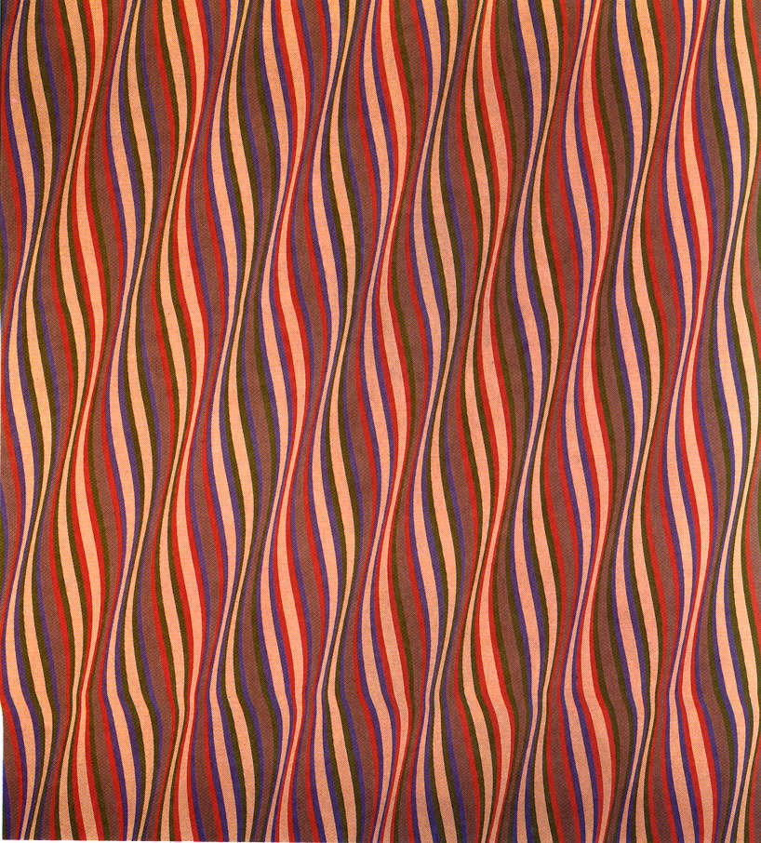
Notes:
Riley, Entice 2, 1974

Slide 13
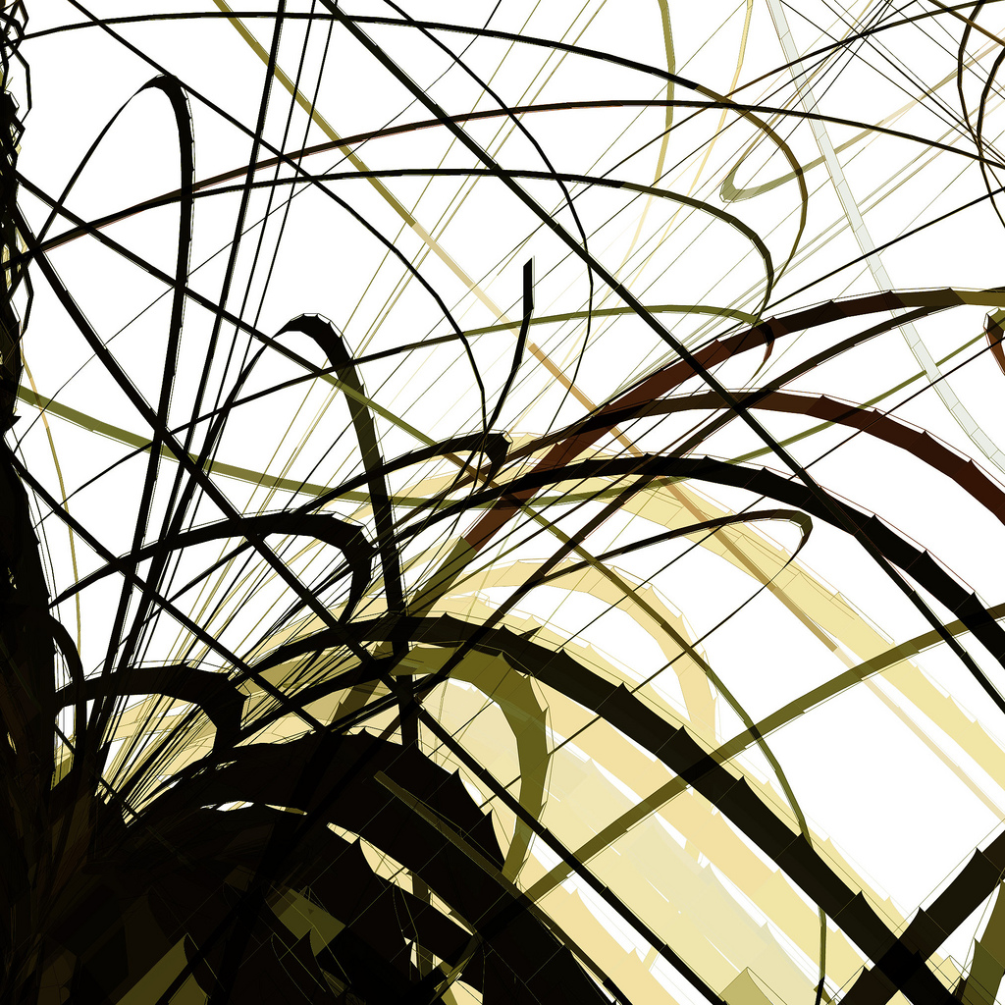

Slide 14
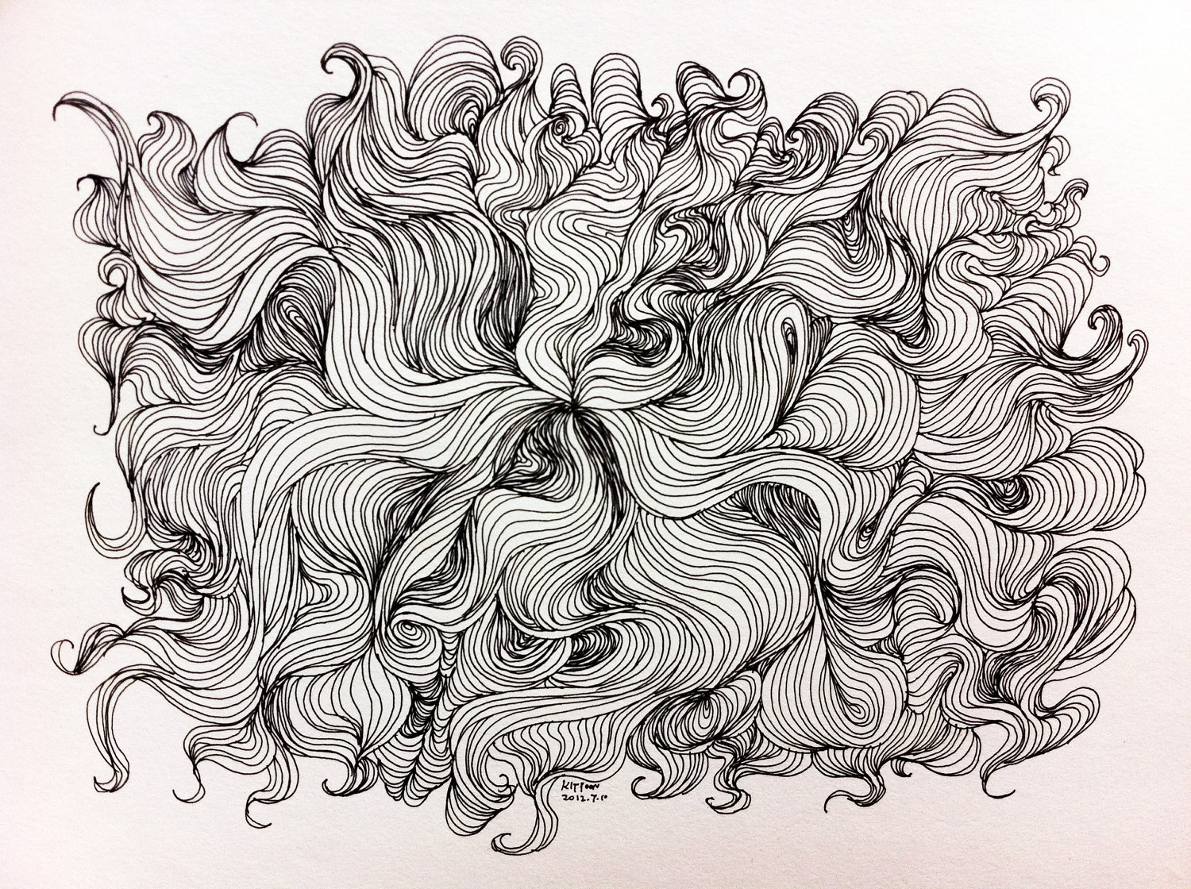

Slide 16
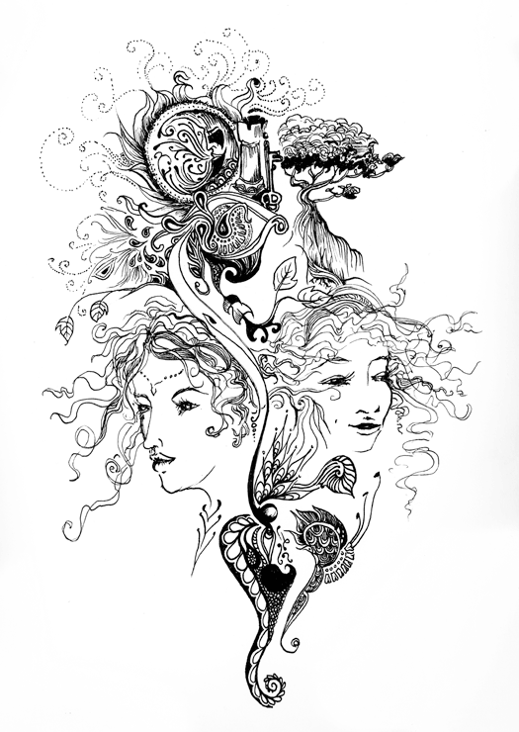
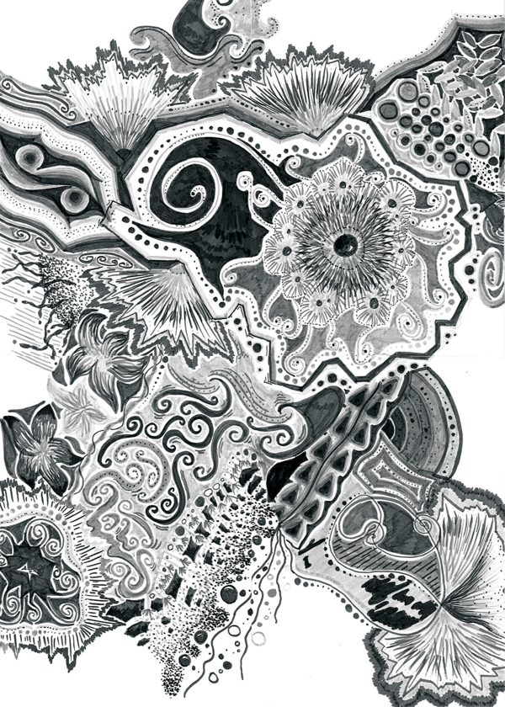
Abstract or Non Representational. Why/why not?

Slide 17
Components – Line types
Directions
(vertical, horizontal, zig zag, curvey…)
Dimensions
(thick, thin, short, long…)
Relationships
(parallel, overlap, intersect, random…)

Slide 18
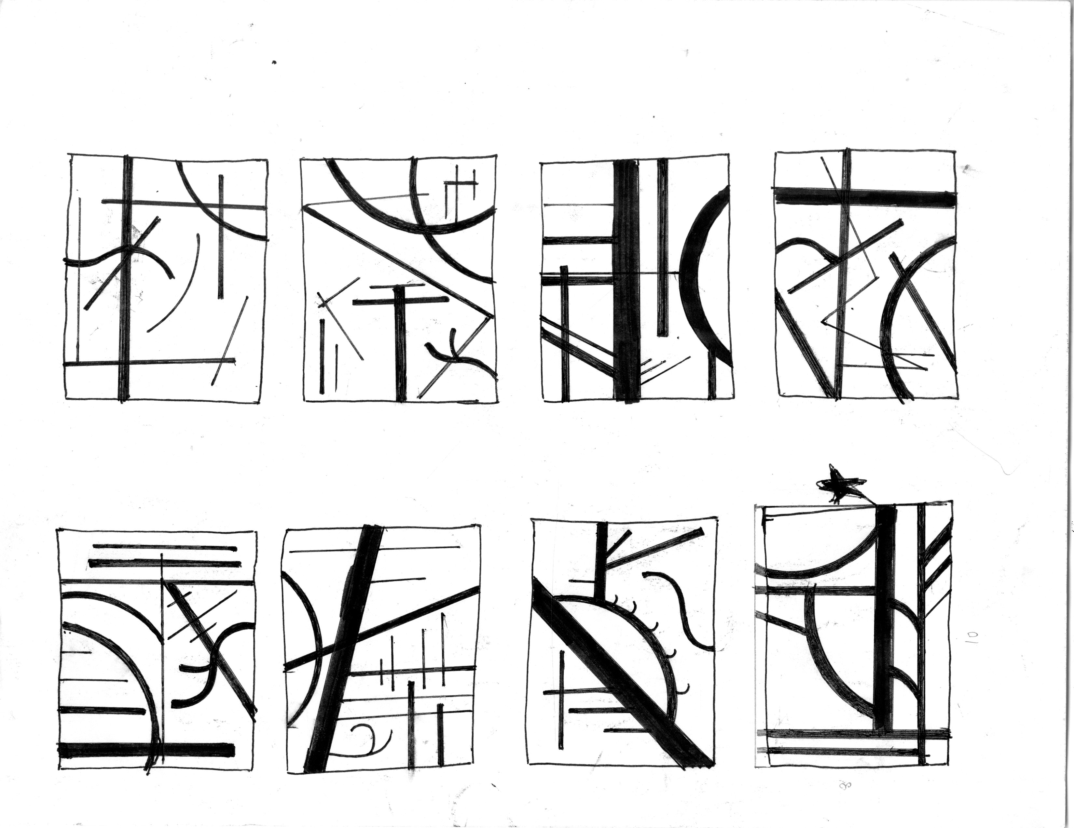

Slide 21
Composition-Principles of design
Balance
Emphasis
Unity

Slide 22
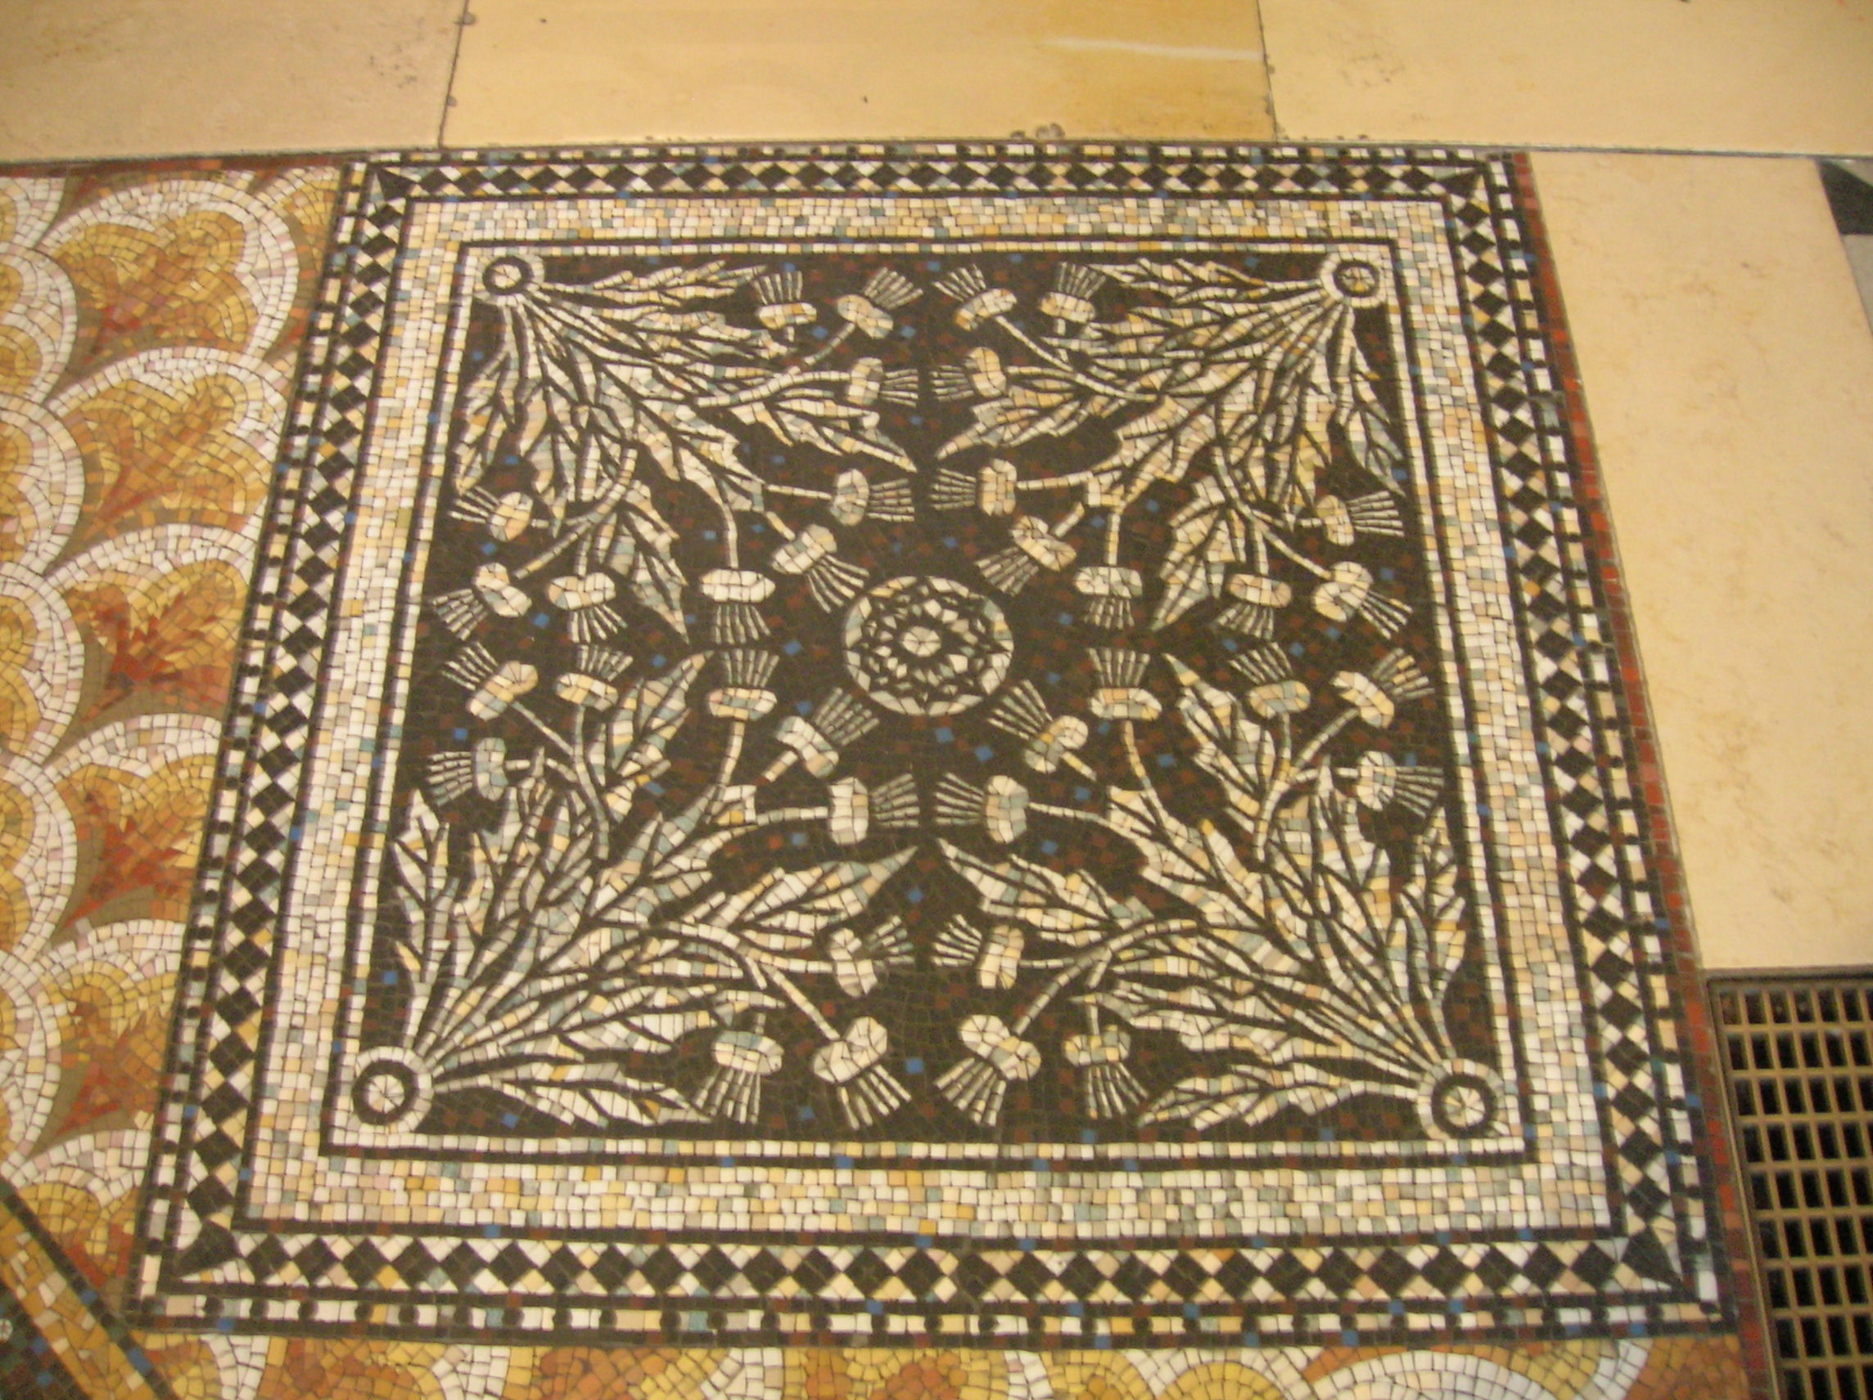
Balance

Slide 23
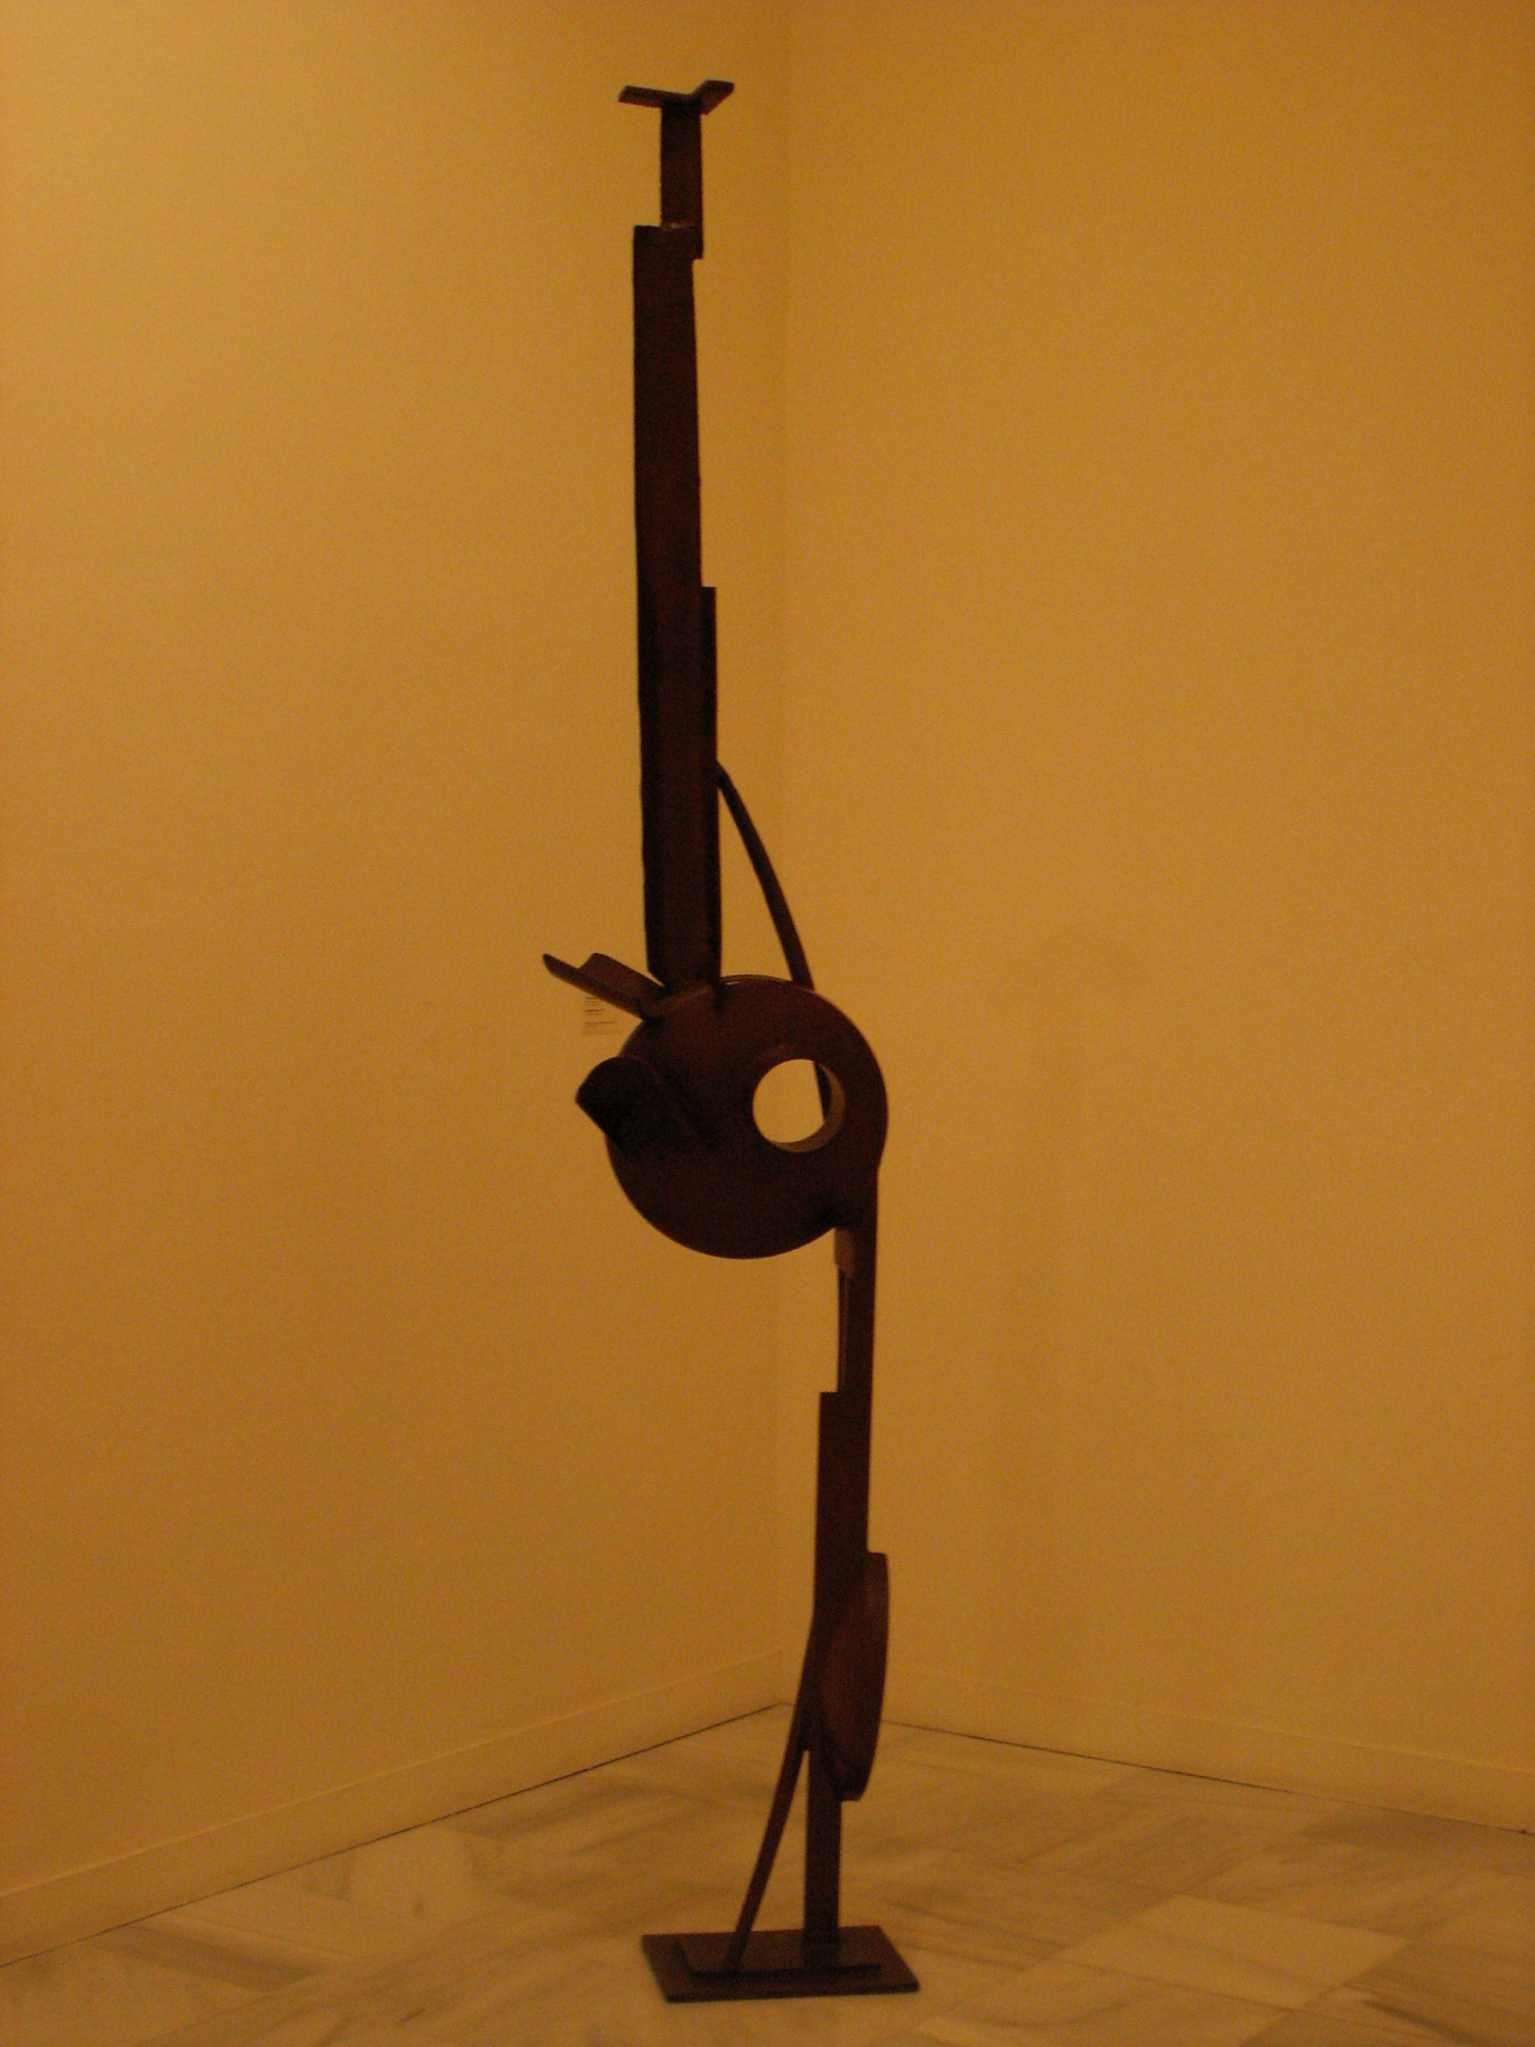
Balance

Slide 24
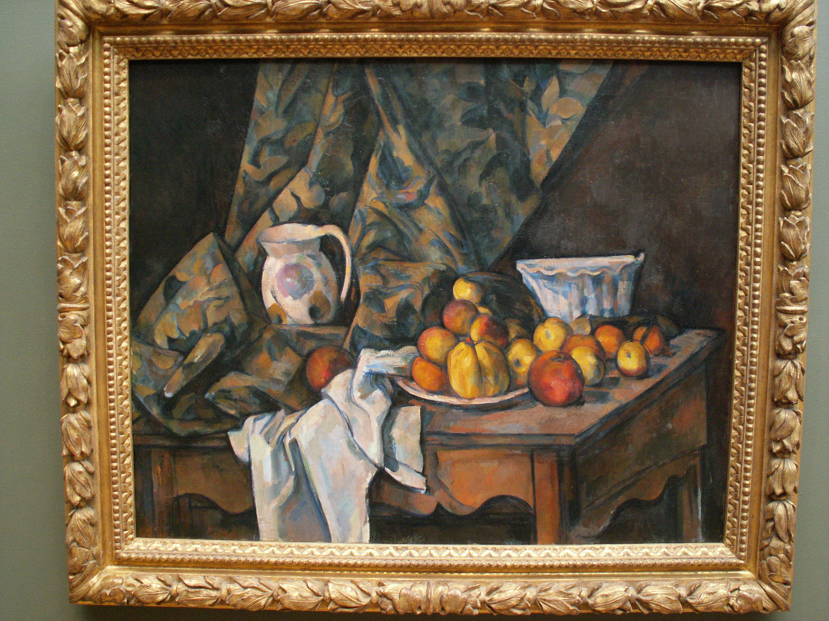
AsymetricalBalance

Slide 25
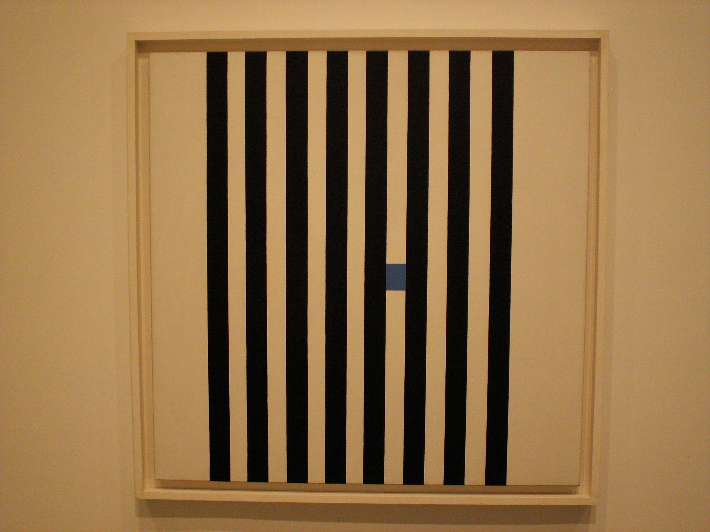
Emphasis

Slide 26
Emphasis

Slide 27
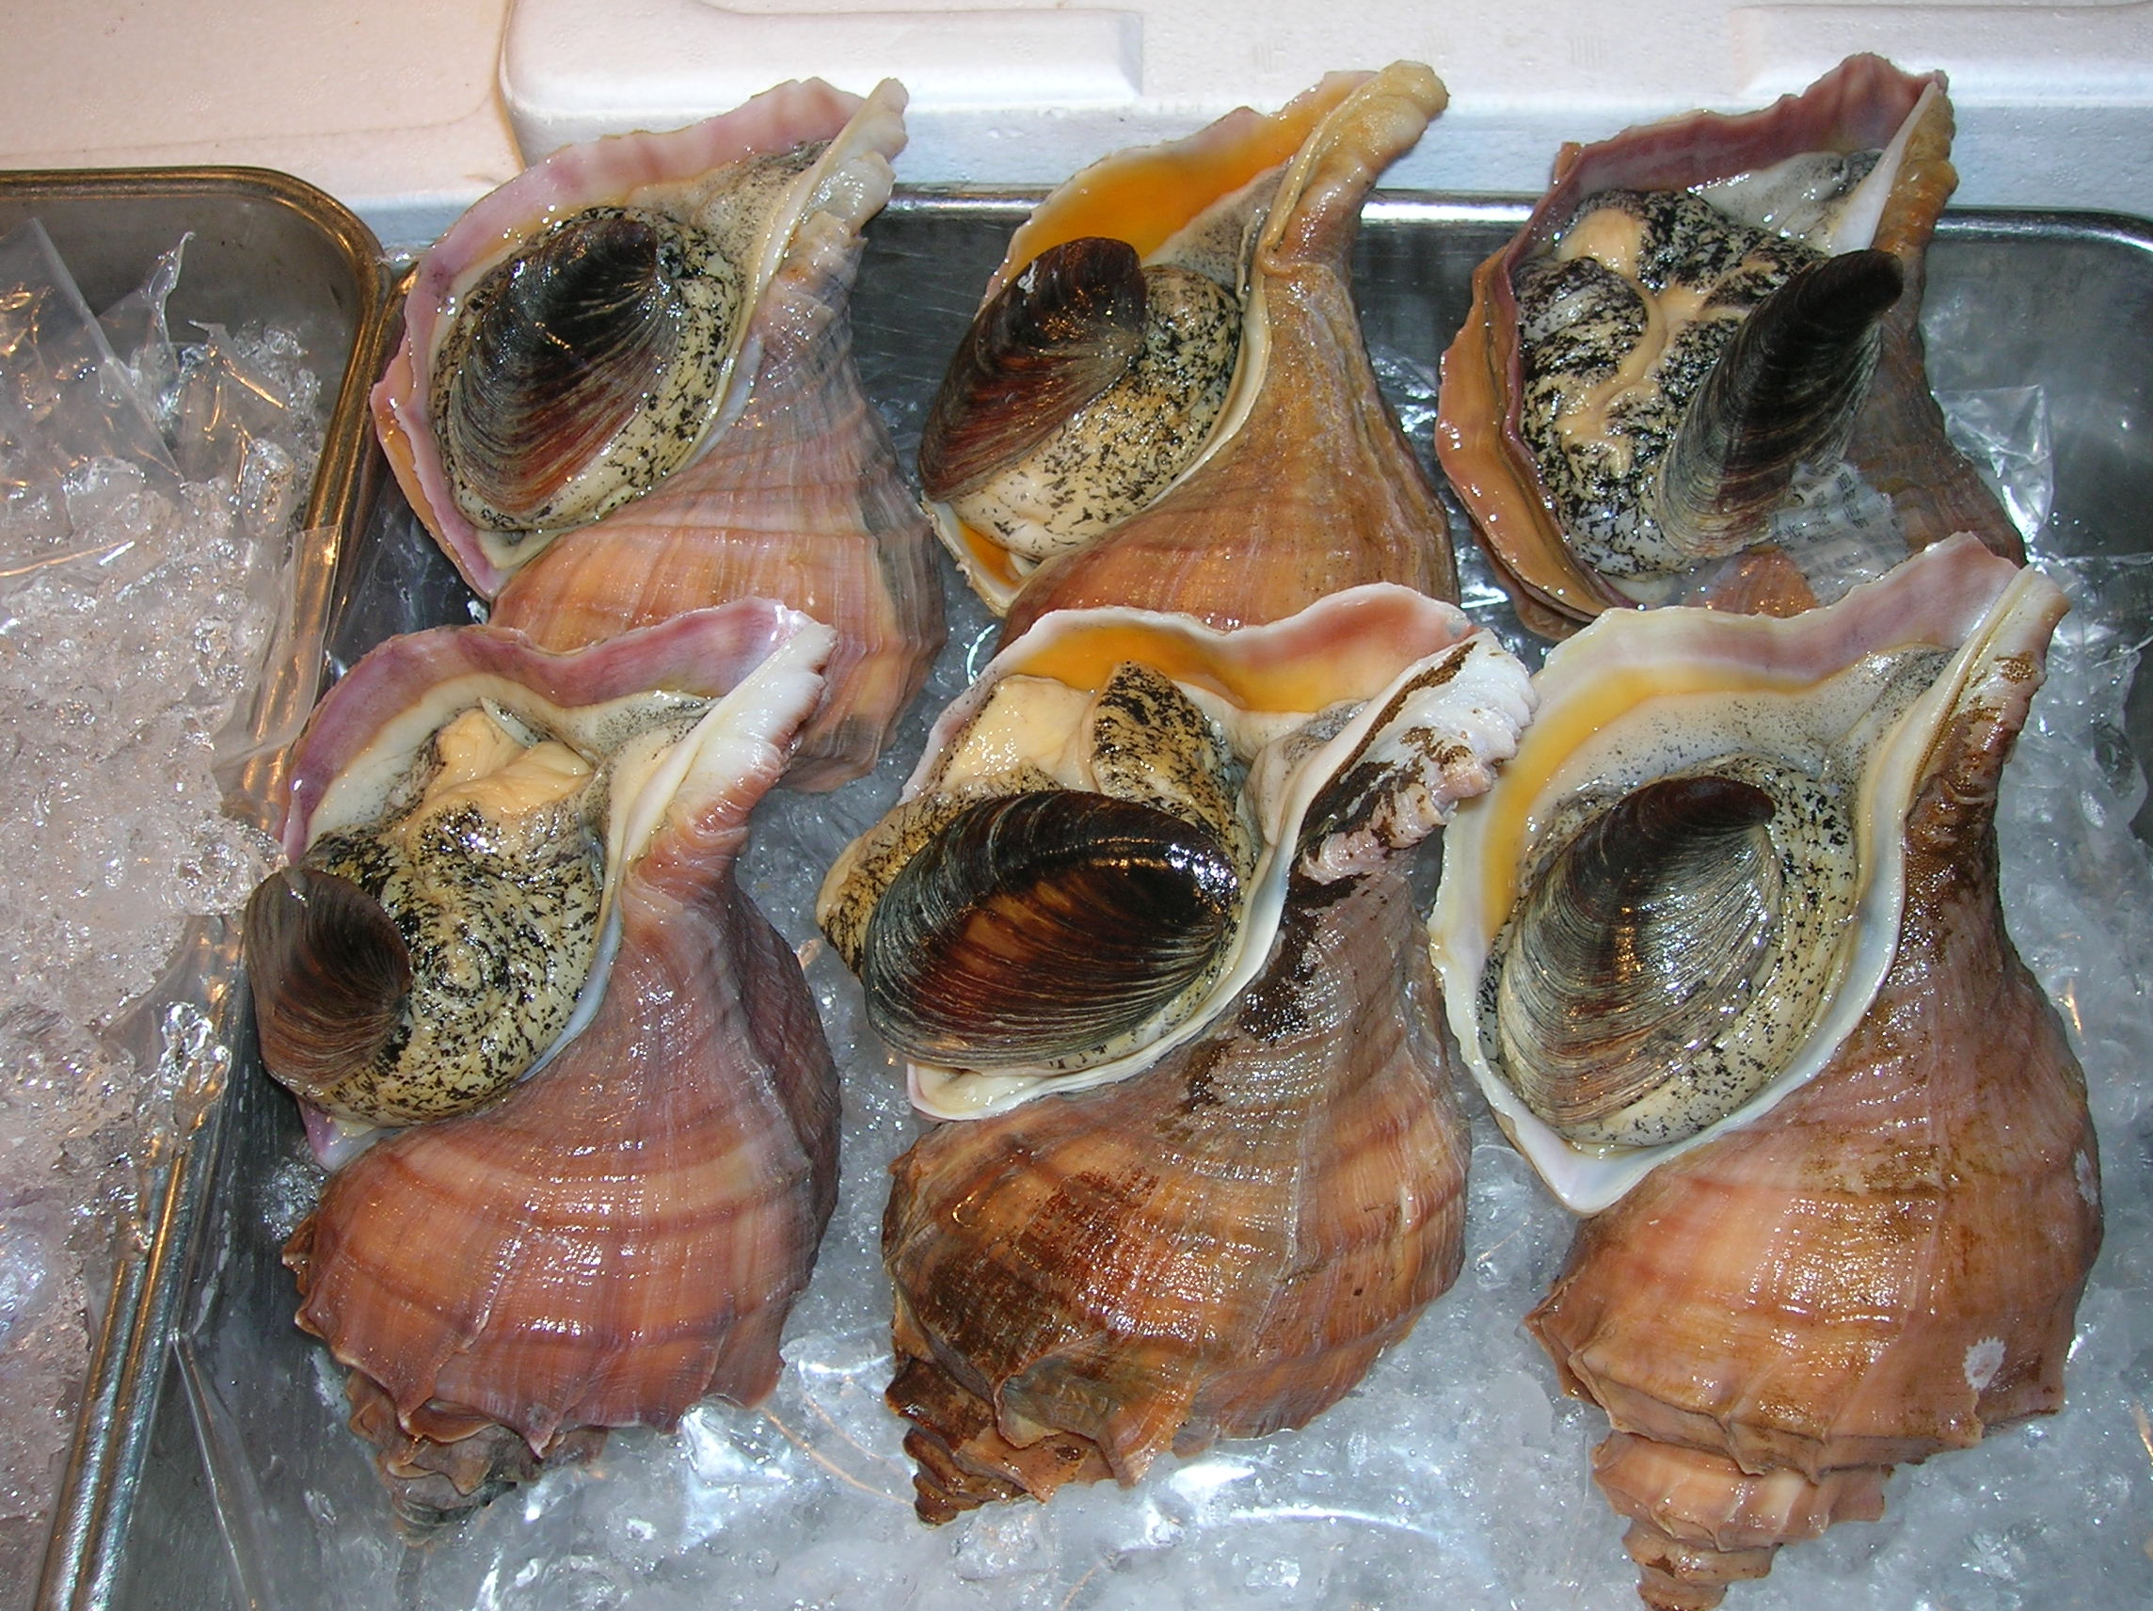
Unity

Slide 28
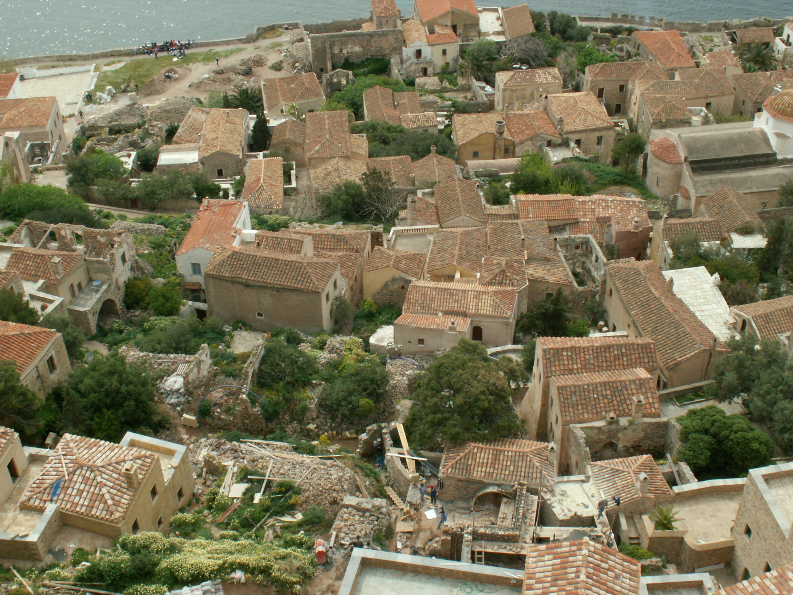

Slide 29
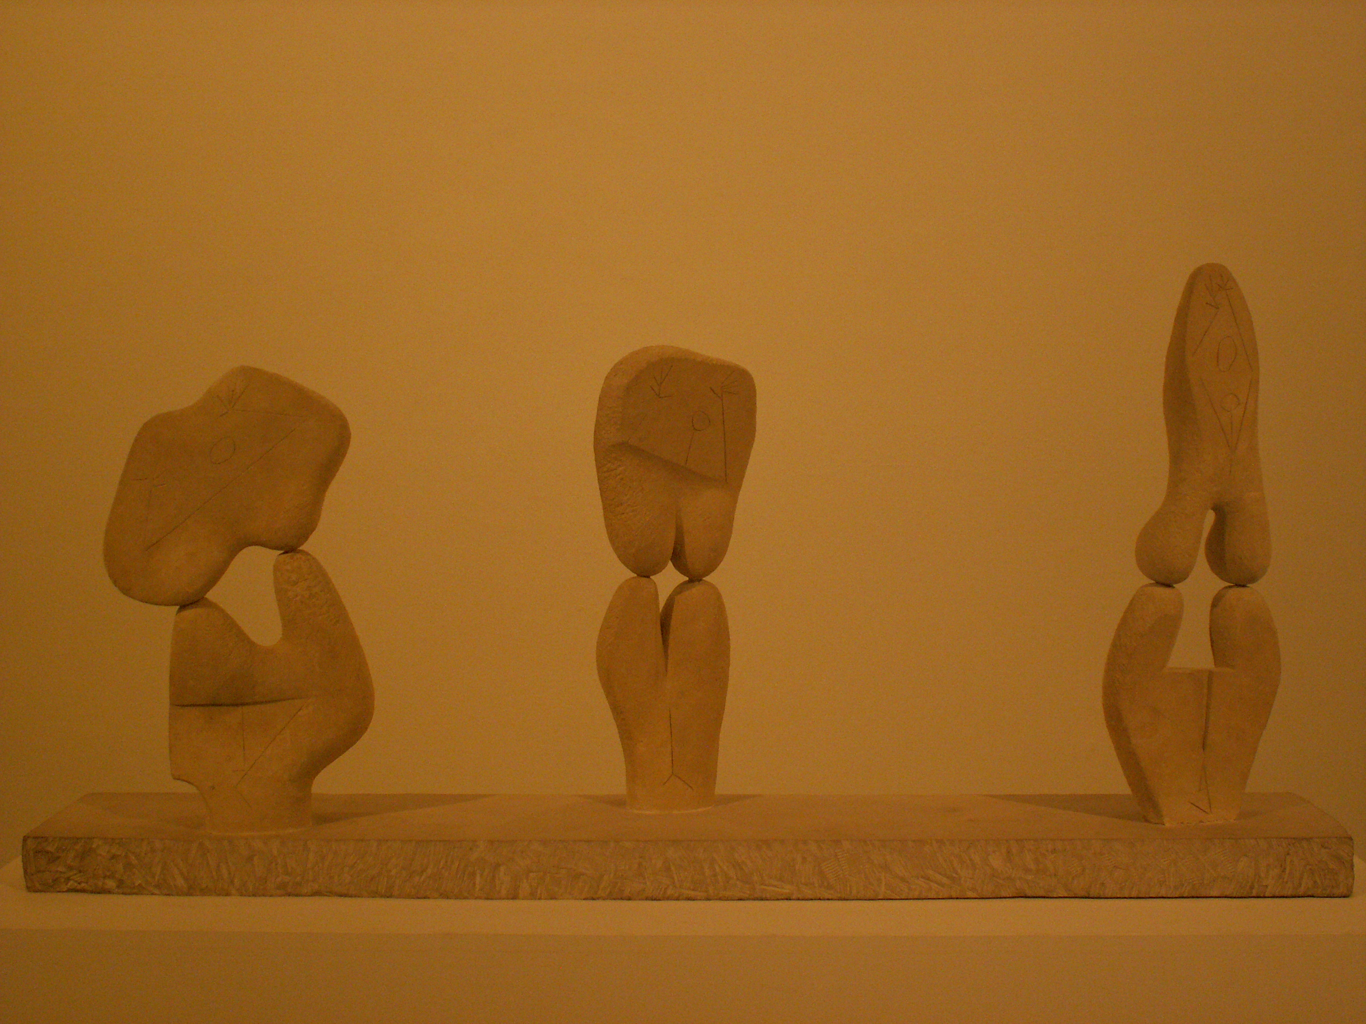

Slide 30
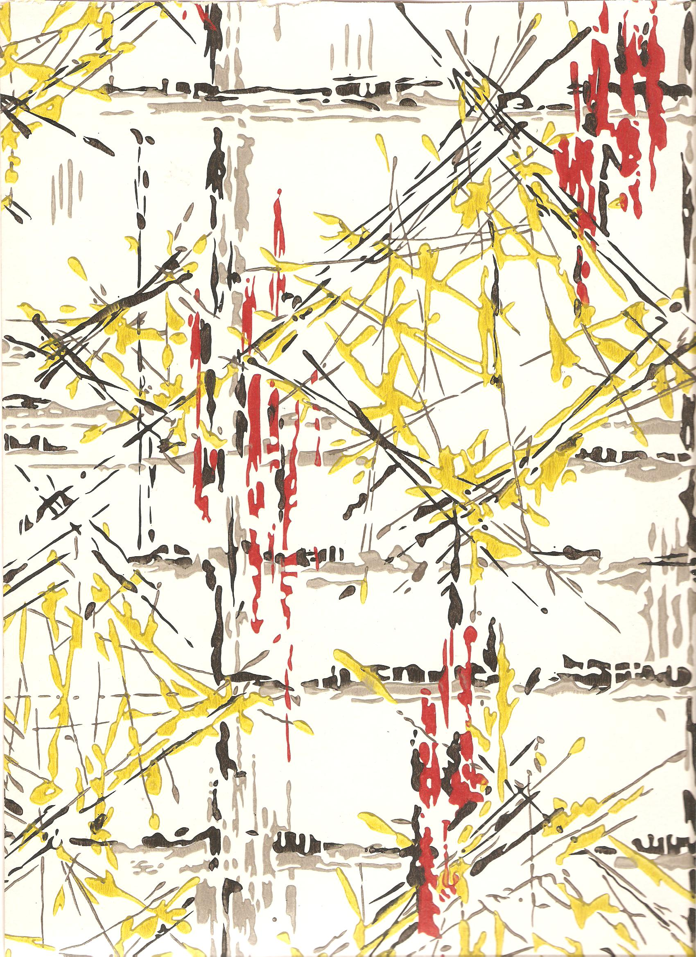
Rhythm

Slide 31
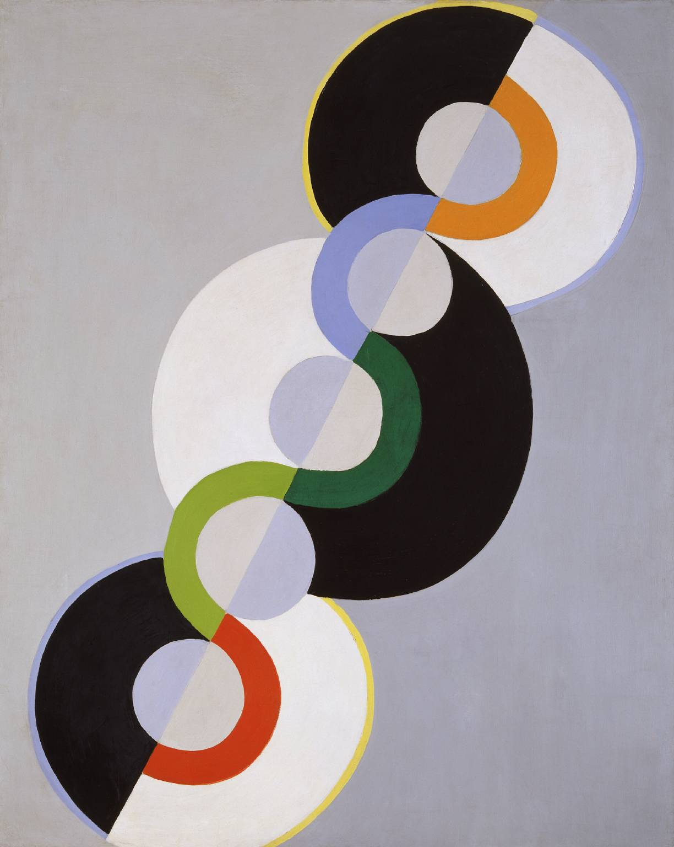
Rhythm

Slide 32
Fill the space….composition

Slide 33
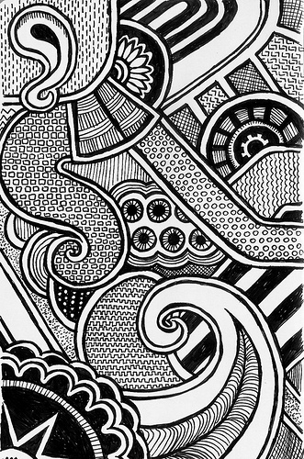
Too much negative space
Drawing continues to all edges

Slide 36
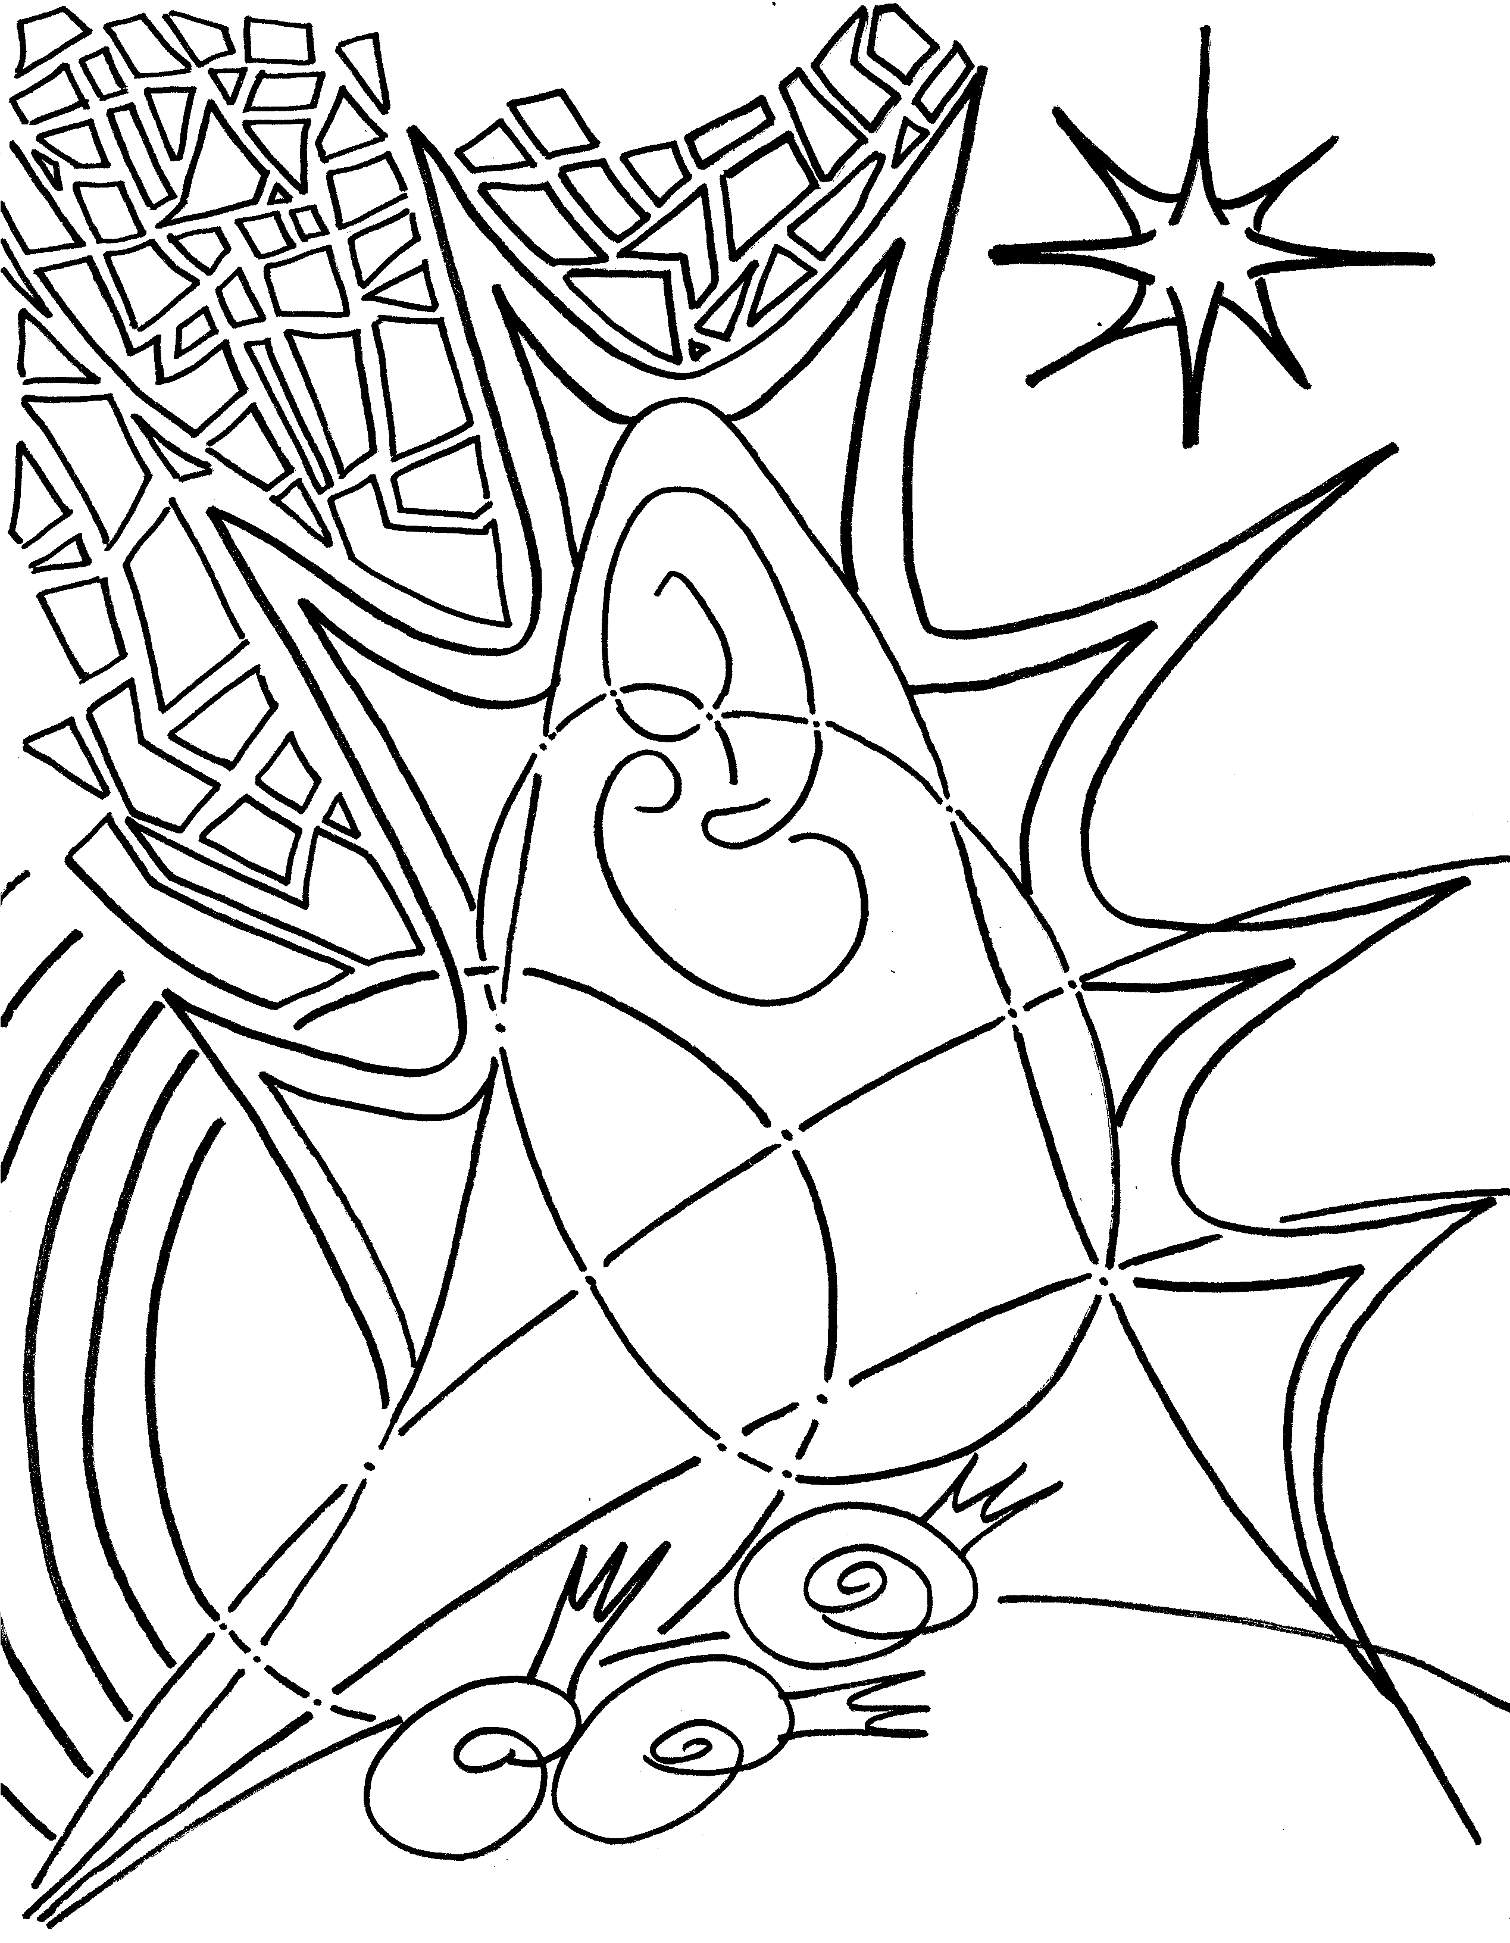

Slide 37
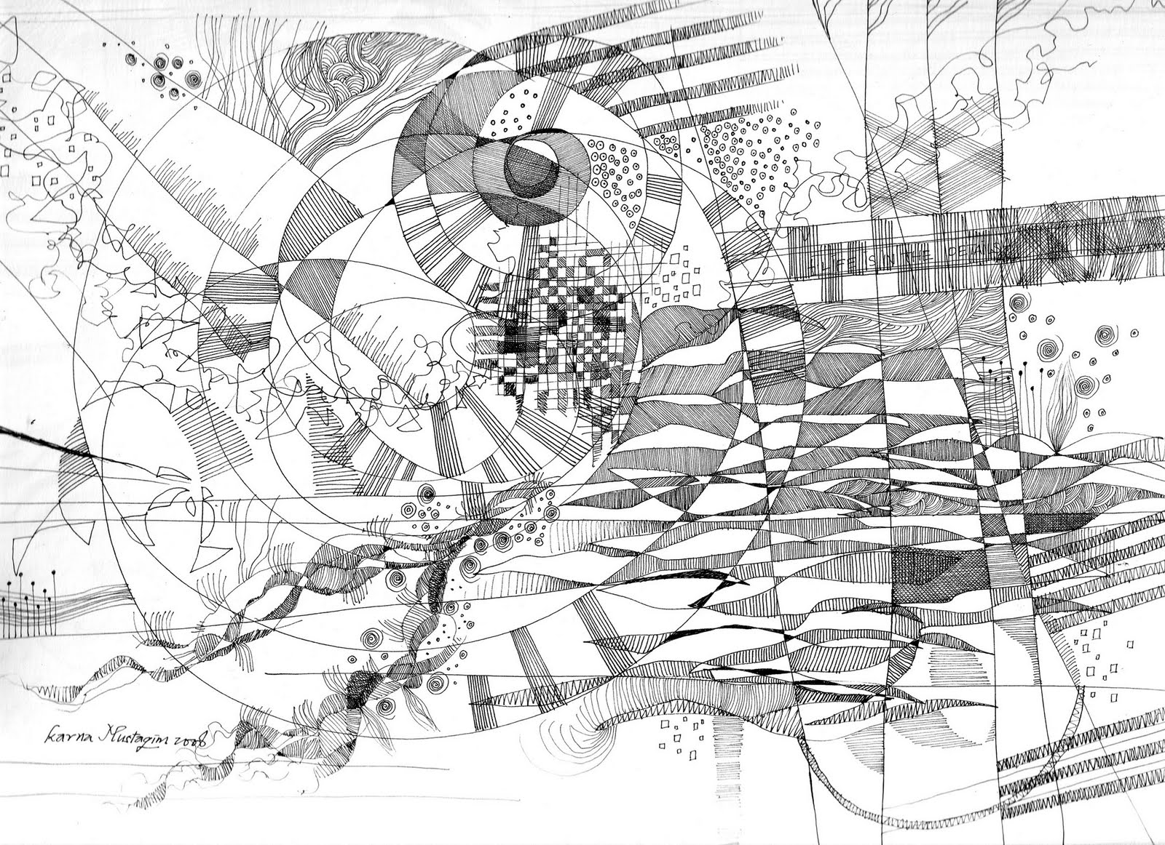

Slide 38
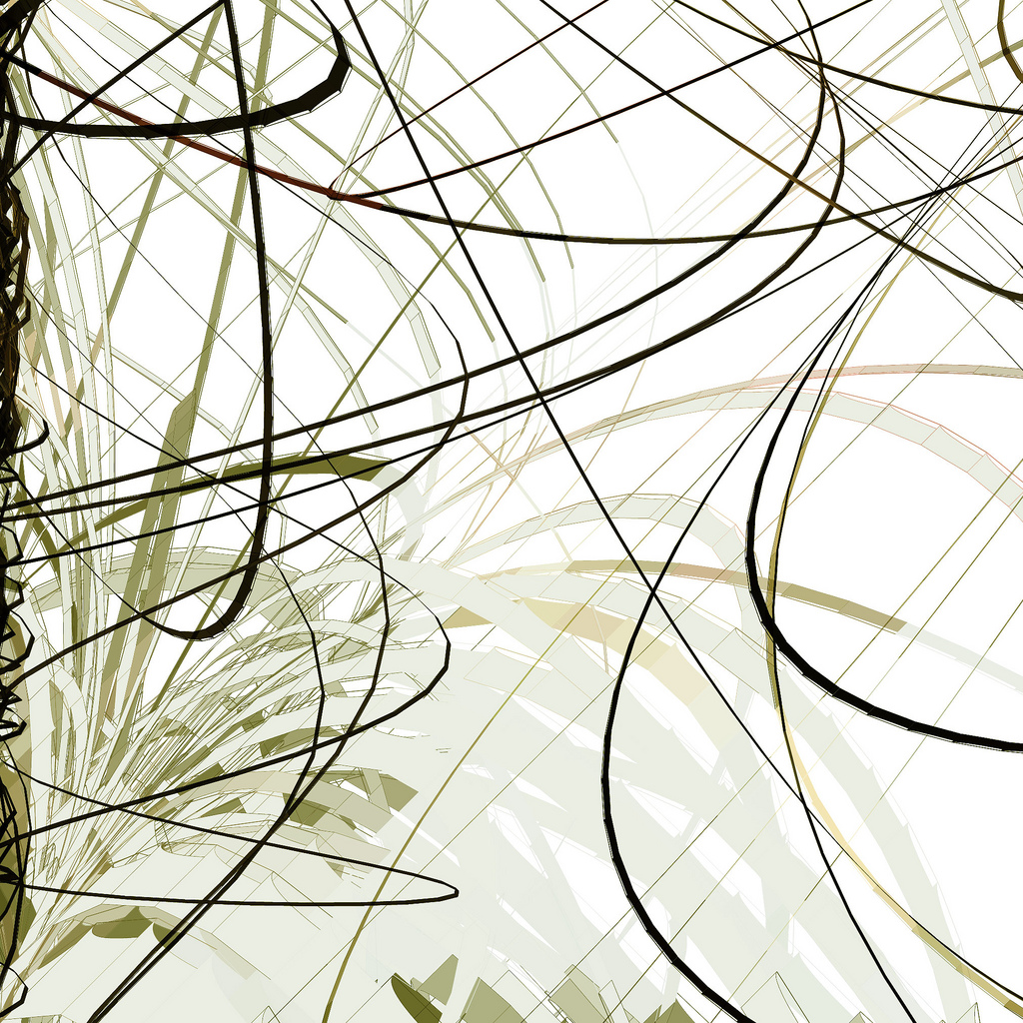

Slide 40
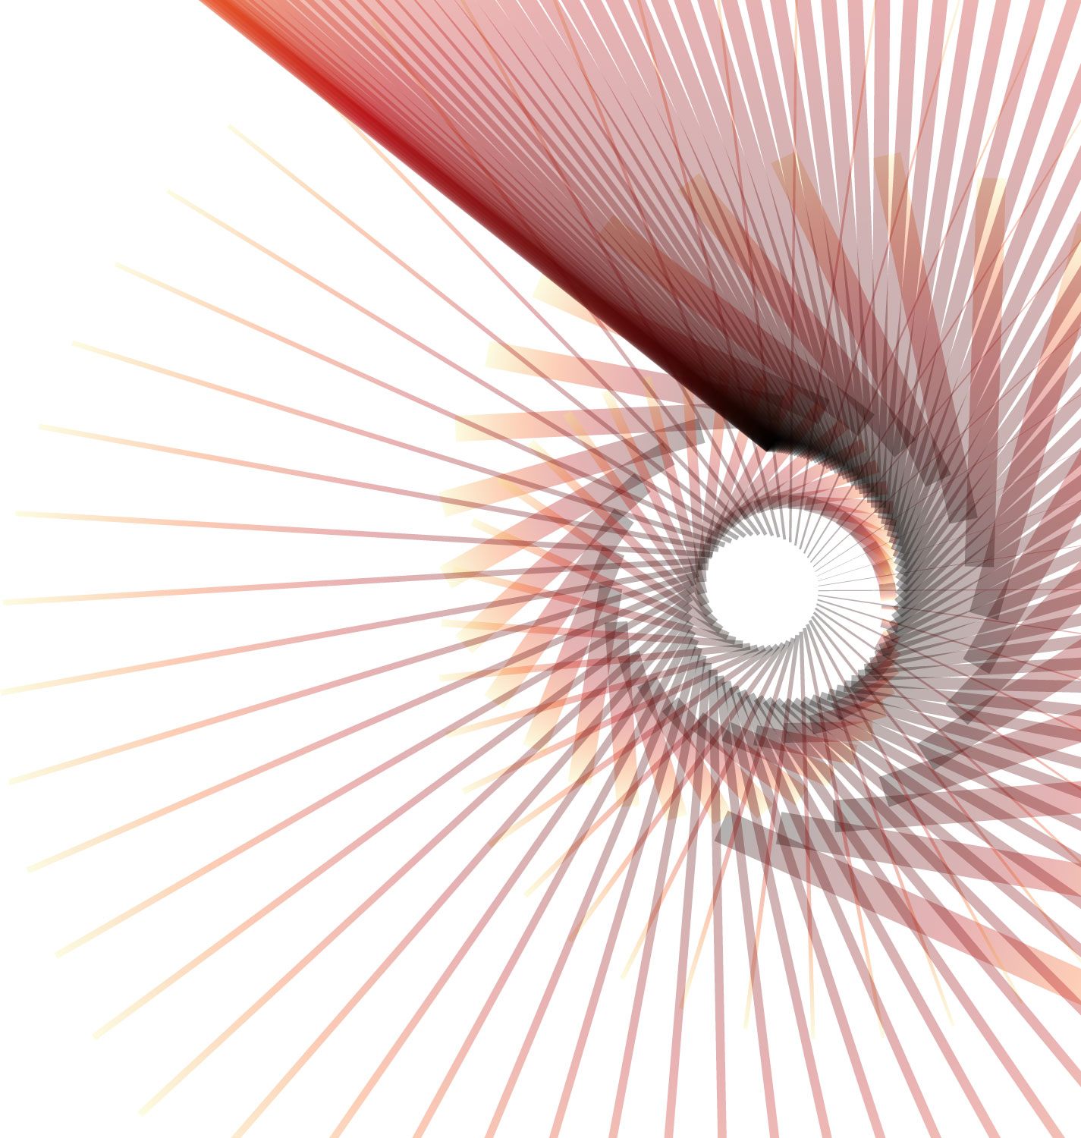

Slide 42
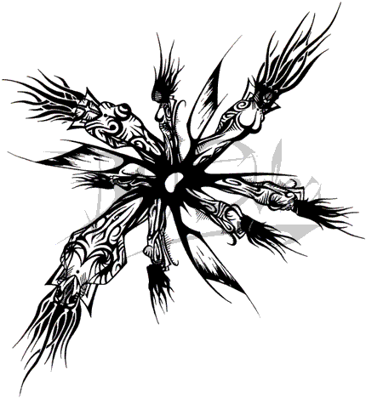

Slide 46
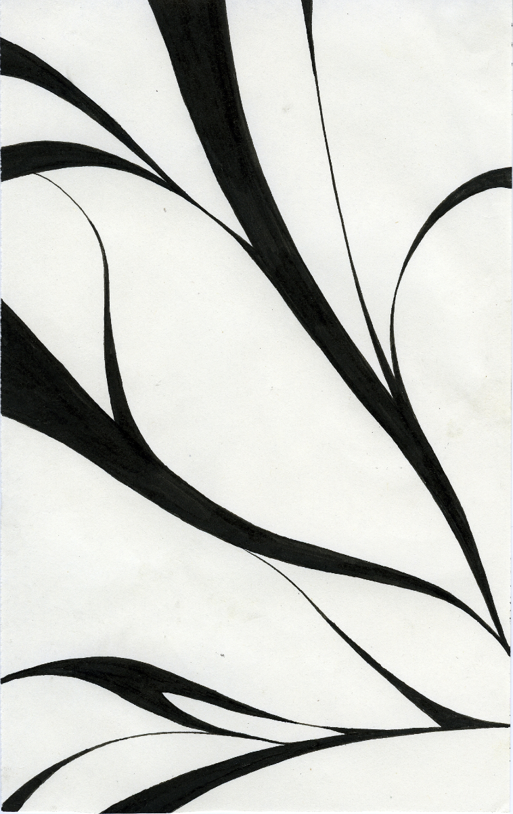

Slide 47
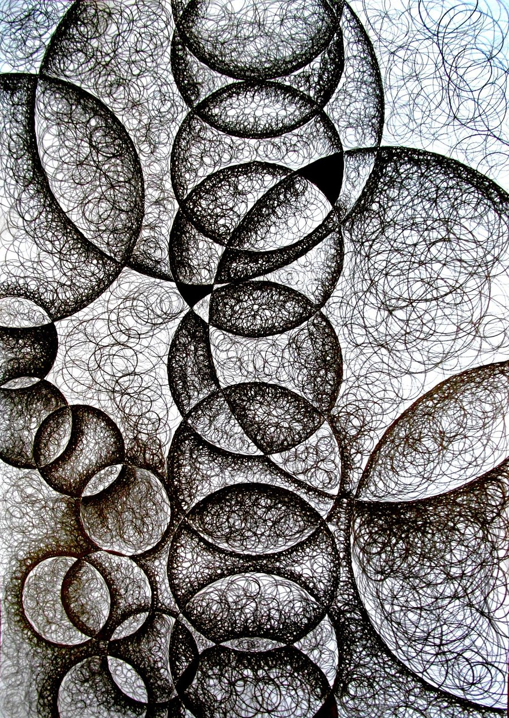

Slide 48
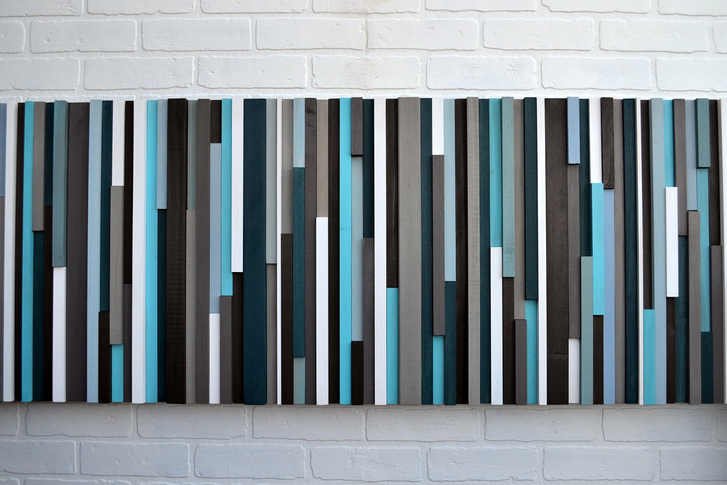

Slide 49
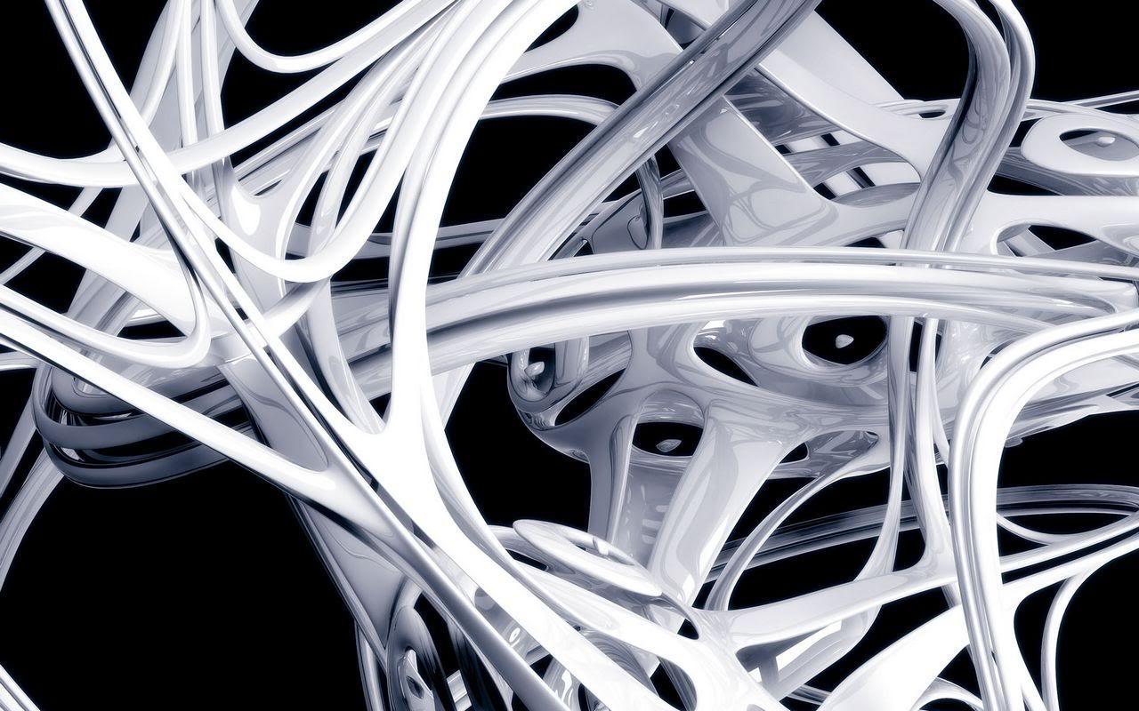

Slide 51
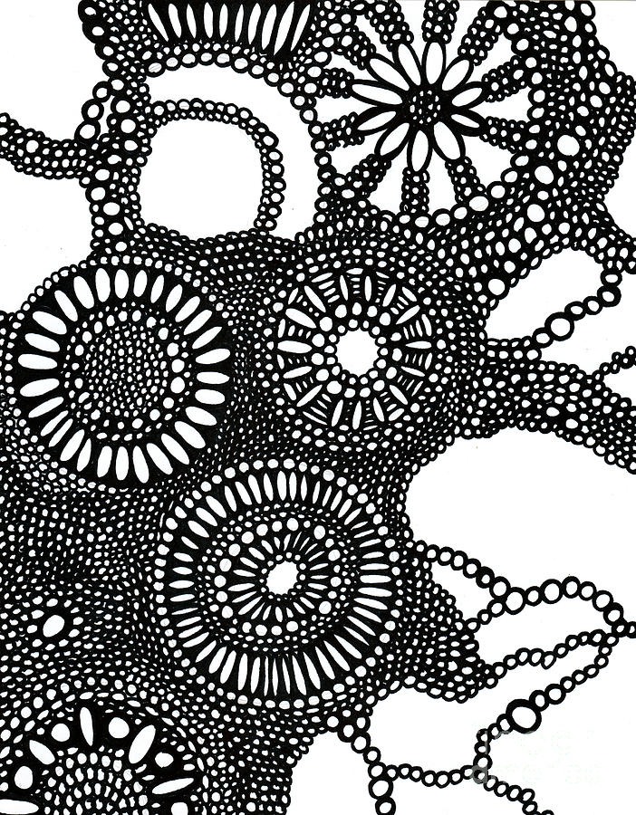

Slide 52
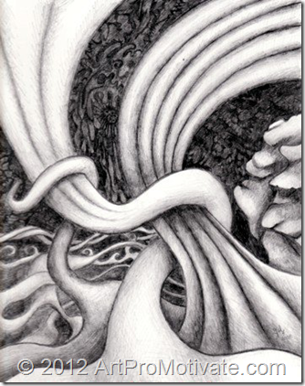

Slide 53
