Slide 1
The Human Figure

Slide 2
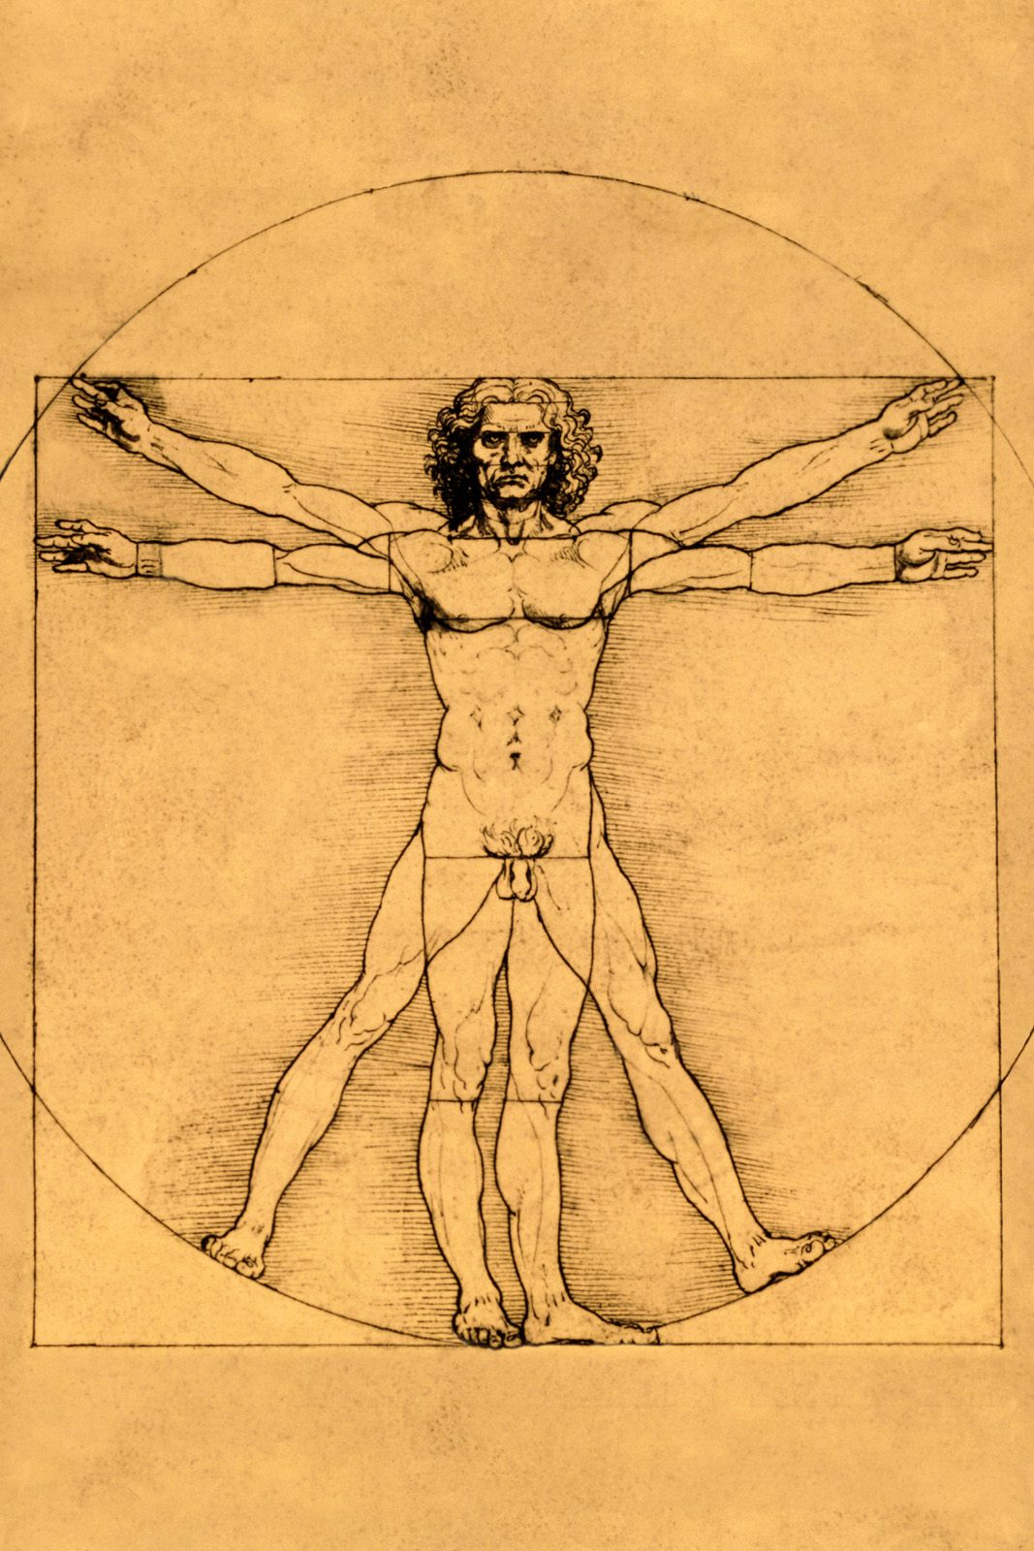

Slide 3
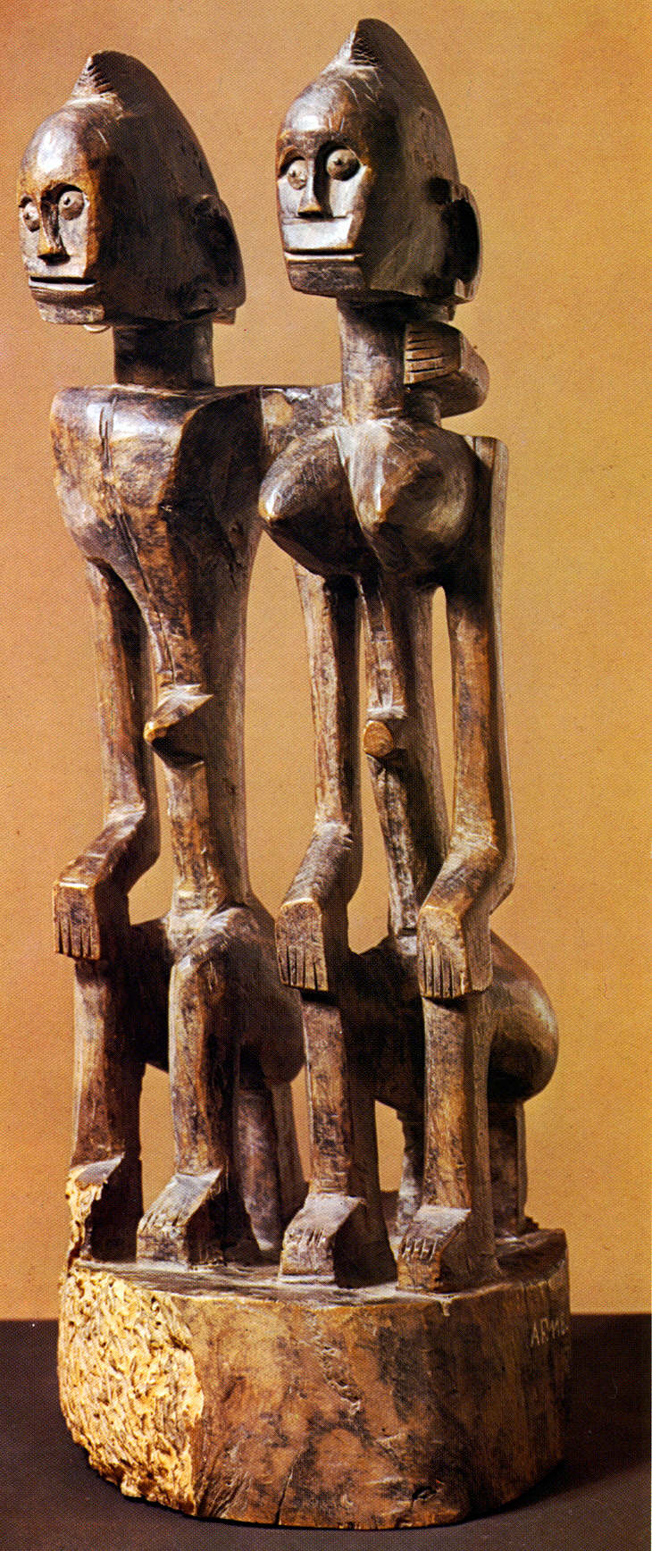
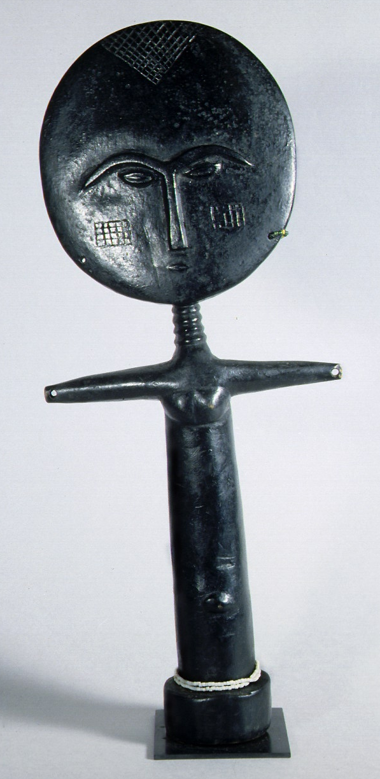

Slide 4
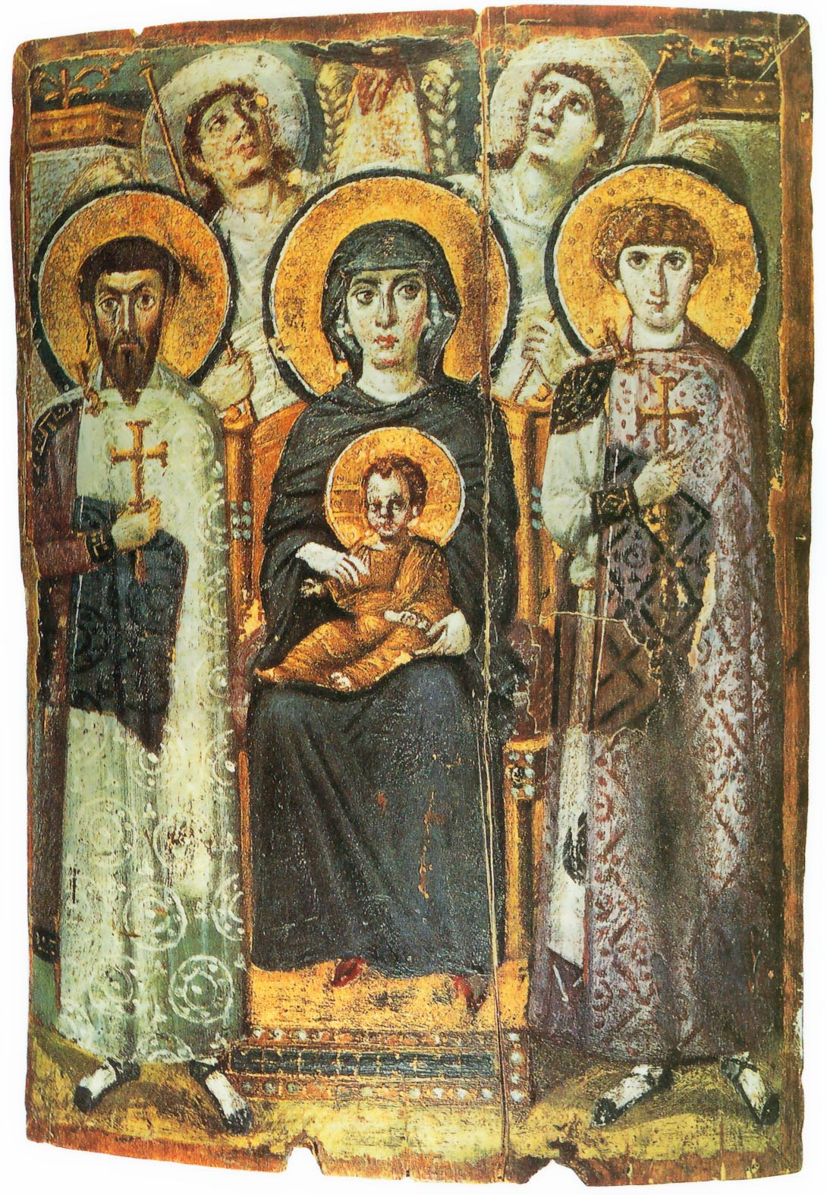

Slide 5
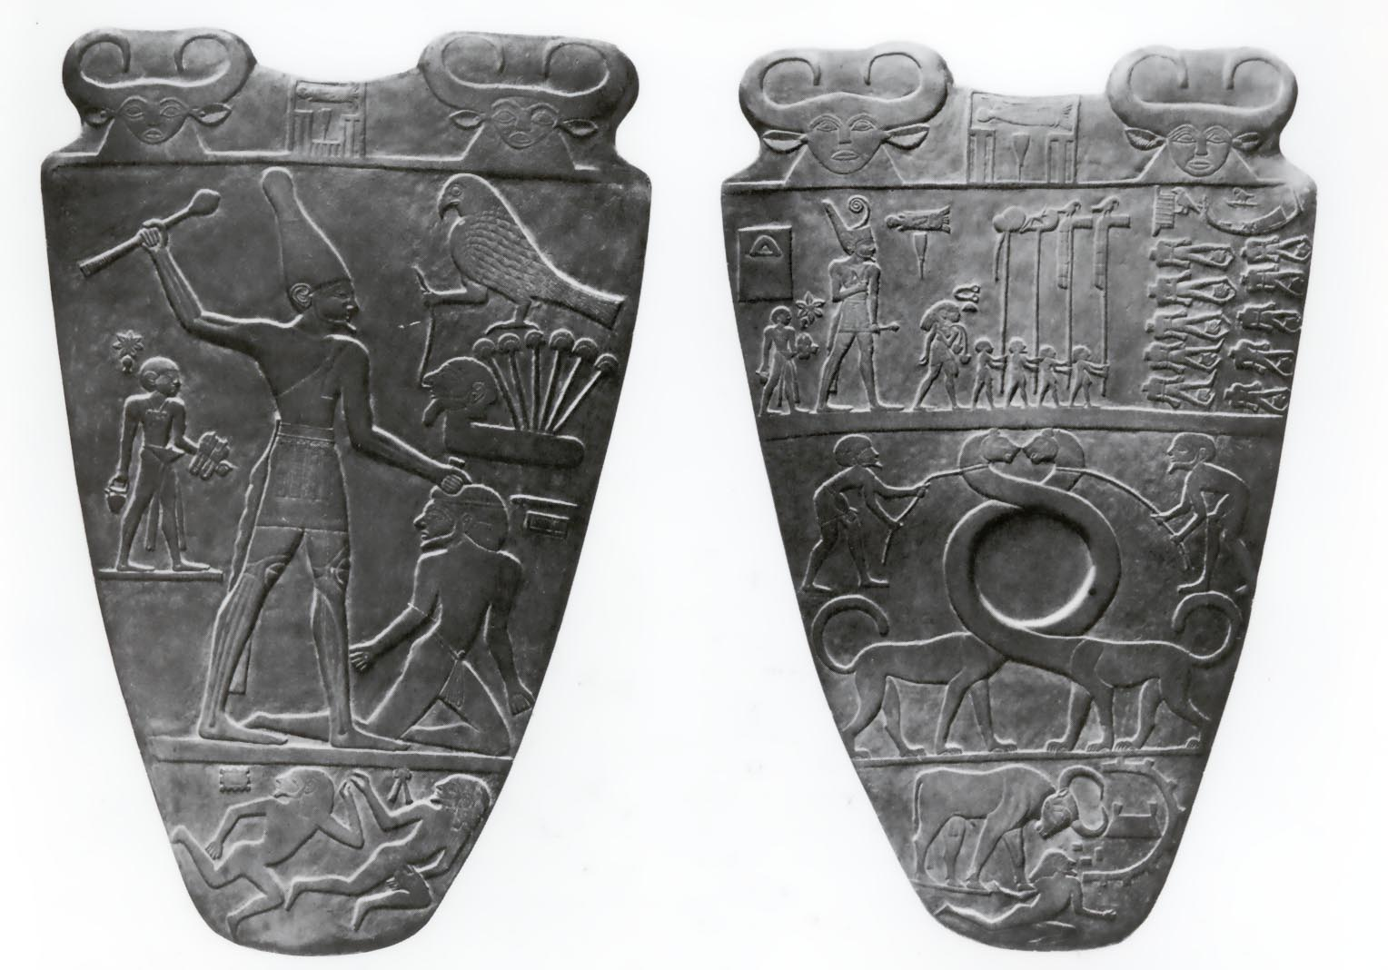

Slide 6
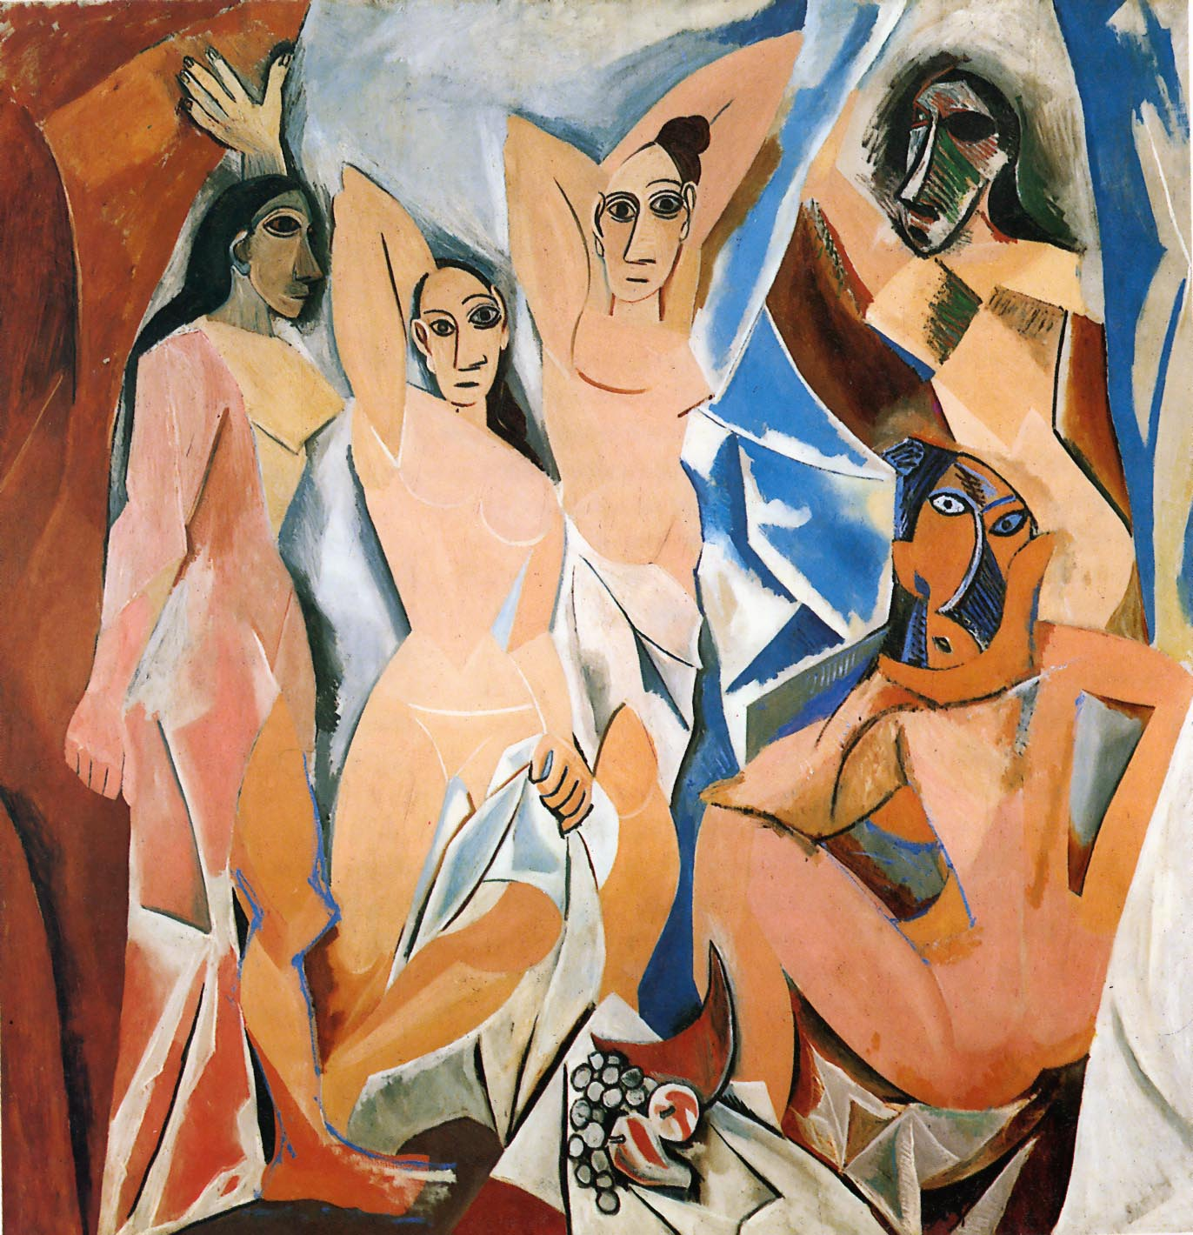

Slide 7
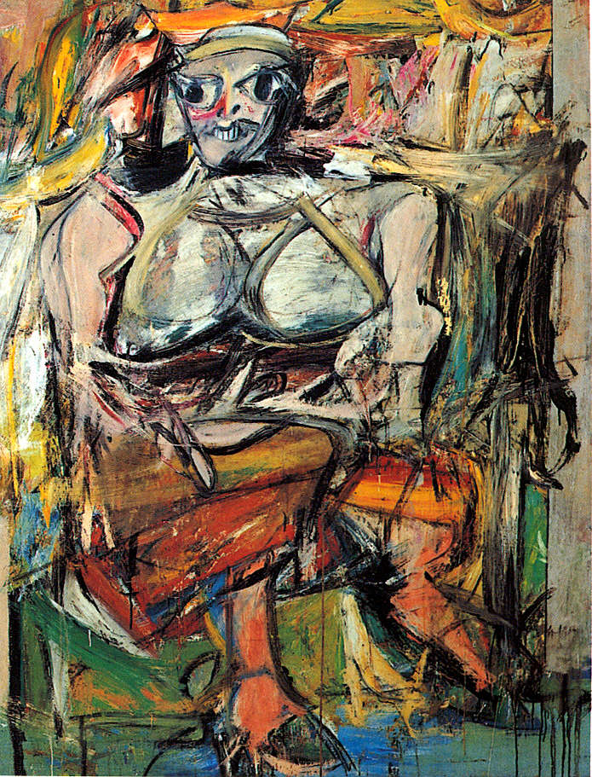

Slide 8
Human Body Proportions

Slide 9
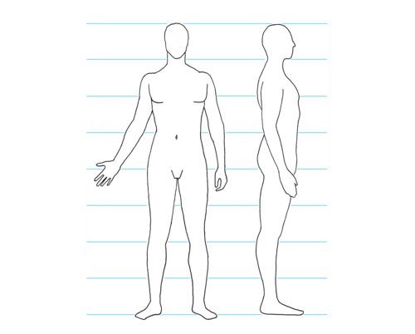
Key Human Body Proportions
7-8 heads per average human body
3 heads to human navel
6 heads to just below the knee
Just below hip bone is at half way height of body
At rest one’s arm (tip of fingers) drops to the middle of the thigh
Length of foot is about length of forearm
Thanks Wikipedia!

Slide 10
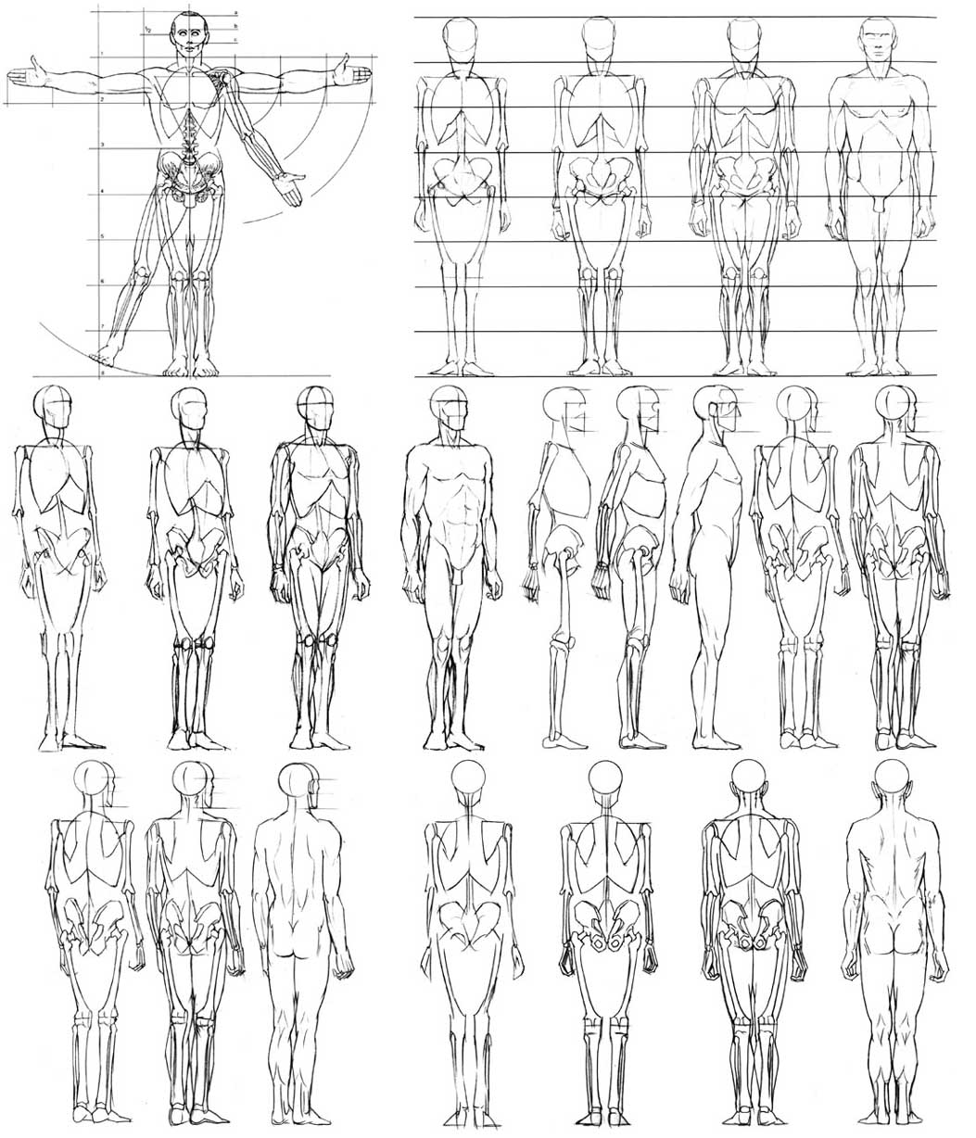

Slide 11
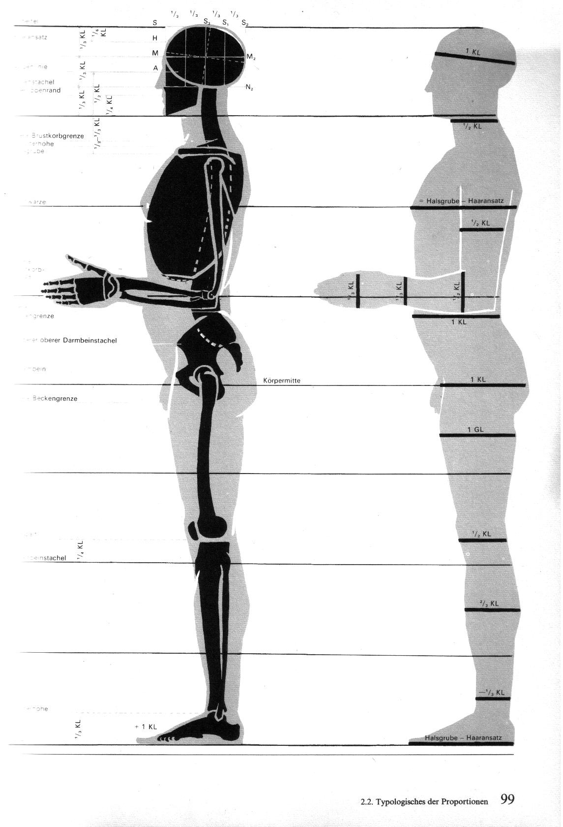

Slide 12
Human Bone structure

Slide 13
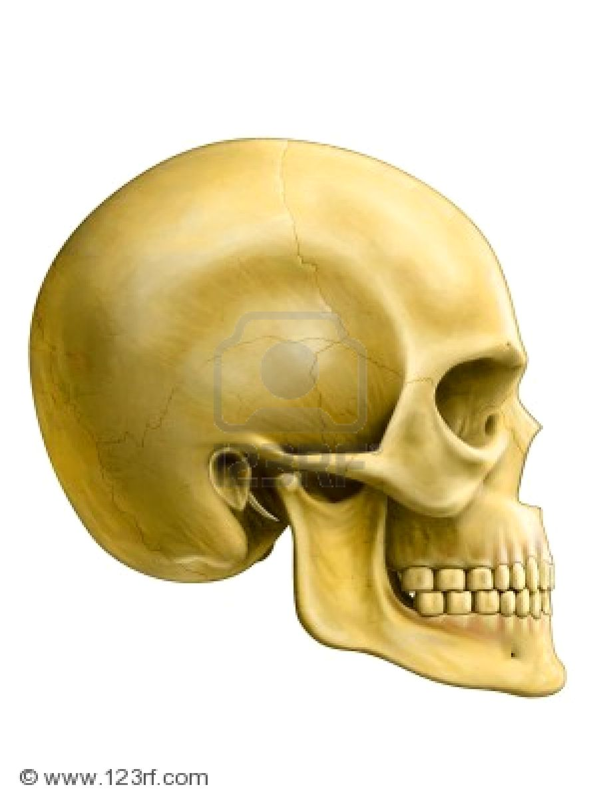

Slide 14
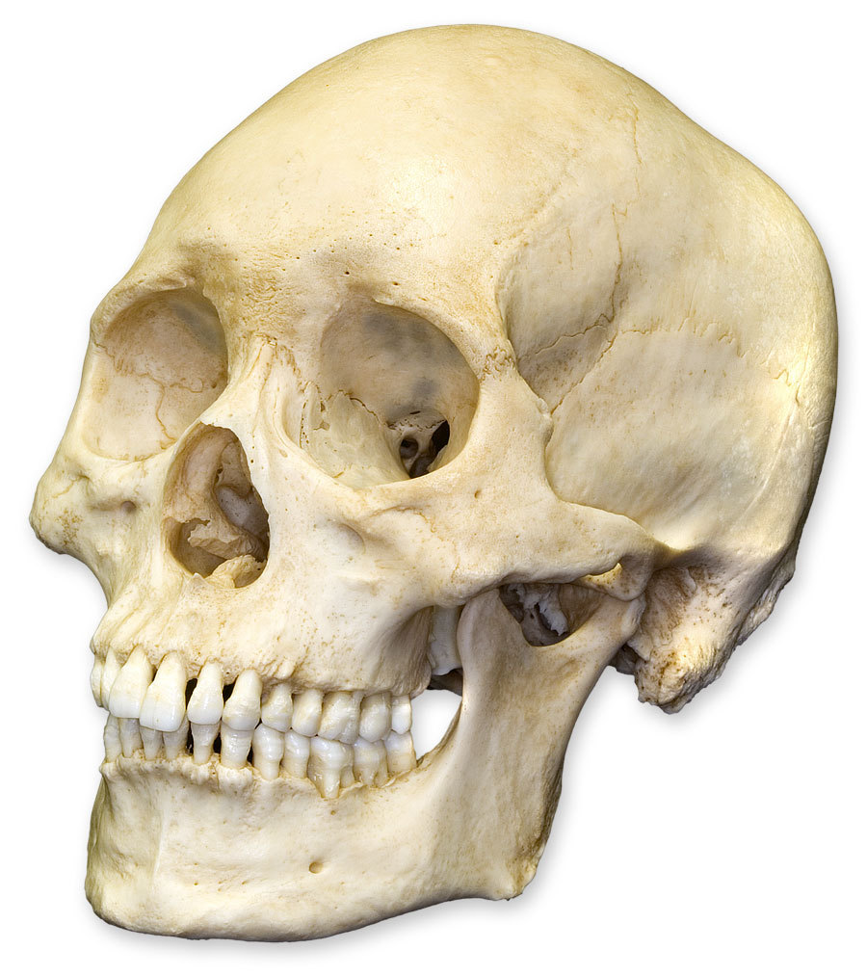

Slide 15
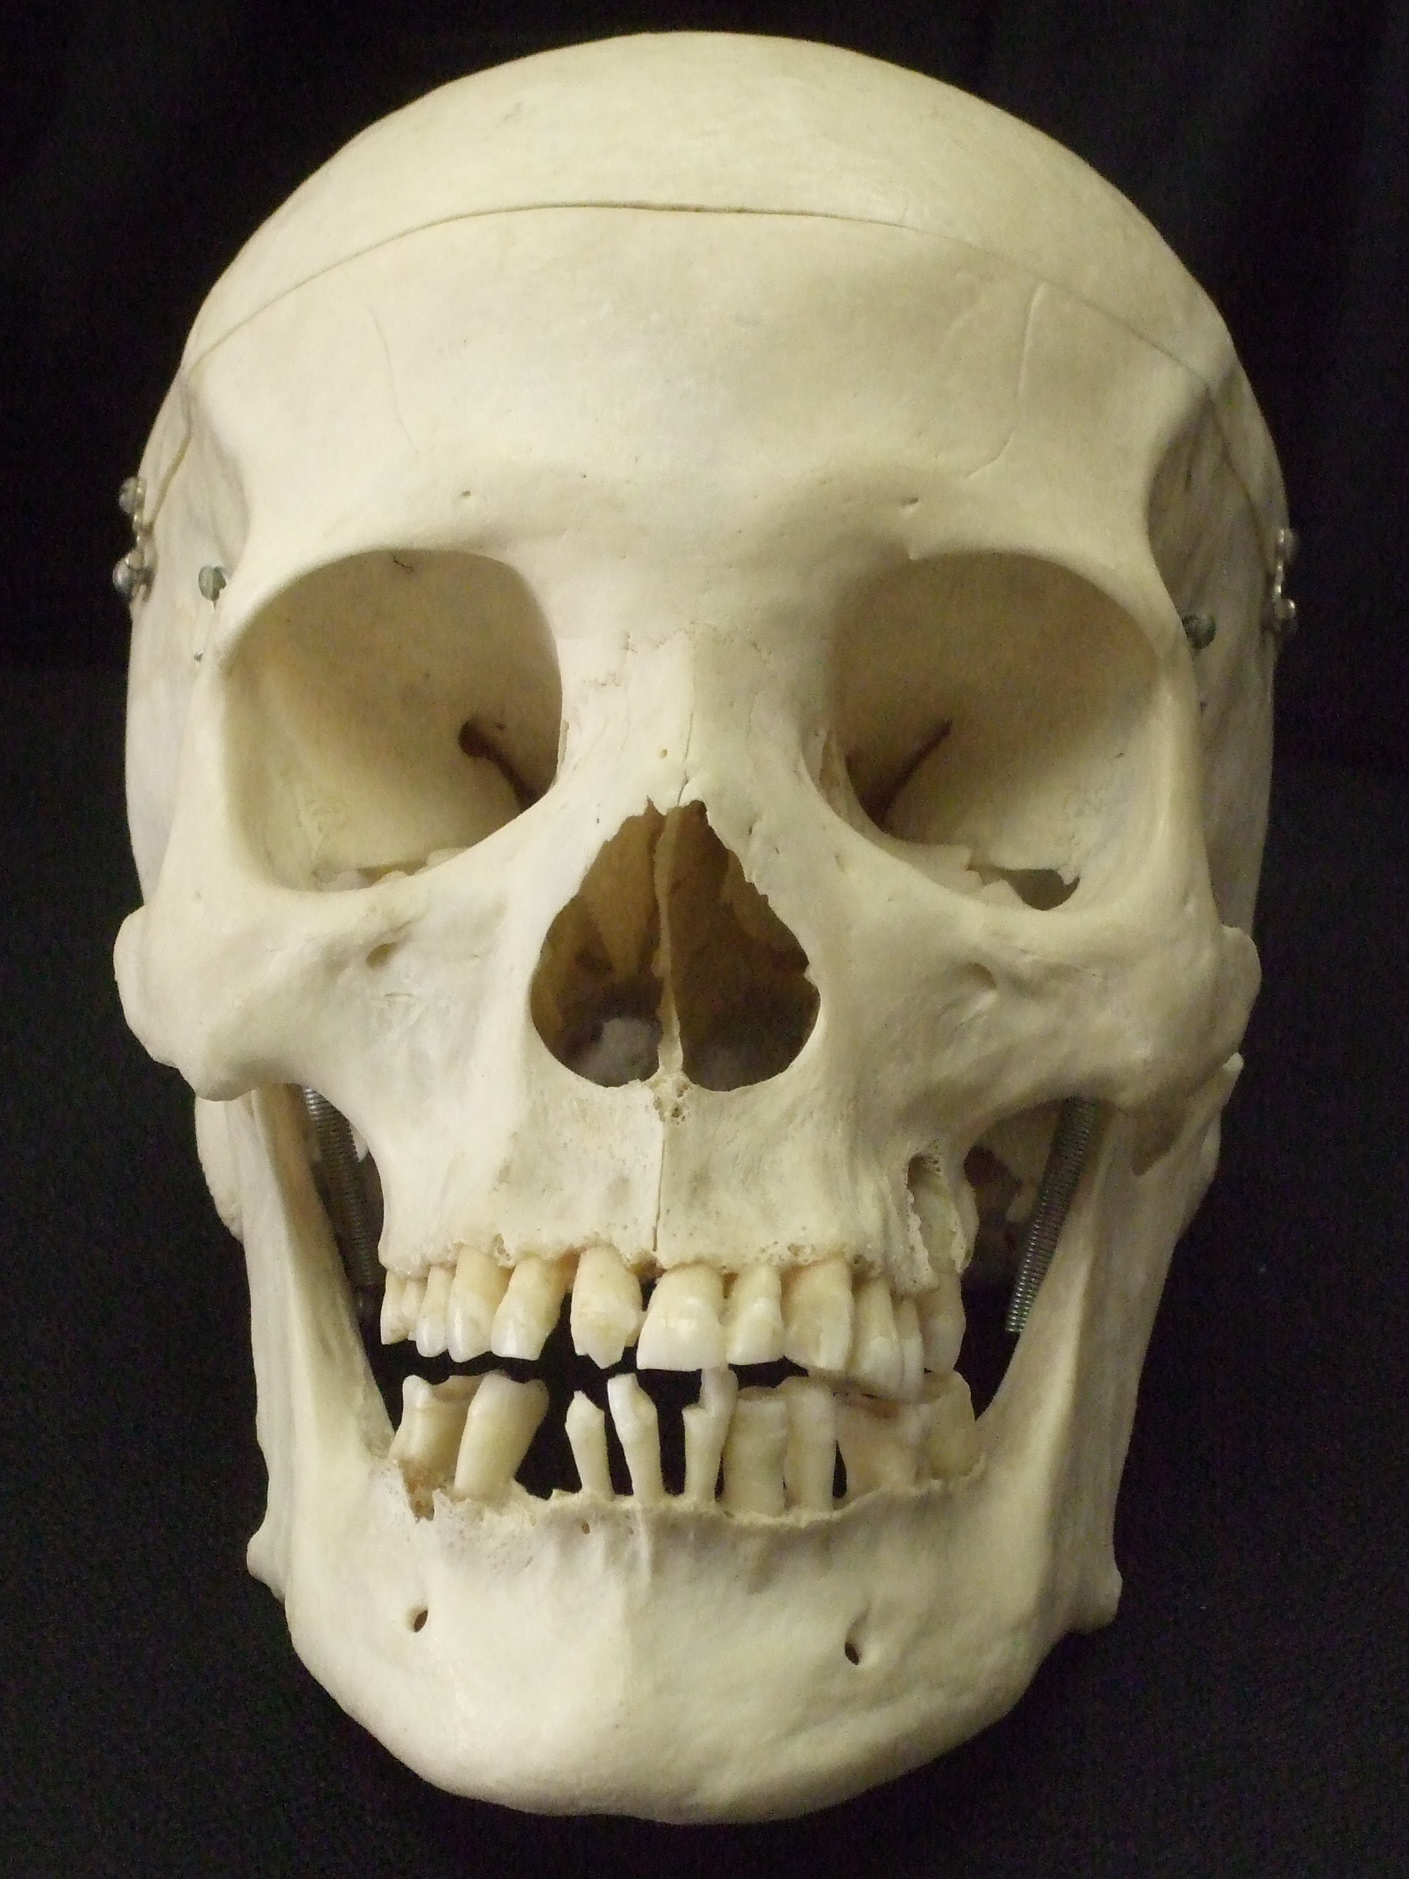

Slide 16
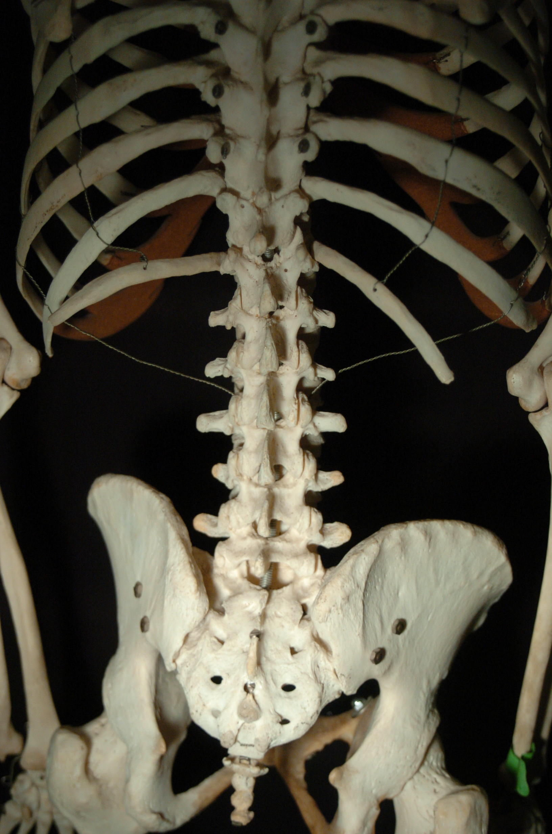

Slide 17
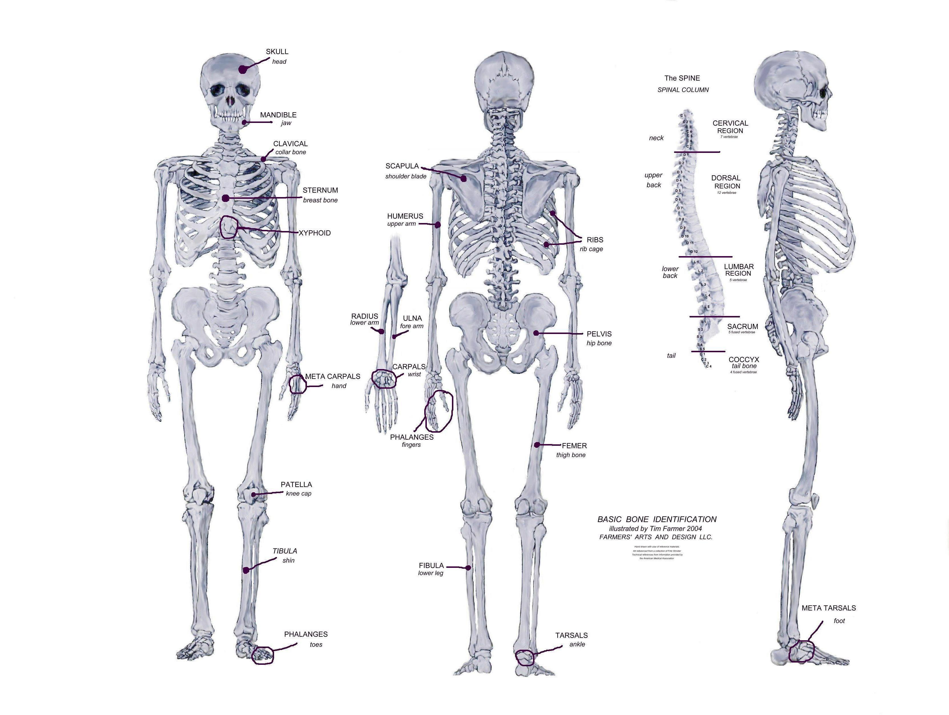

Slide 18
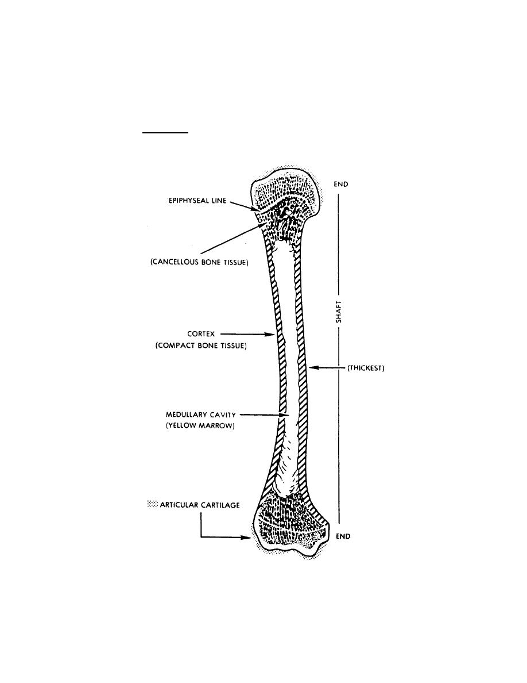

Slide 19
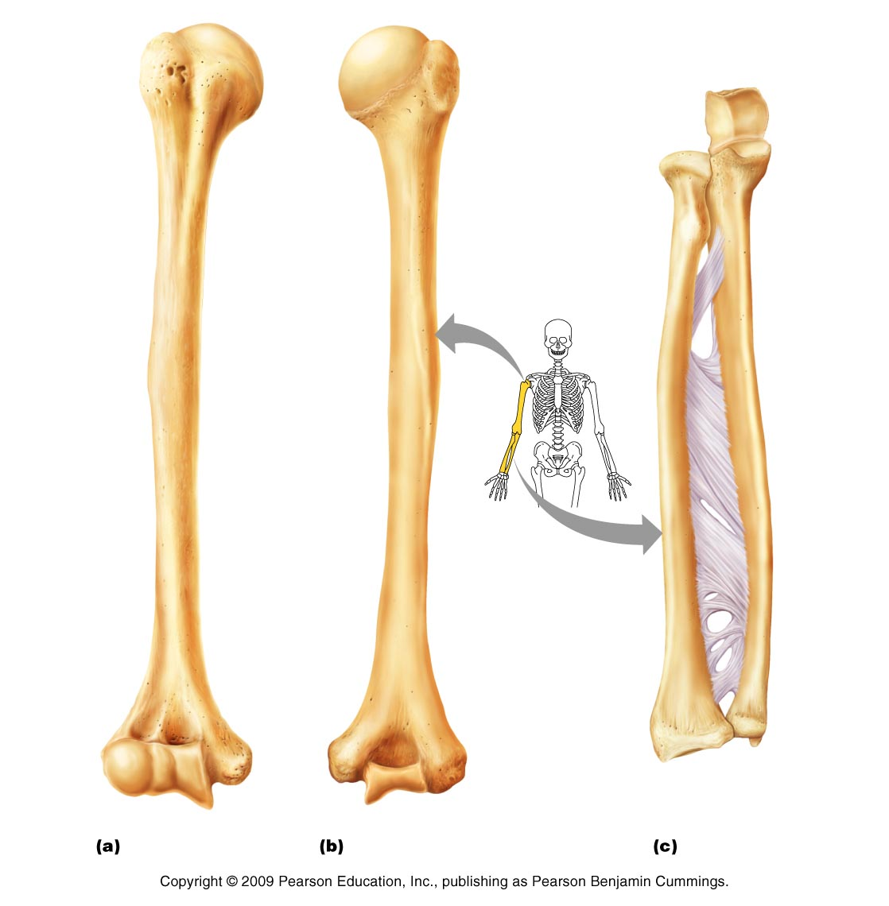

Slide 20
Human Muscle Systems

Slide 21
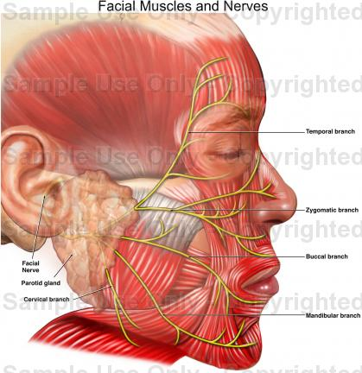

Slide 22
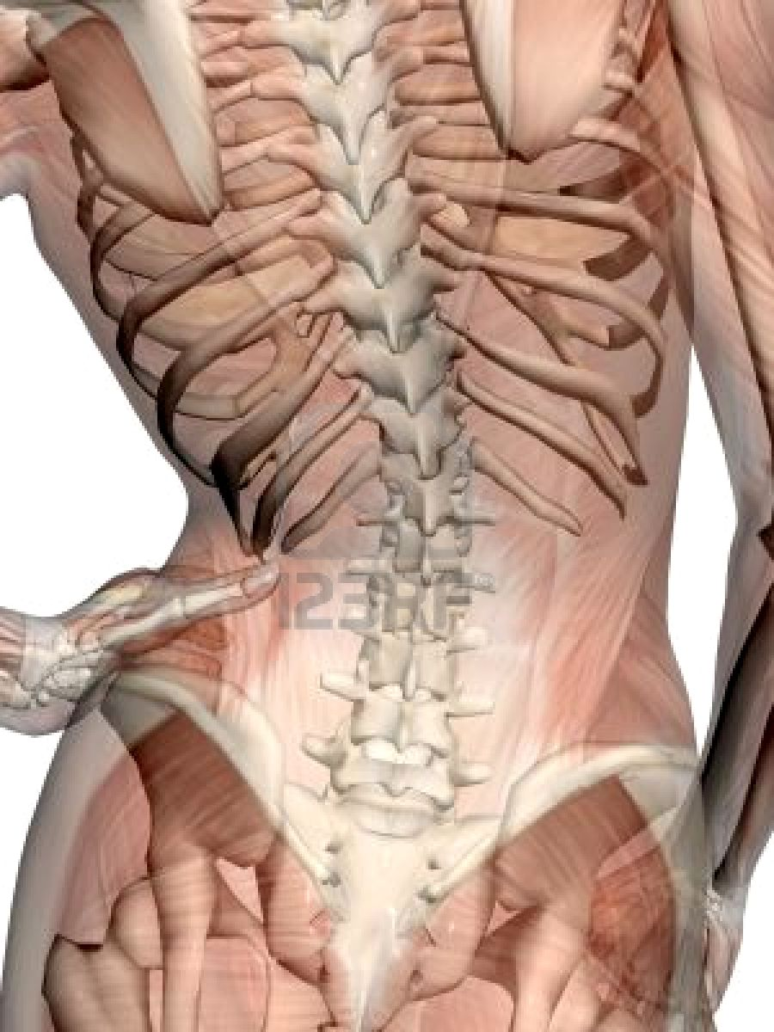

Slide 23
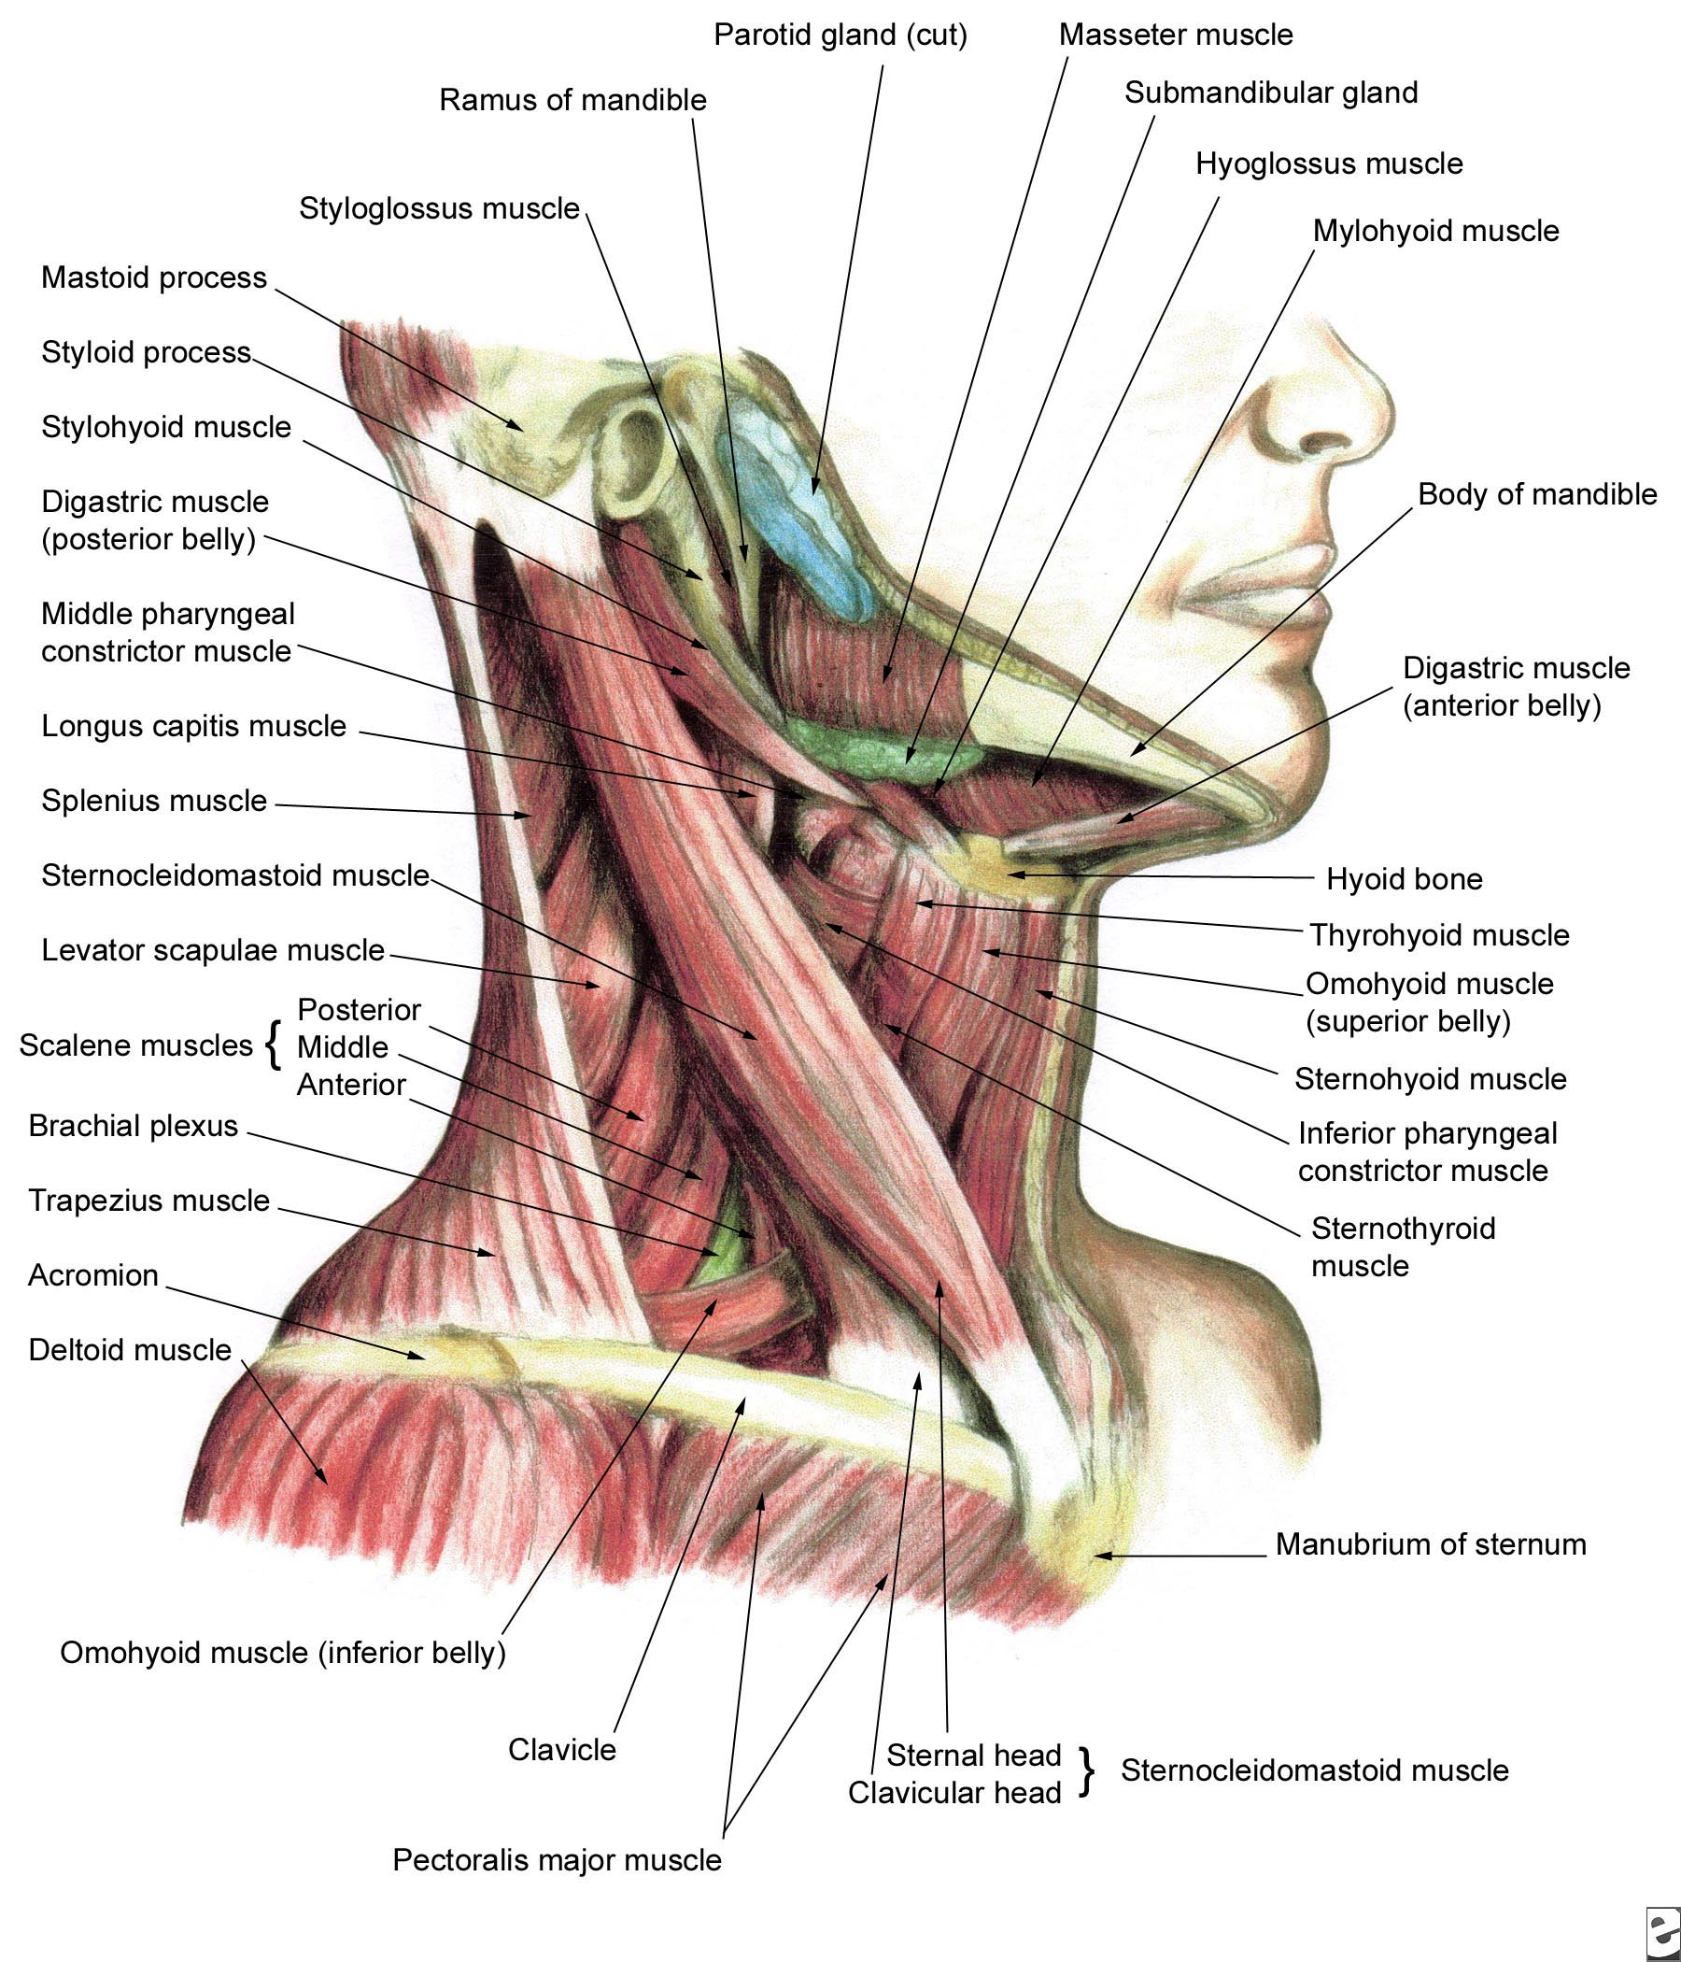

Slide 24
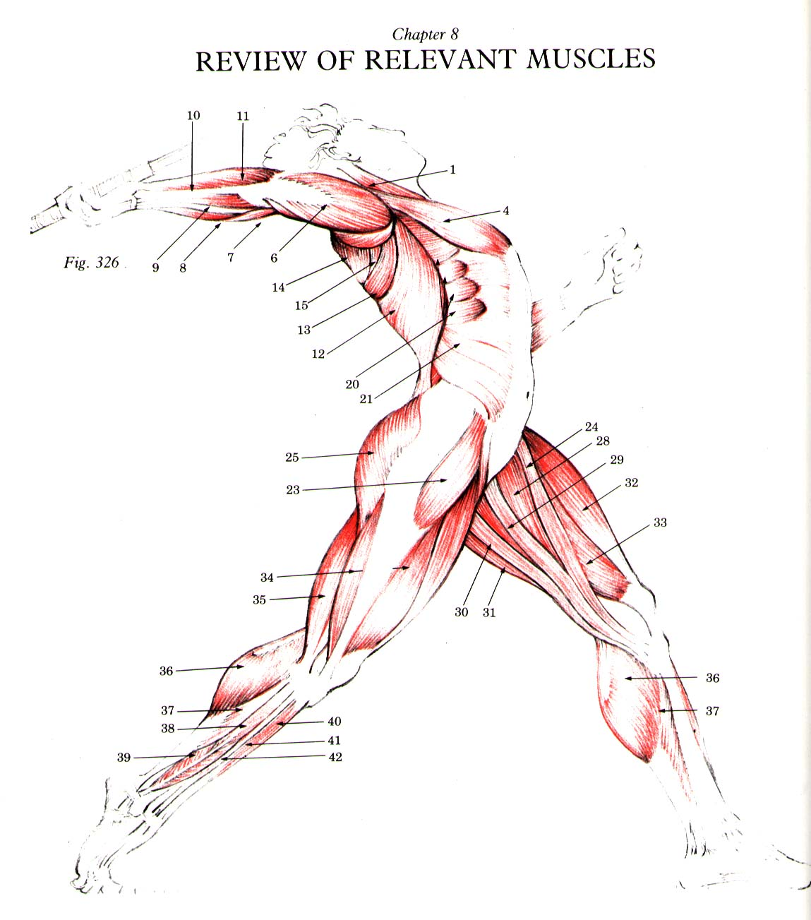

Slide 25
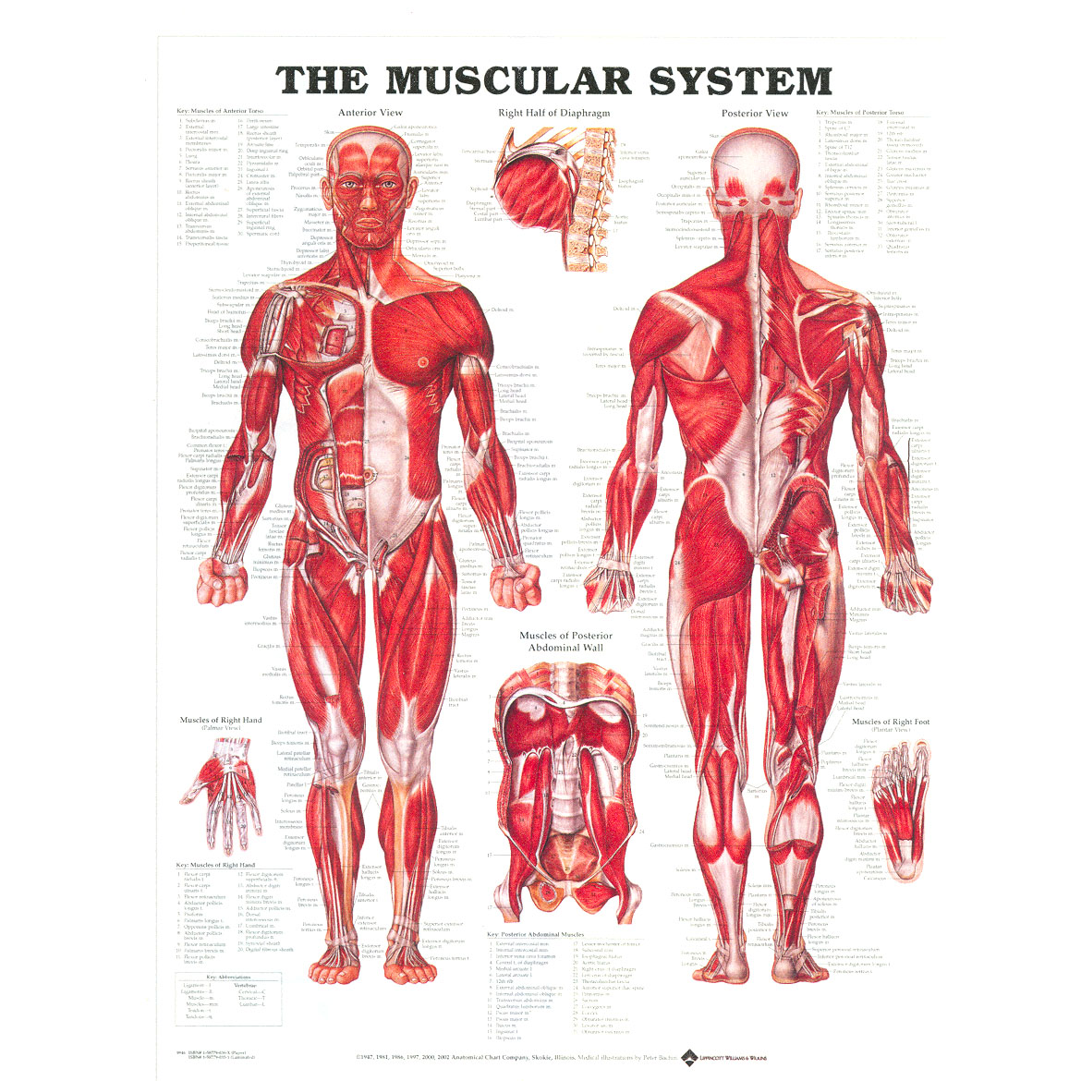

Slide 26
The Figure-Complete

Slide 27
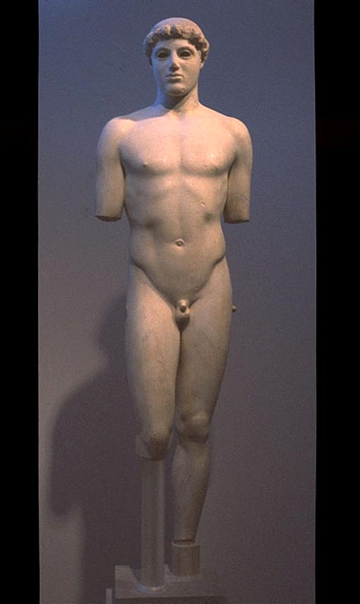
Notes:
Left: Kroisos Anavysos, Greece(ca. 530 B.C.E.)
Right: Ephebe ("Kritios Boy") ca. 480 B.C.E.

Slide 28
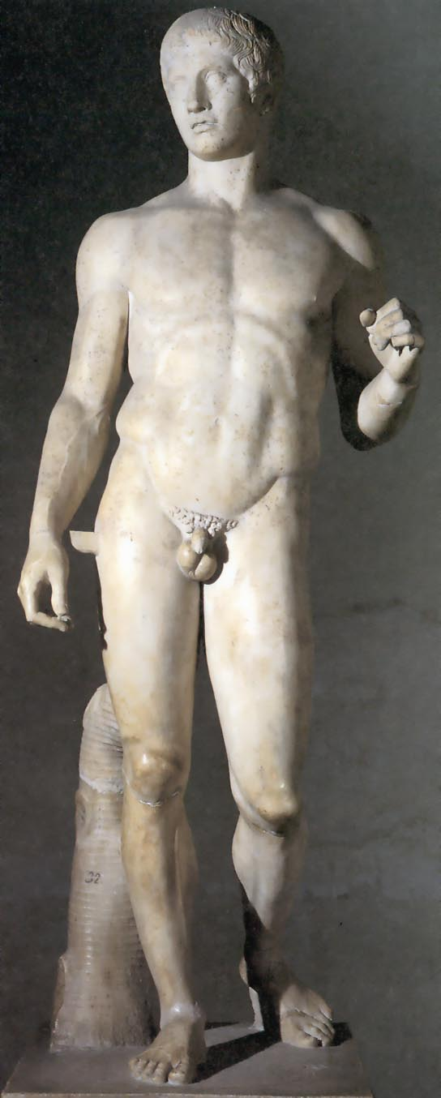
Notes:
Greek High Classical, Polykleitos, Doryphorus, ~450 BCE

Slide 29
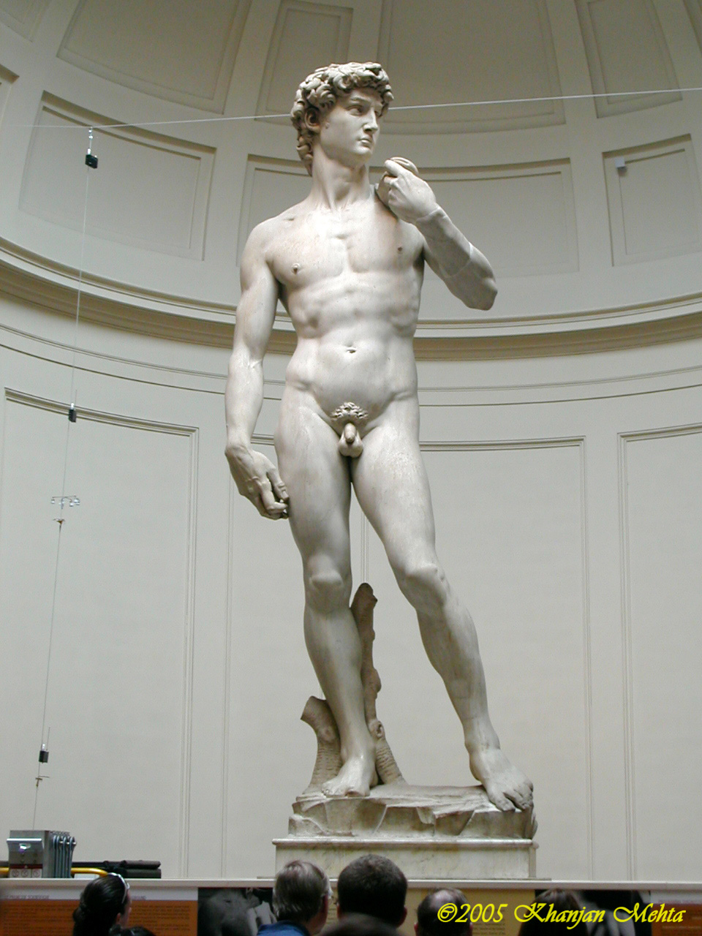

Slide 30
Gesture drawing

Slide 31
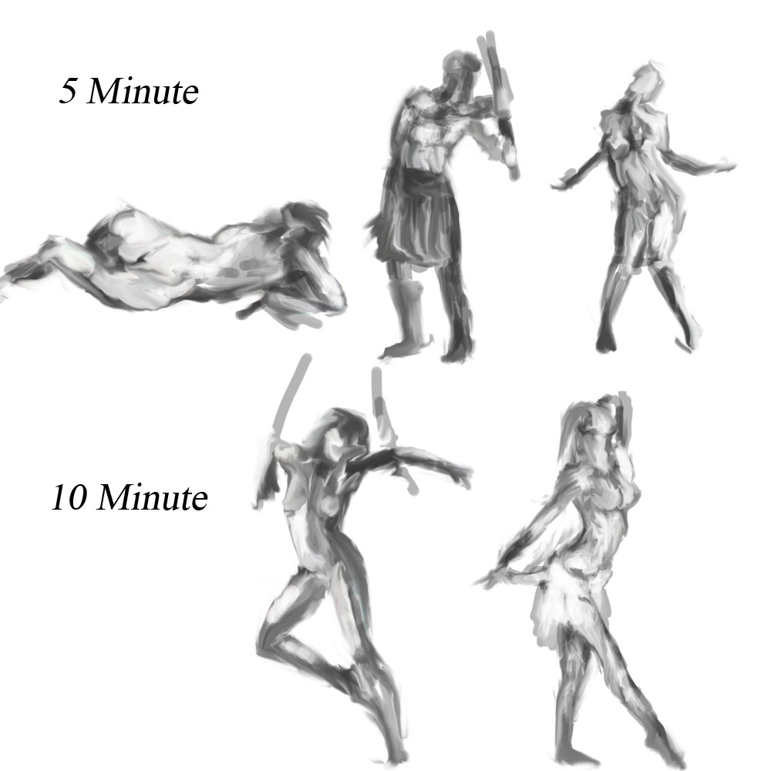

Slide 32
Human face

Slide 33
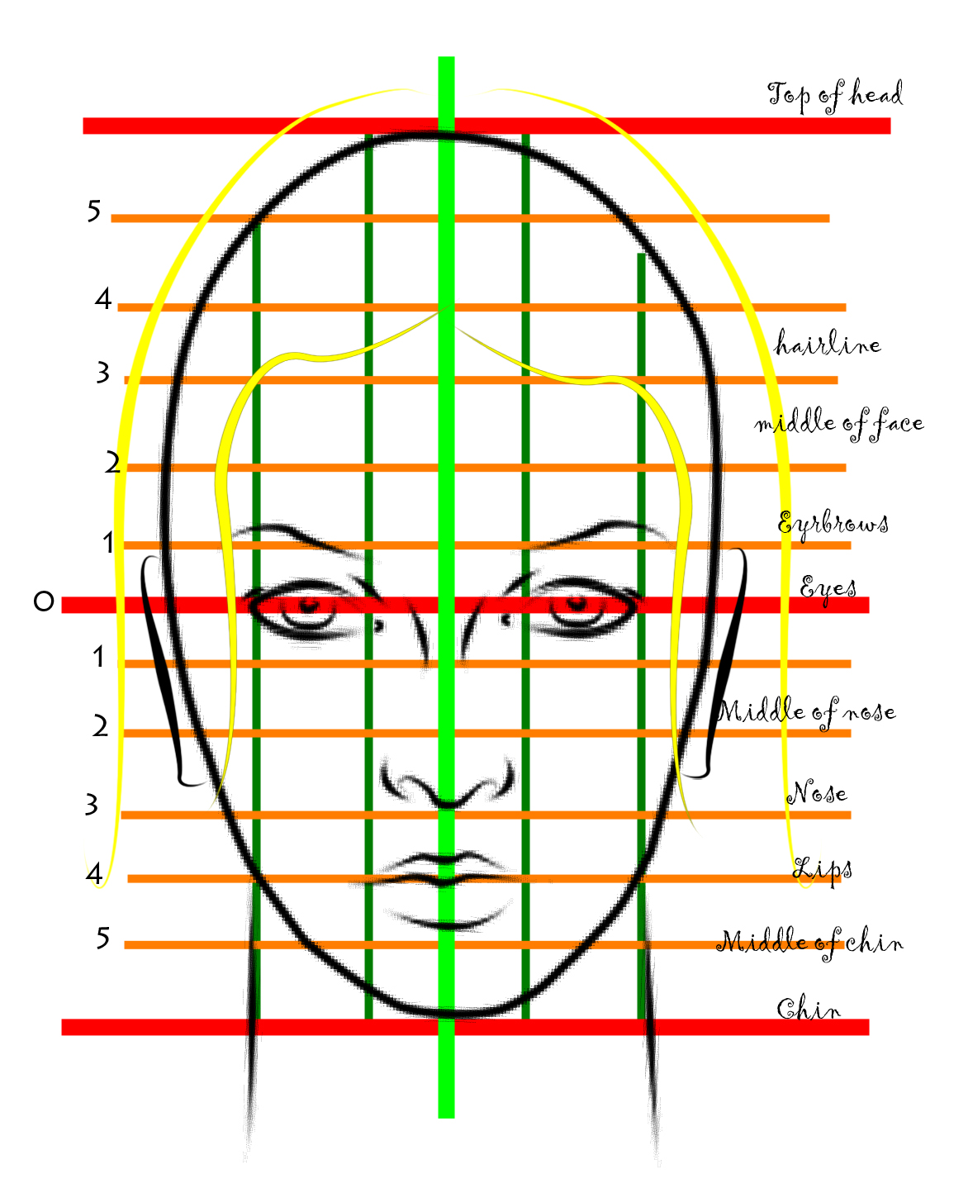

Slide 34
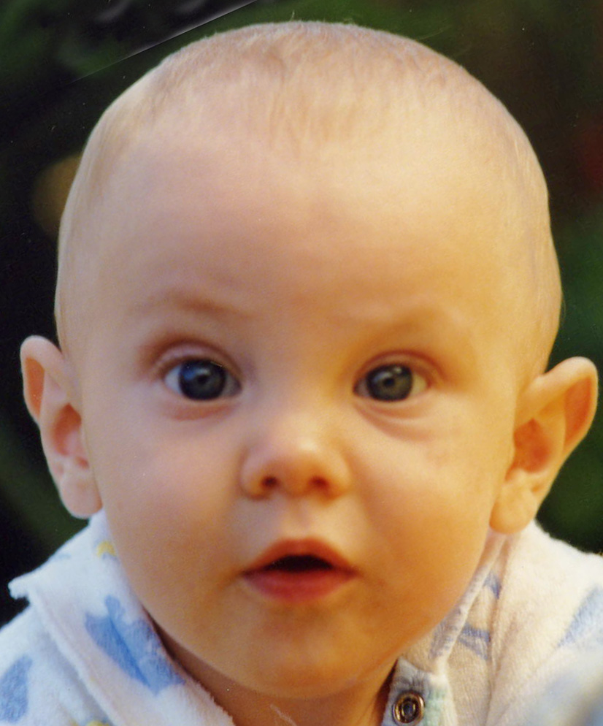

Slide 35
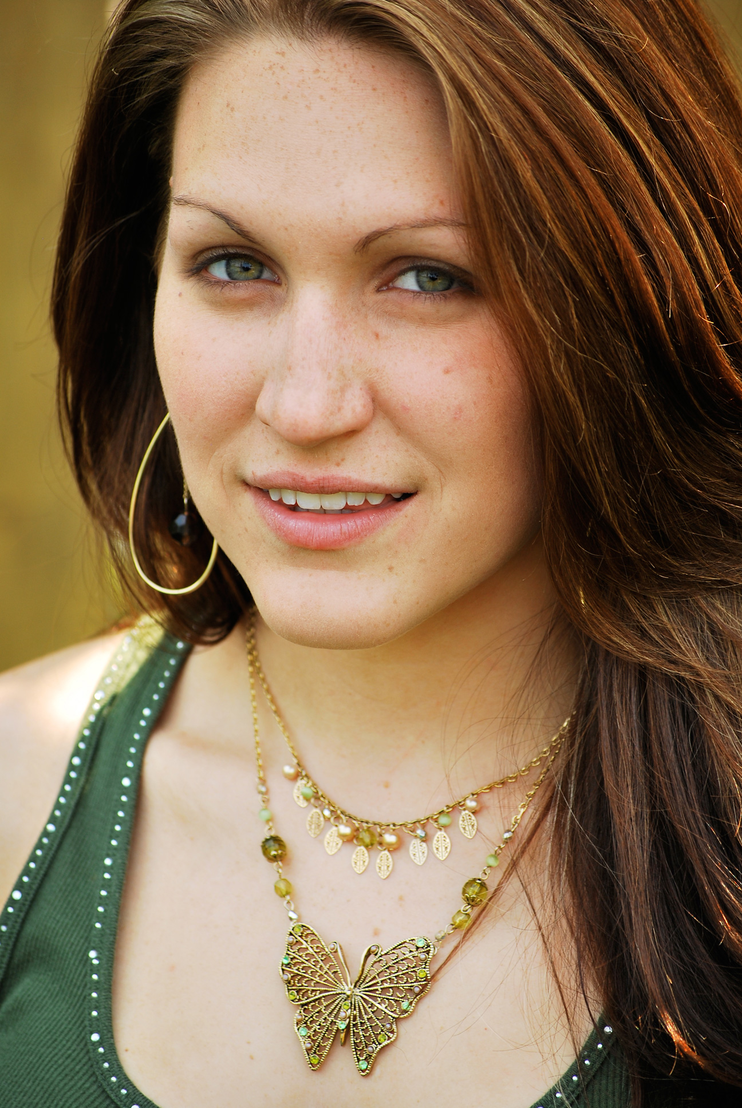

Slide 36
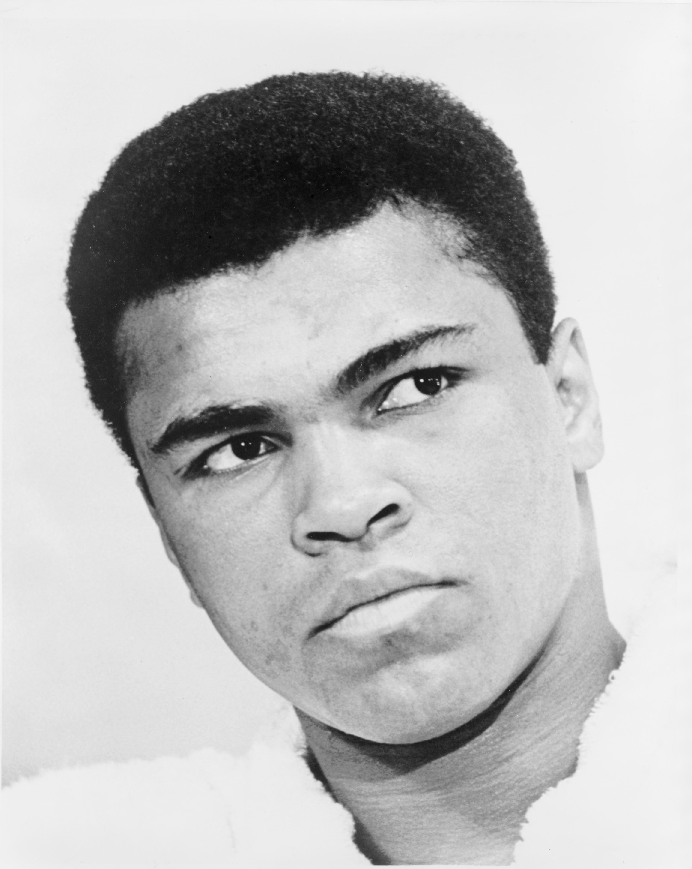

Slide 37
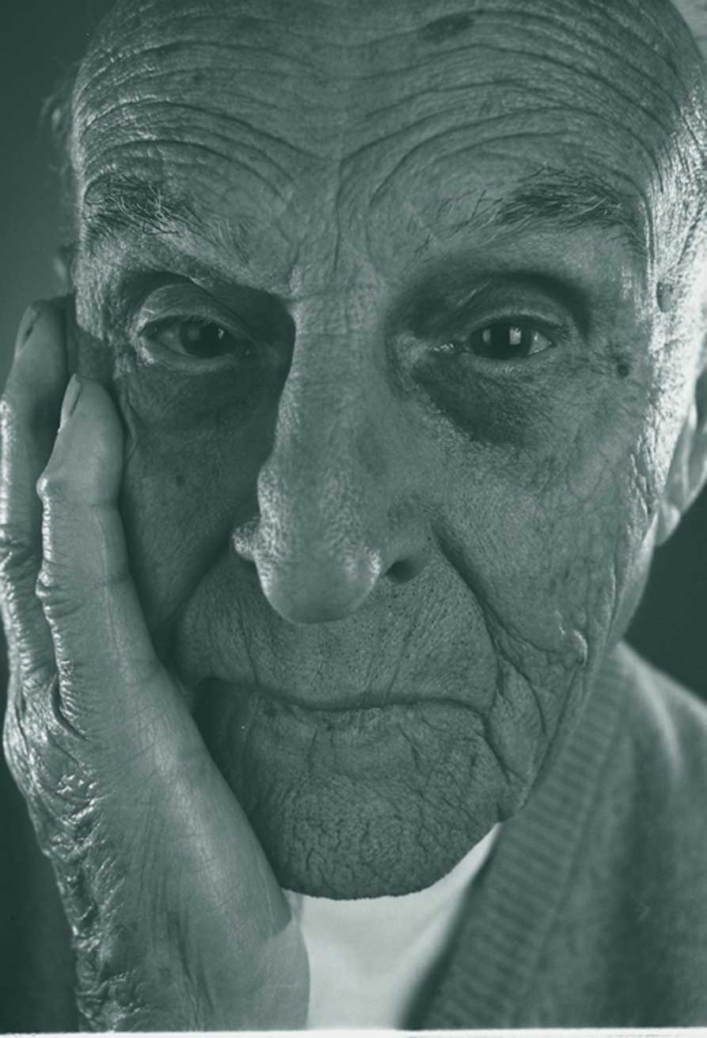

Slide 38
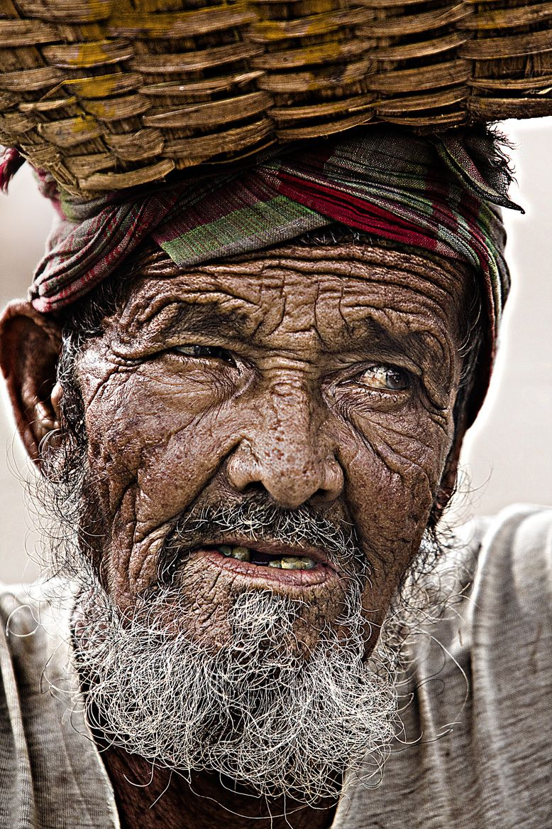

Slide 39
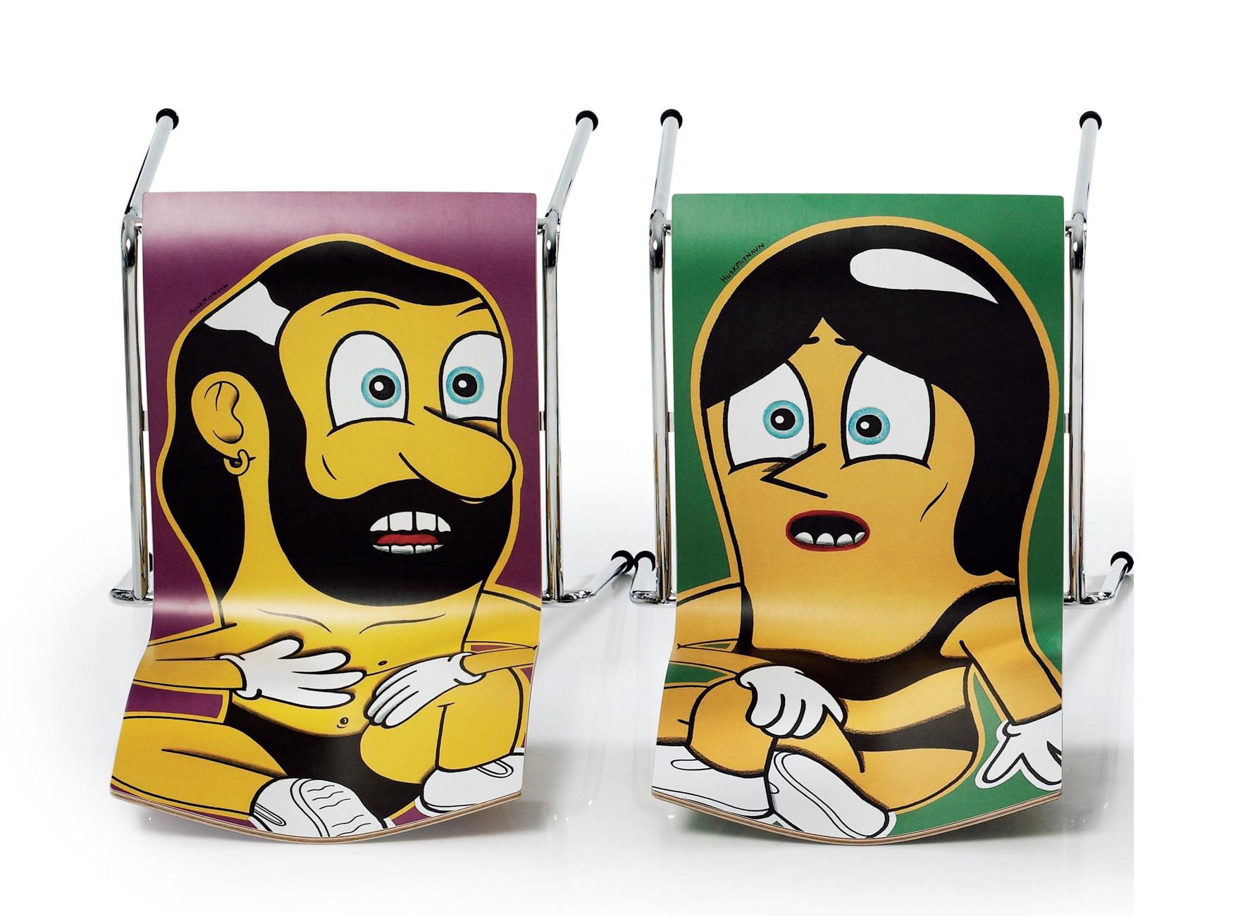

Slide 40
Facial features and proportion

Slide 41
Key Human Face/Head Proportions
Eyes are in the center of head on the vertical axis
The base of the nose is about 2/3 of the way down the face-vertical
Eyes are separated from each other by one eye width
The mouth is about as wide as two eyes
Ears on the vertical extend from the top of the eye to the bottom of the nose
Thanks Wikipedia!

Slide 42
Hands

Slide 43
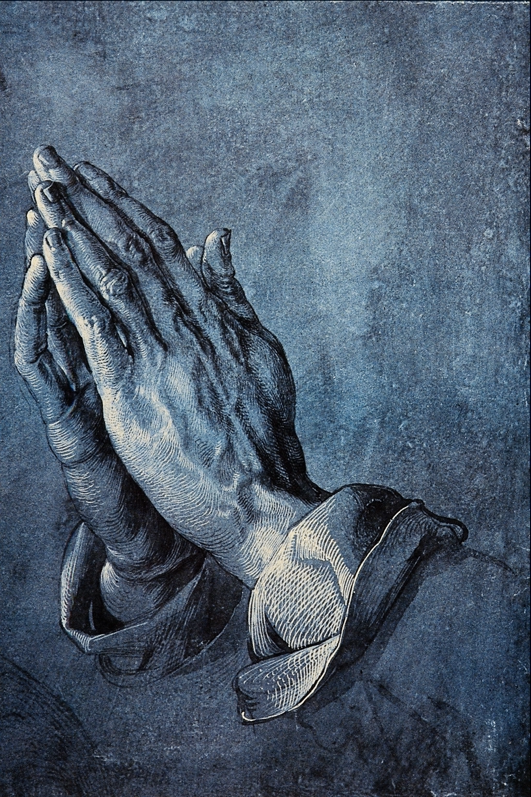

Slide 44
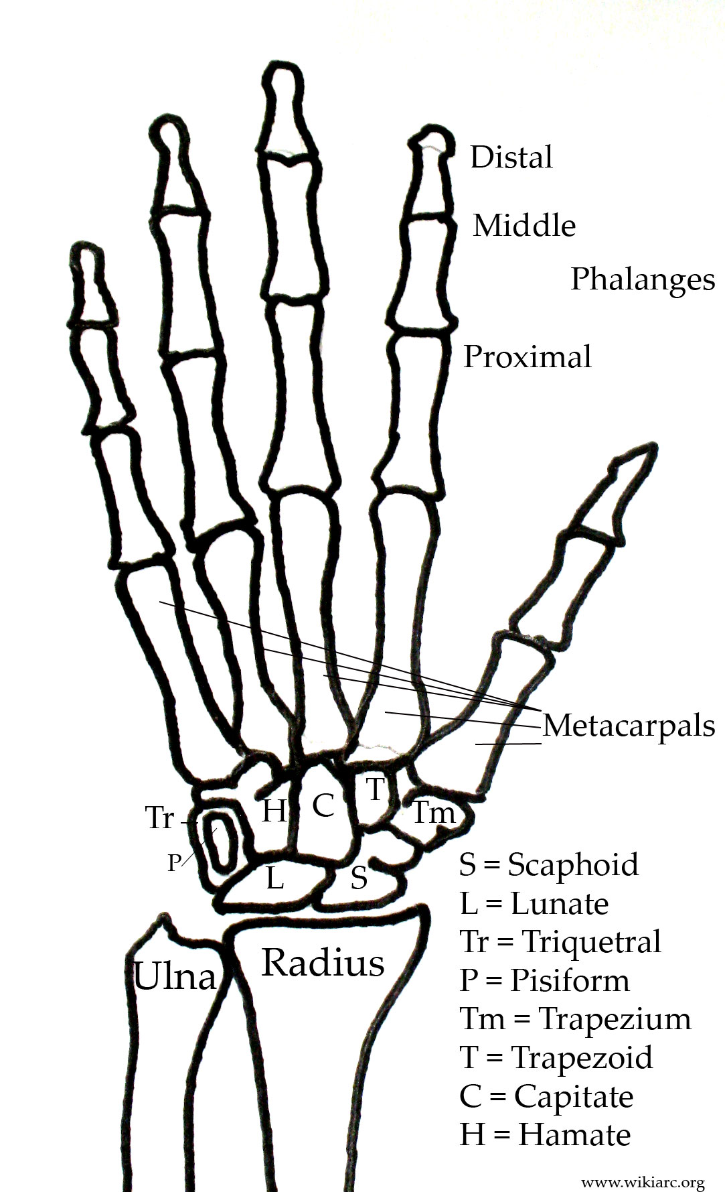

Slide 45
The Human Figure

Slide 46
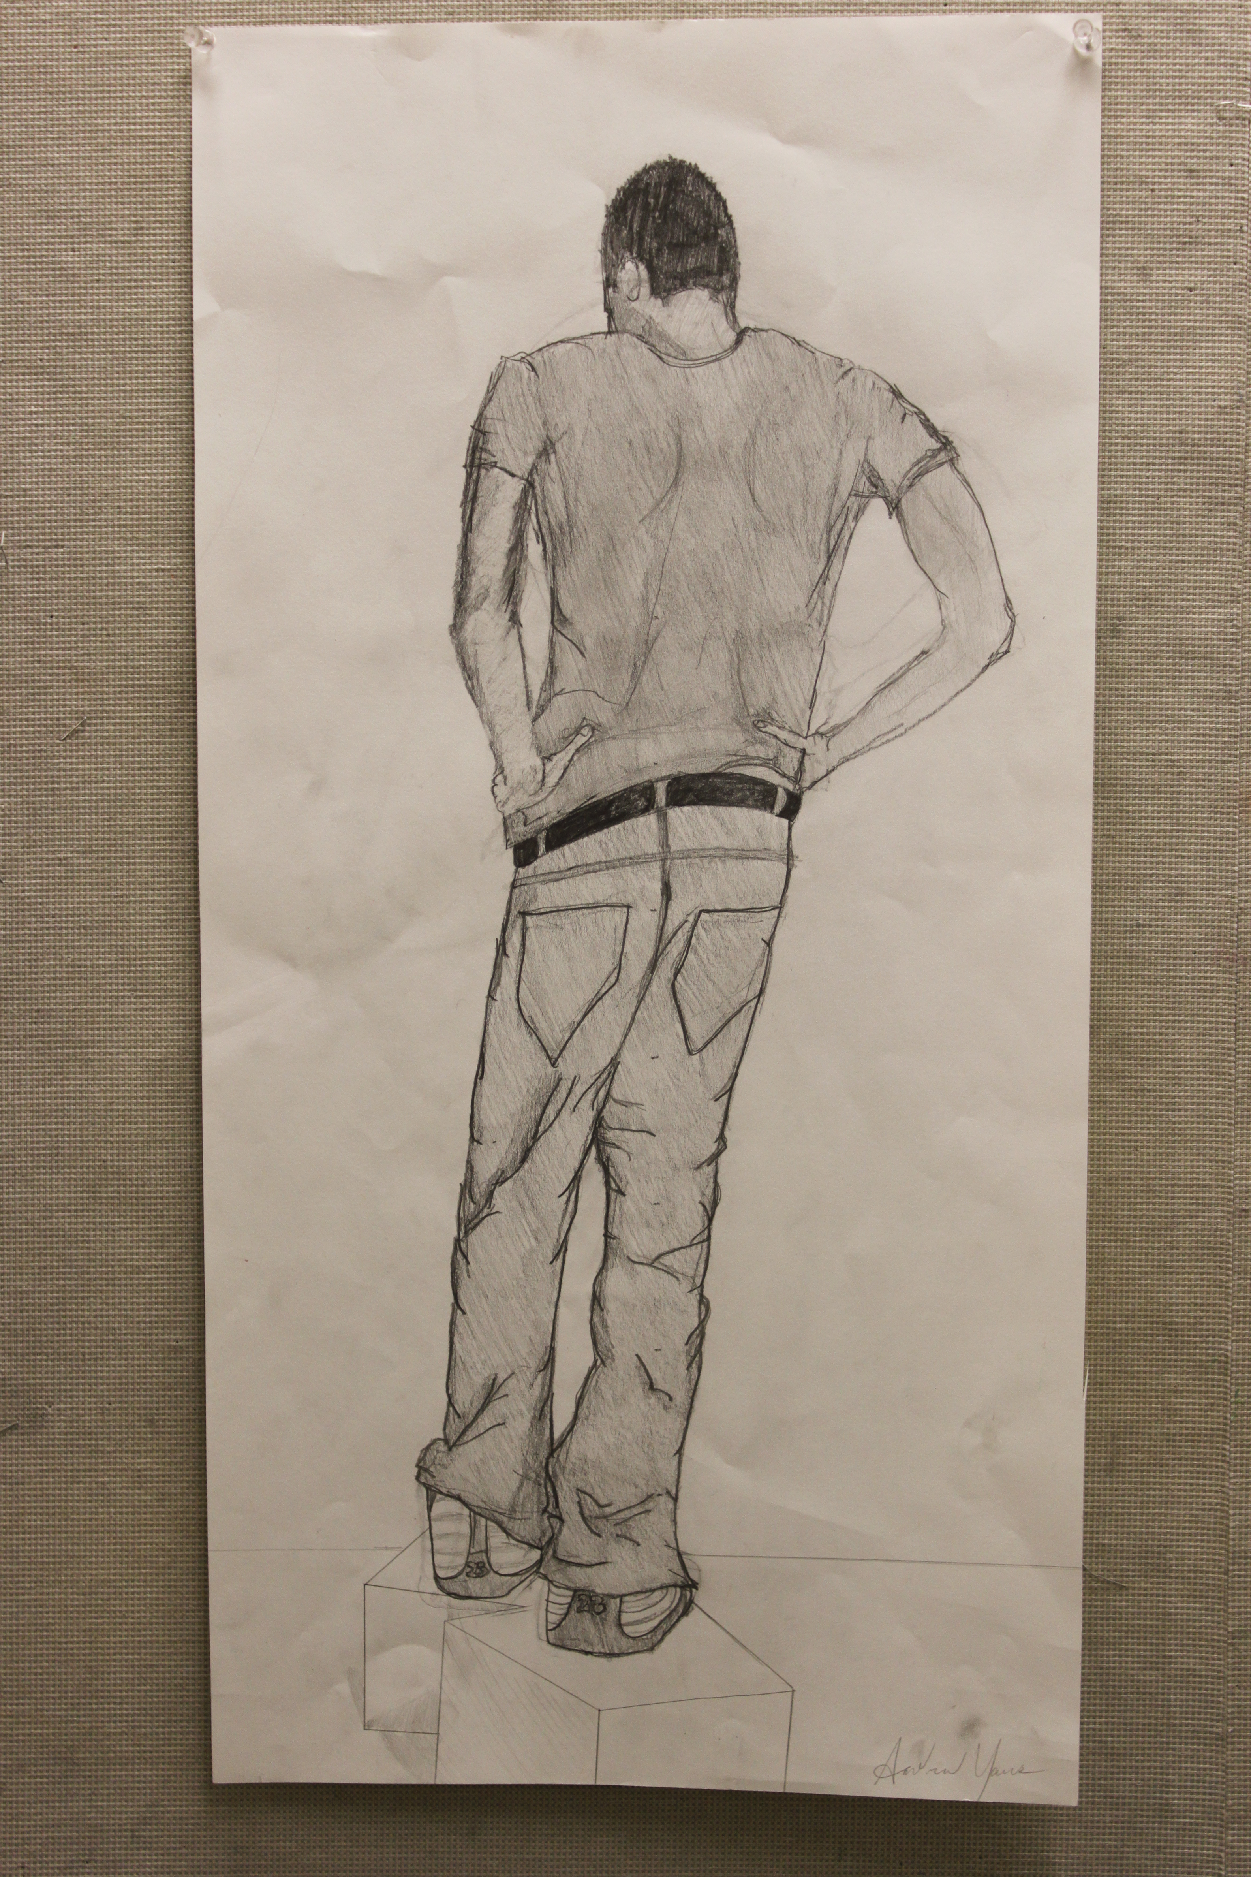

Slide 47
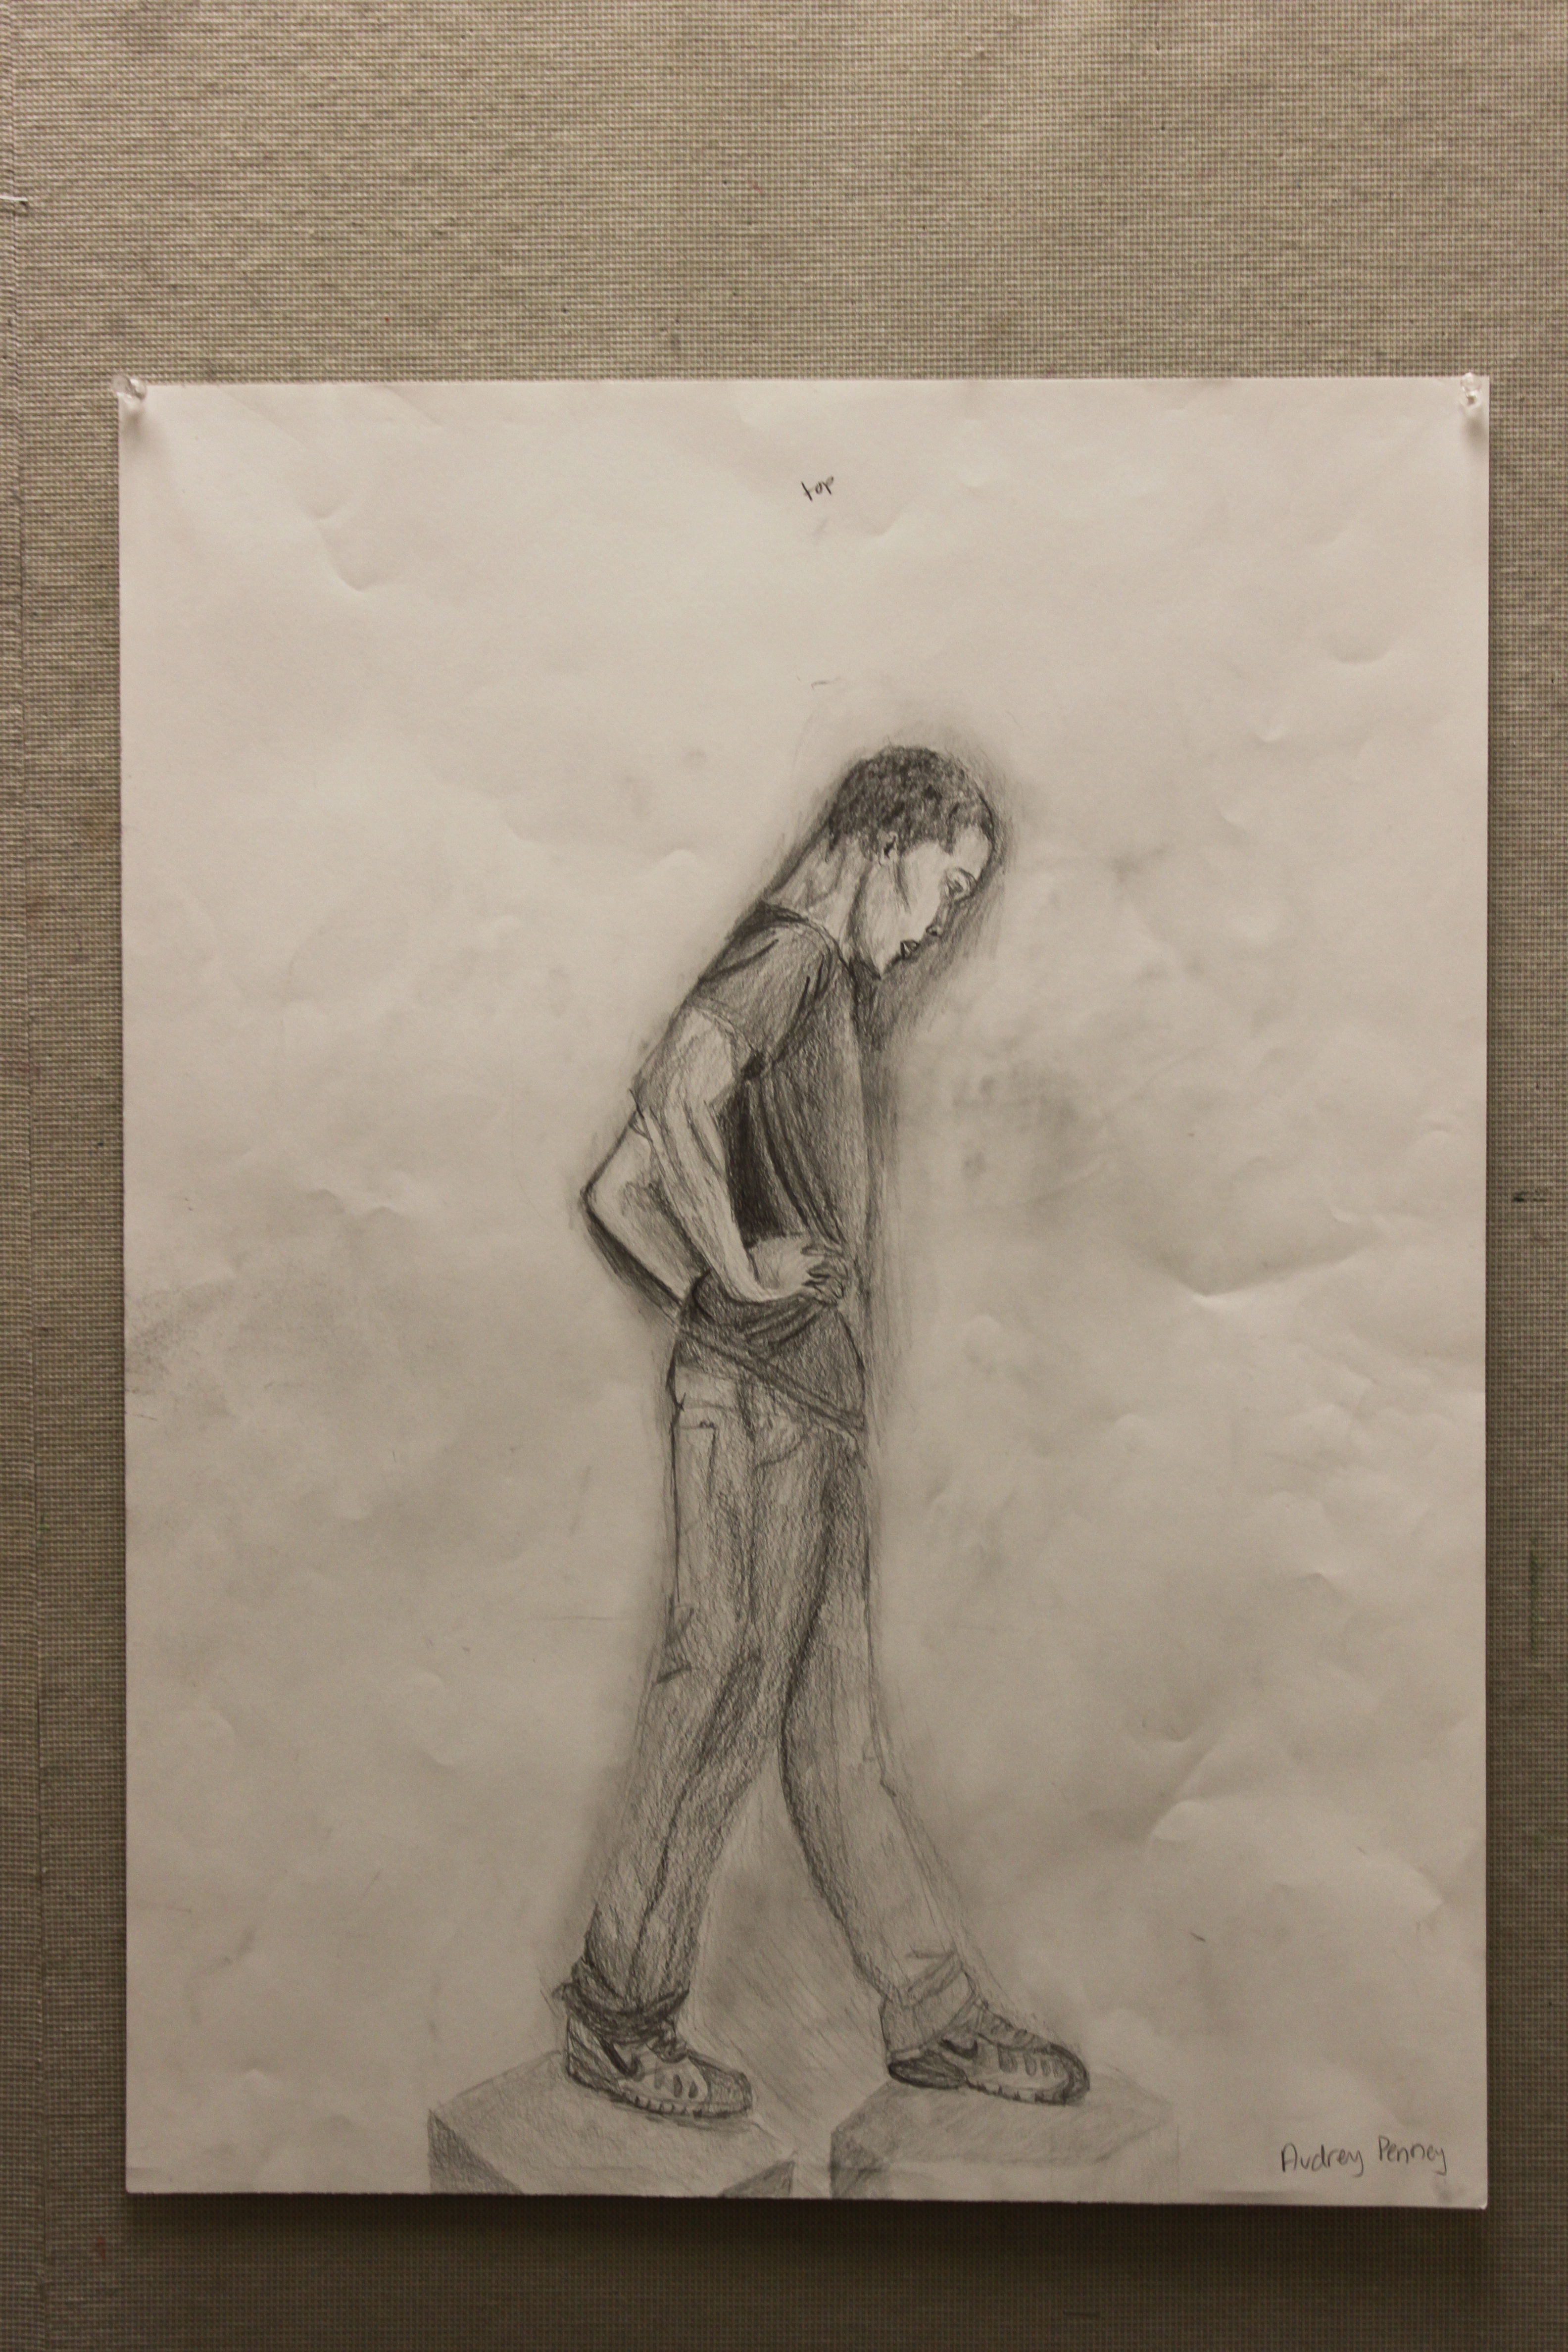

Slide 48
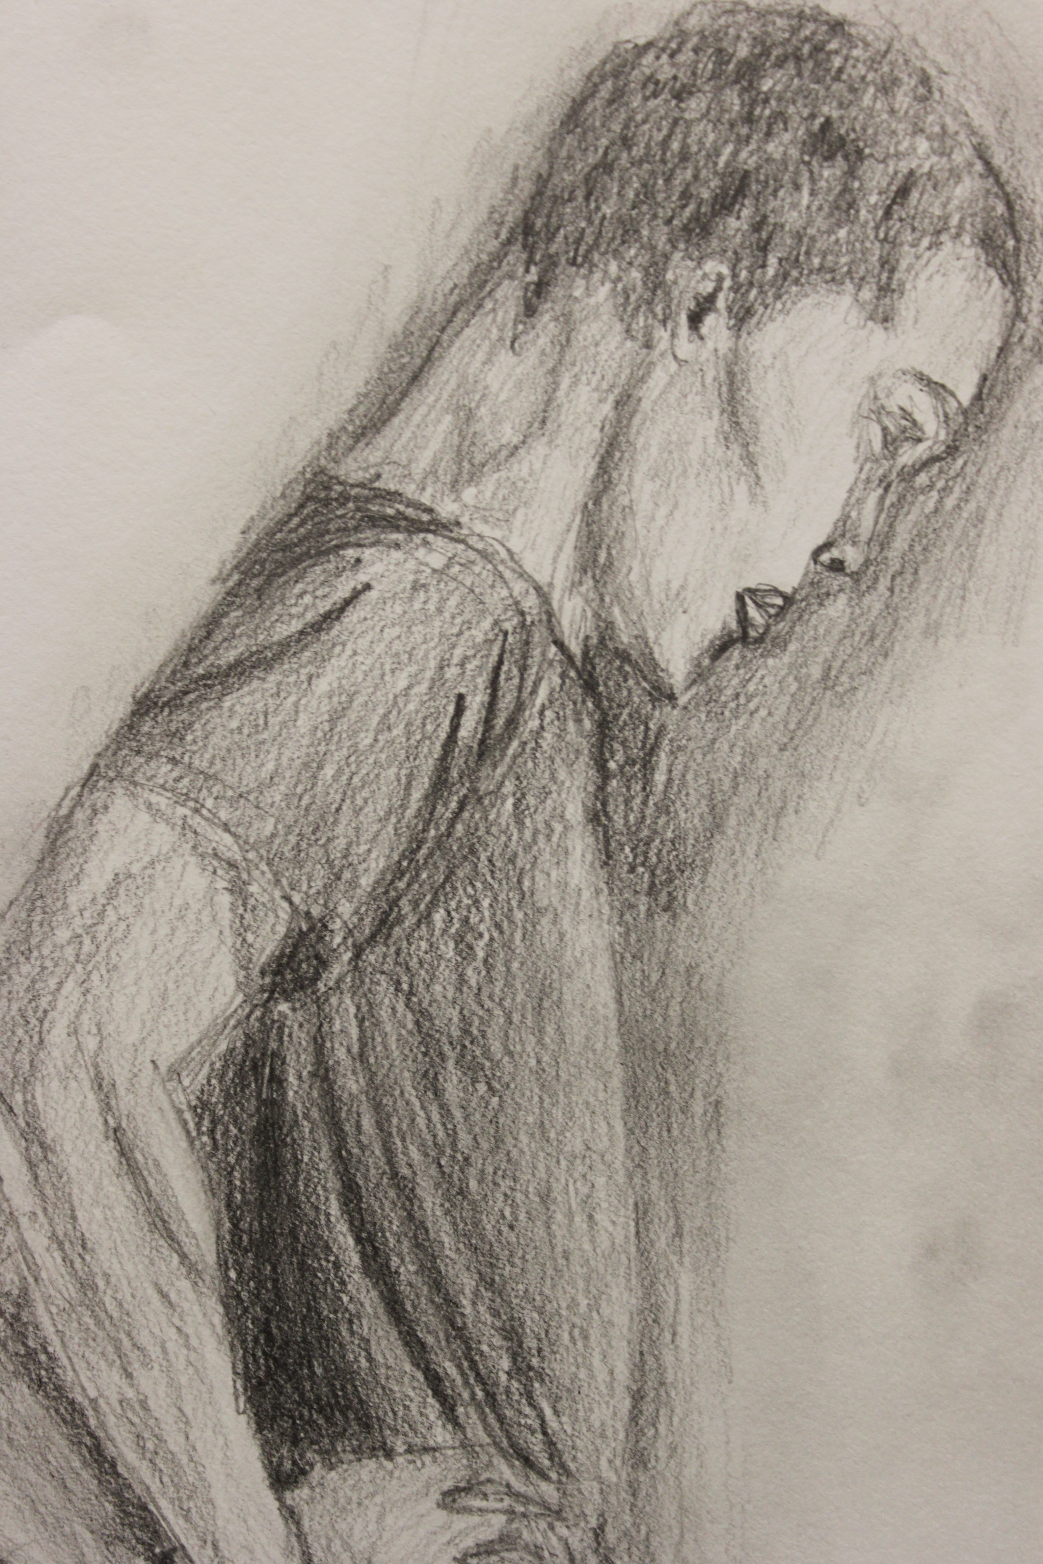

Slide 49
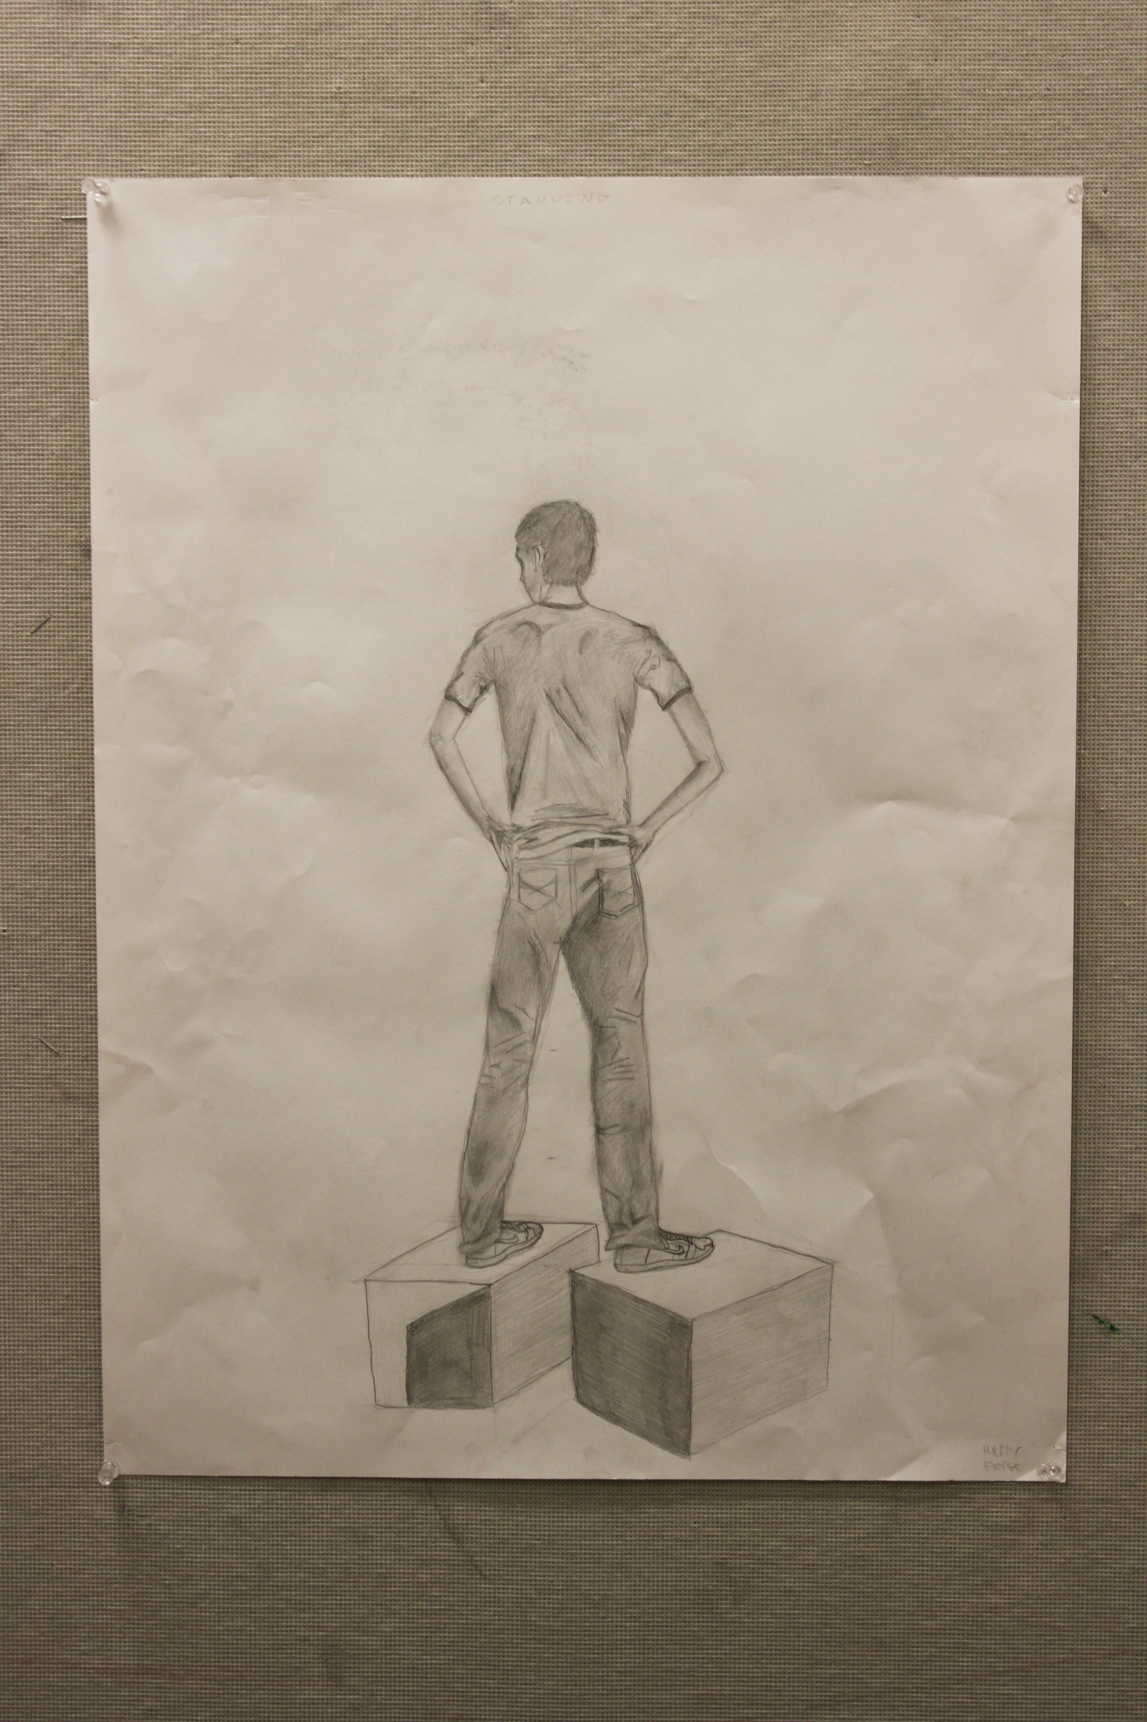

Slide 50
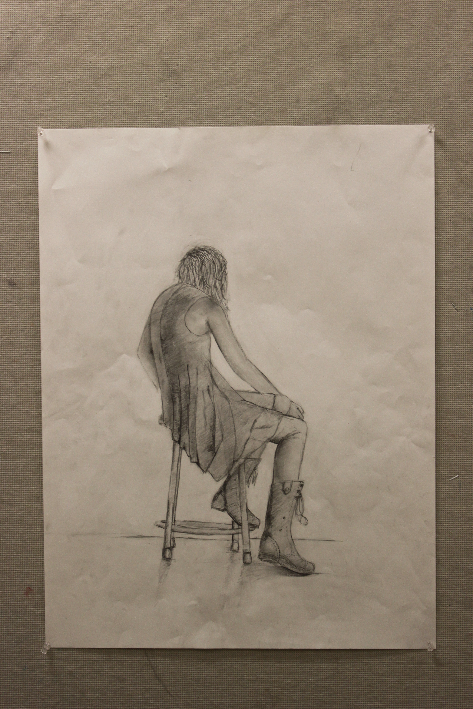

Slide 51
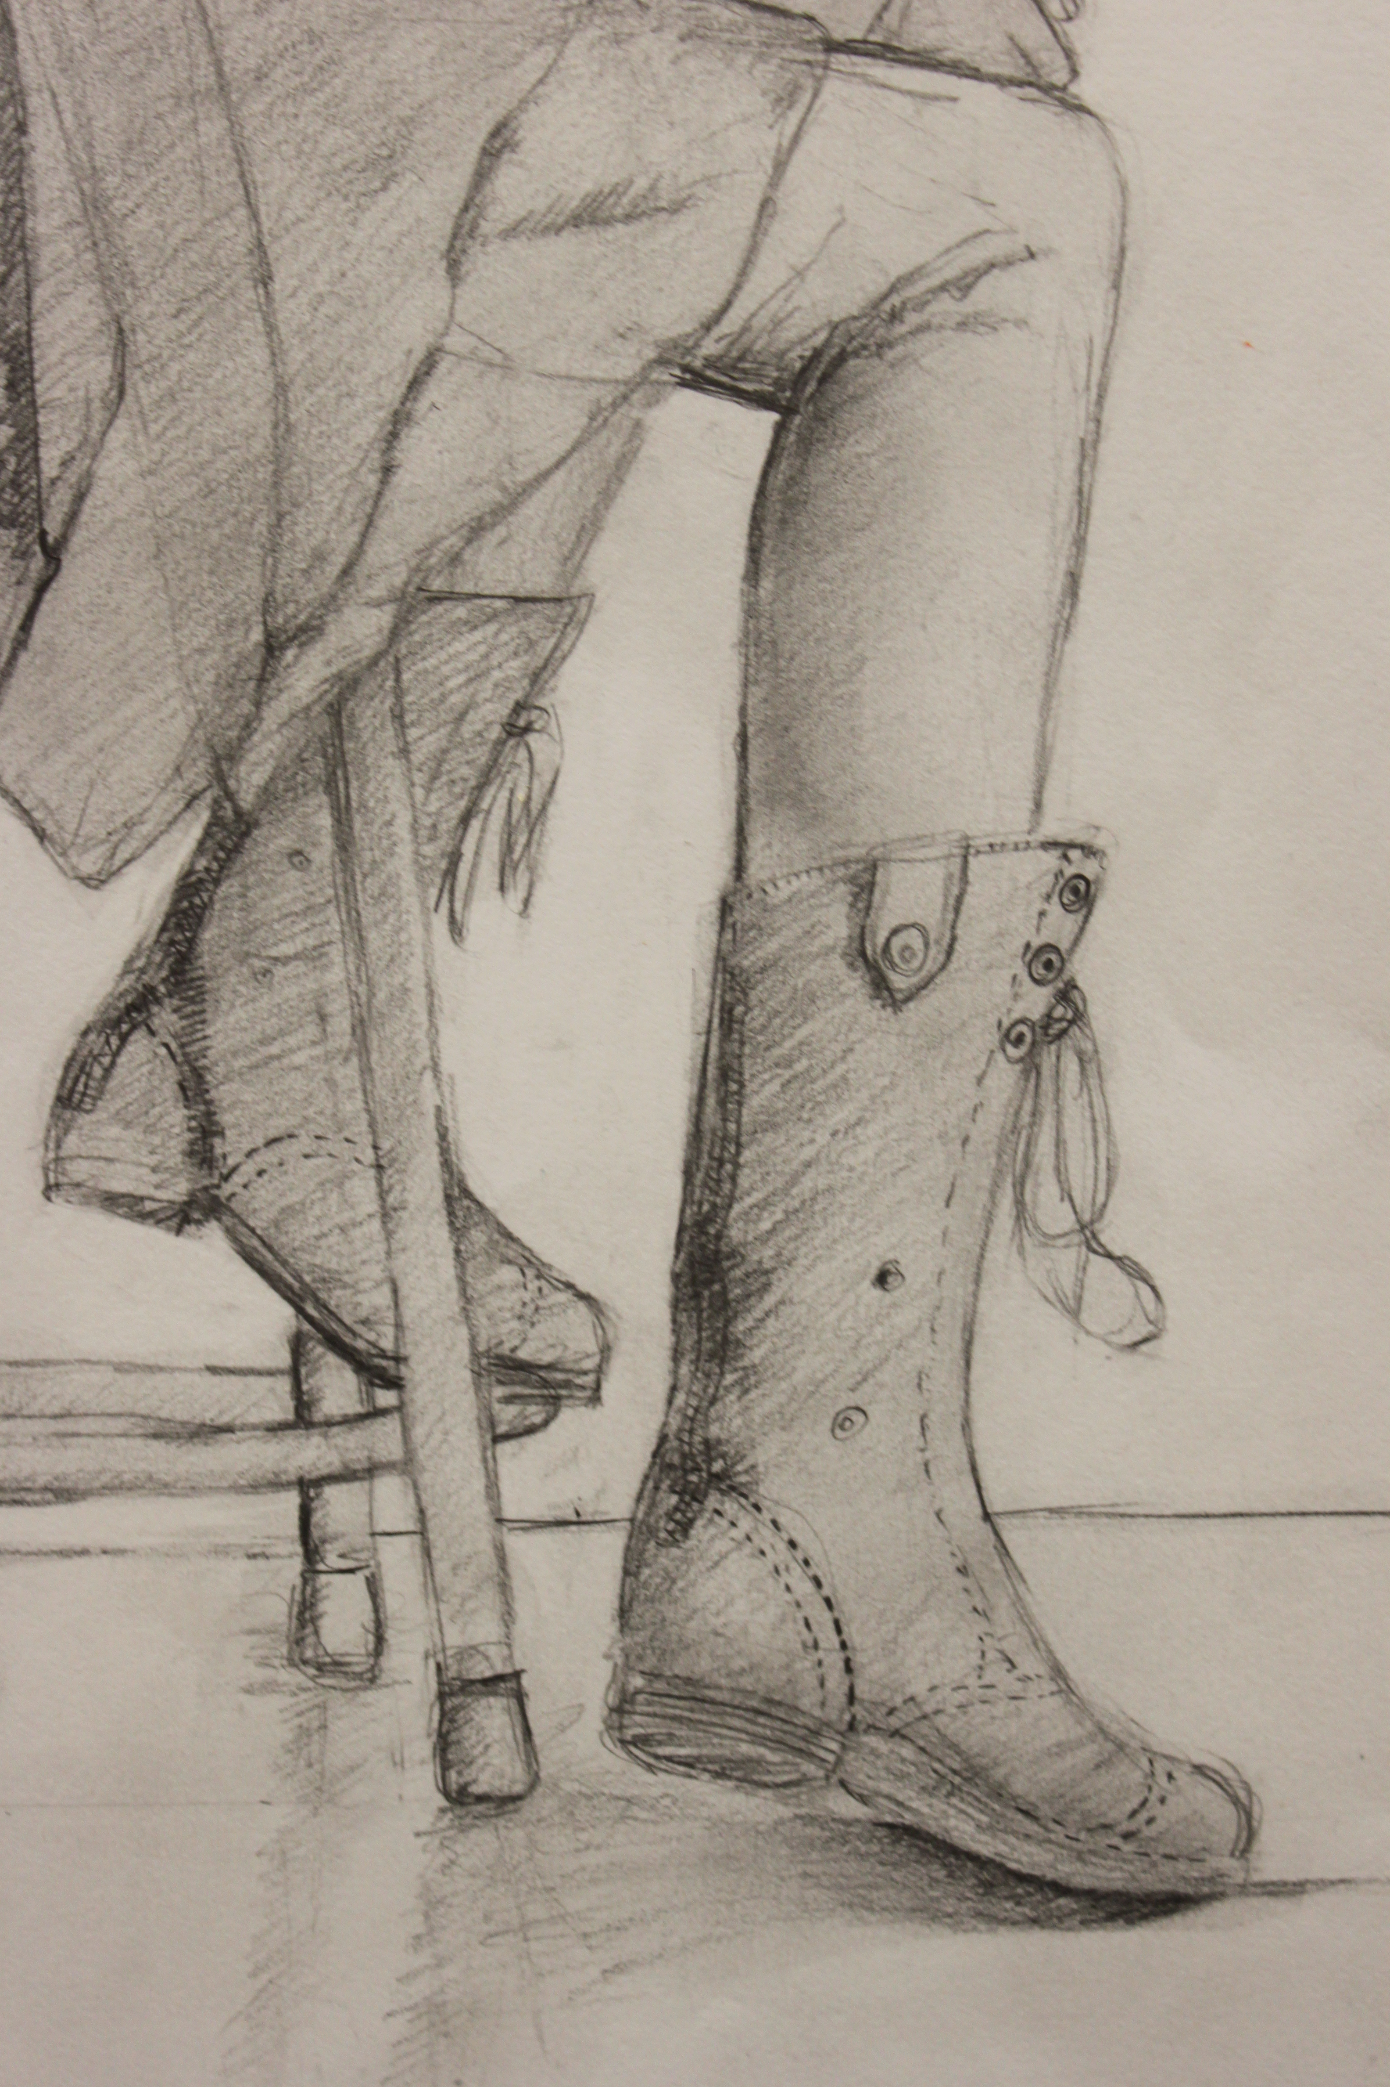

Slide 52
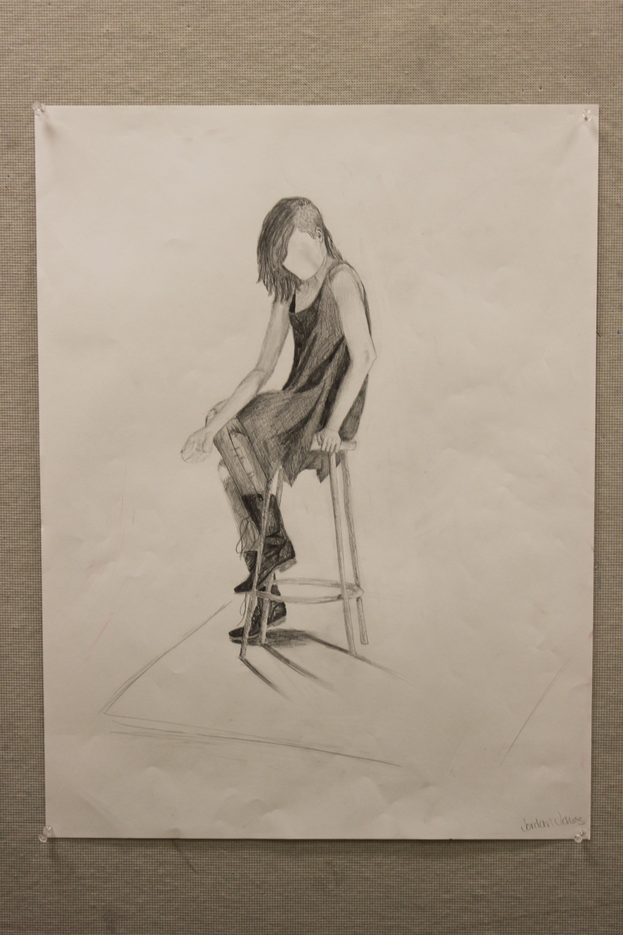

Slide 53
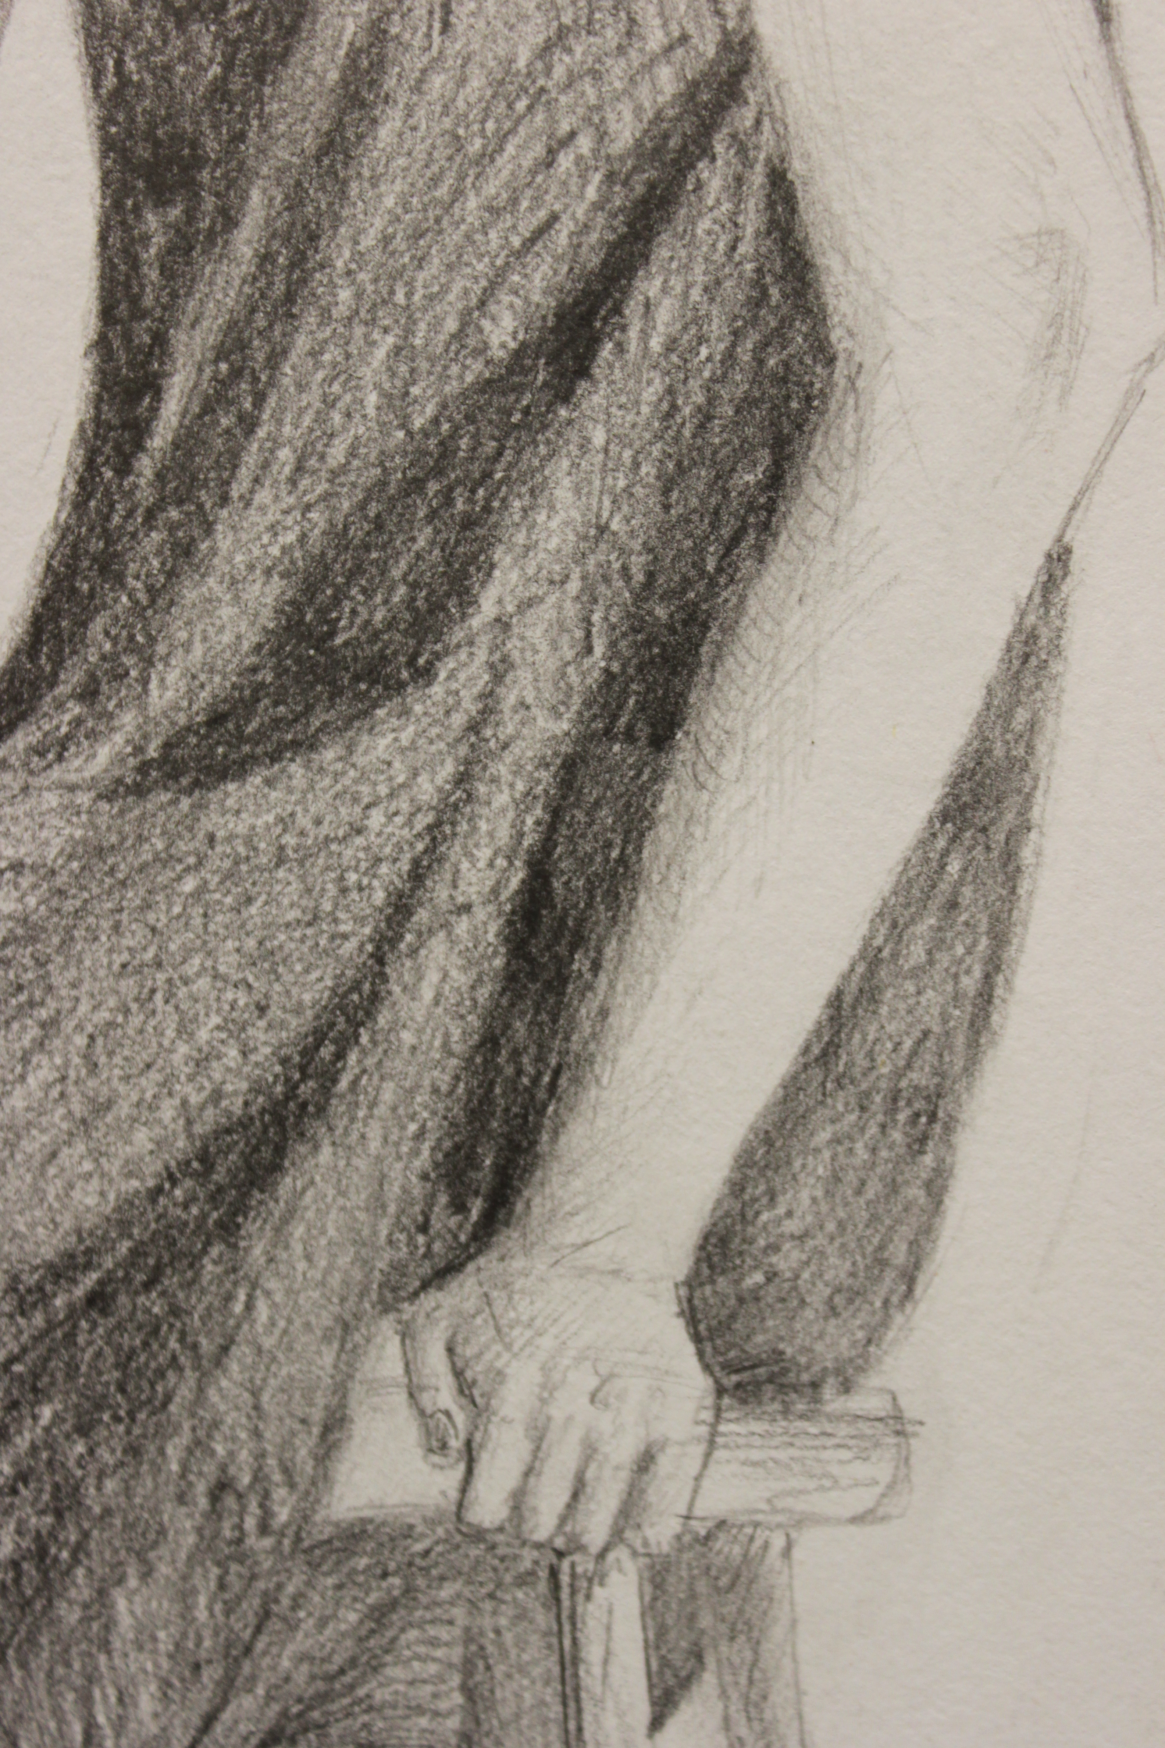

Slide 54
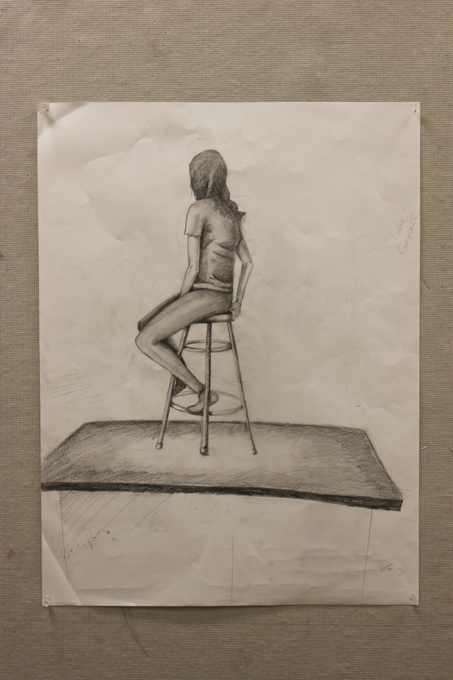

Slide 55
