Slide 1
Global Prehistory 30,000-500 BCE

Slide 2
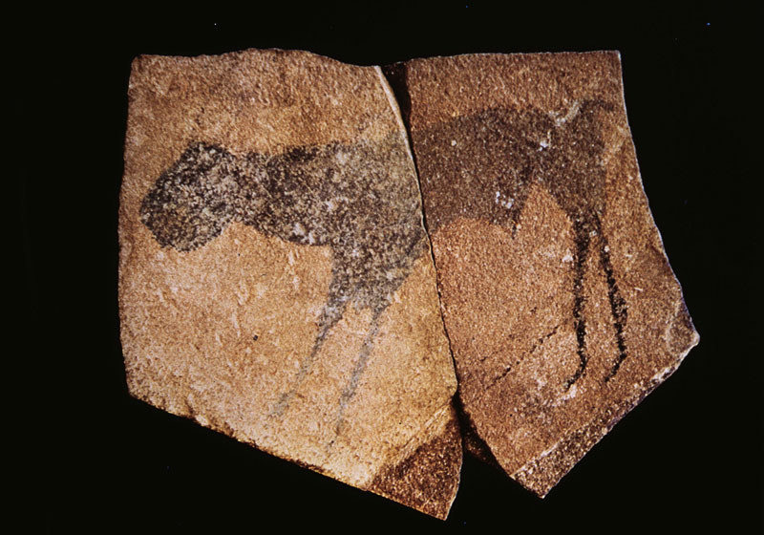
Notes:
Apollo 11 stones
Namibia
25,500-25300 BCE
Charcoal on stone

Slide 3
Notes:
Apollo 11 stones( location of)
Namibia
25,500-25300 BCE
Charcoal on stone

Slide 4
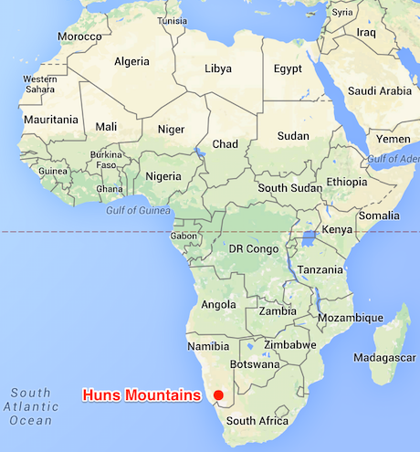
Notes:
Apollo 11 stones( location of)
Namibia
25,500-25300 BCE
Charcoal on stone

Slide 5
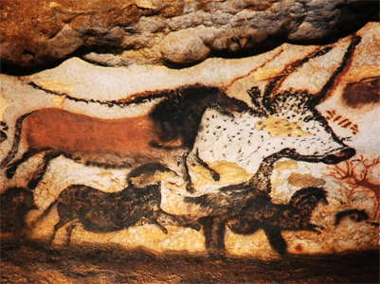
Notes:
Great Hall of the Bulls
Lascaux, France
Paleolithic Europe
15000-13000 BCE
Rock Painting

Slide 6
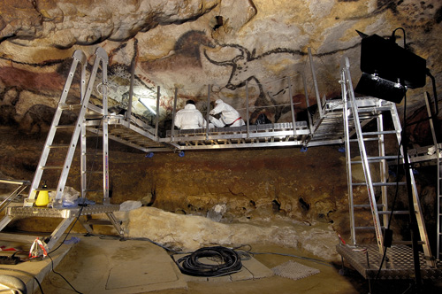
Notes:
Detail
Great Hall of the Bulls
Lascaux, France
Paleolithic Europe
15000-13000 BCE
Rock Painting

Slide 7
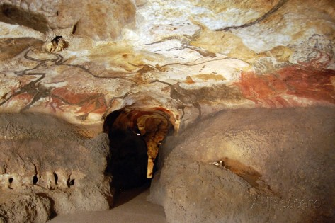
Notes:
detail
Great Hall of the Bulls
Lascaux, France
Paleolithic Europe
15000-13000 BCE
Rock Painting

Slide 8
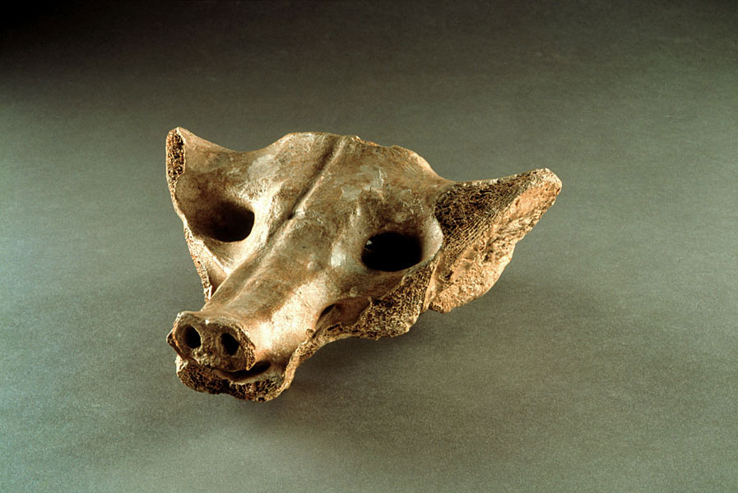
Notes:
Camelid sacrum in the shape of a canine
Tequixquiac, Central Mexico
14000-17000 BCE
bone

Slide 9
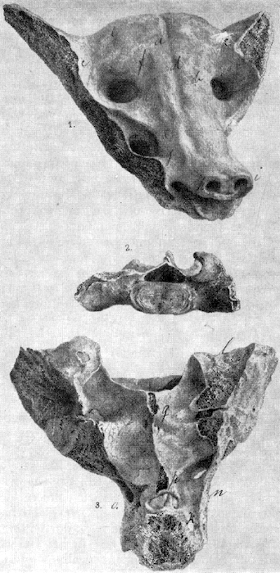
Notes:
Camelid sacrum in the shape of a canine
Tequixquiac, Central Mexico
14000-17000 BCE
bone

Slide 10
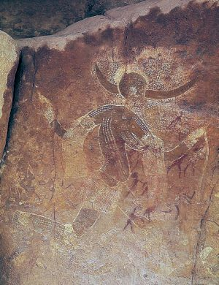
Notes:
Running horned woman
Tassili n”ajjer, Algeria
6000-4000 BCE
Pigment on rock

Slide 11
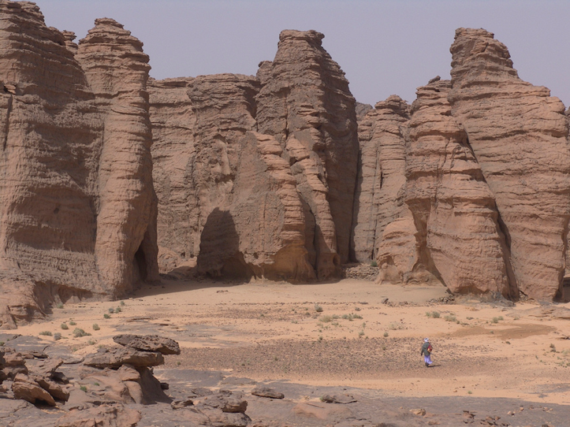
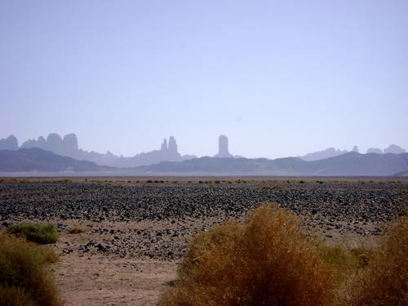
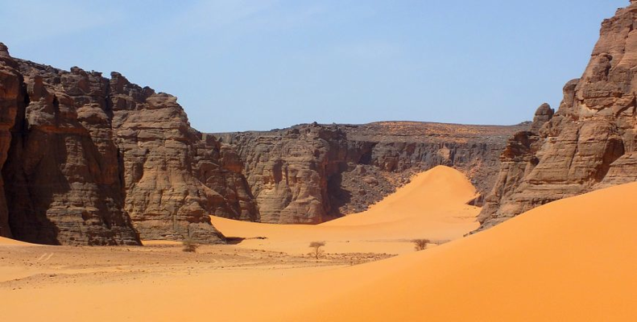
Notes:
Running horned woman
Tassili n”ajjer, Algeria (location of)
6000-4000 BCE
Pigment on rock

Slide 12
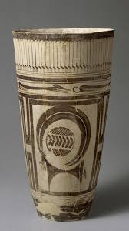
Notes:
Beaker with ibex motifs
Susa, Iran 3500 BCE painted terra cotta

Slide 13
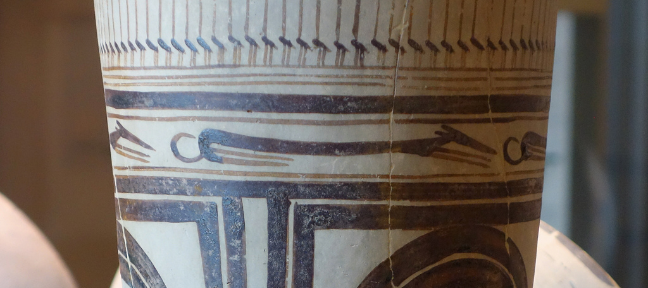
Notes:
Detail
Beaker with ibex motifs
Susa, Iran 3500 BCE painted terra cotta

Slide 14
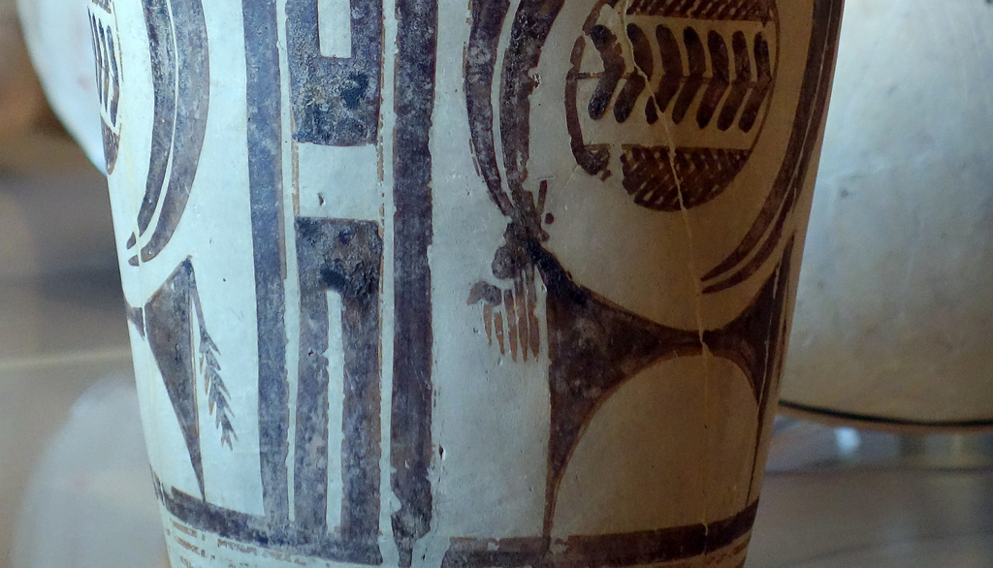
Notes:
Detail
Beaker with ibex motifs
Susa, Iran 3500 BCE painted terra cotta

Slide 15
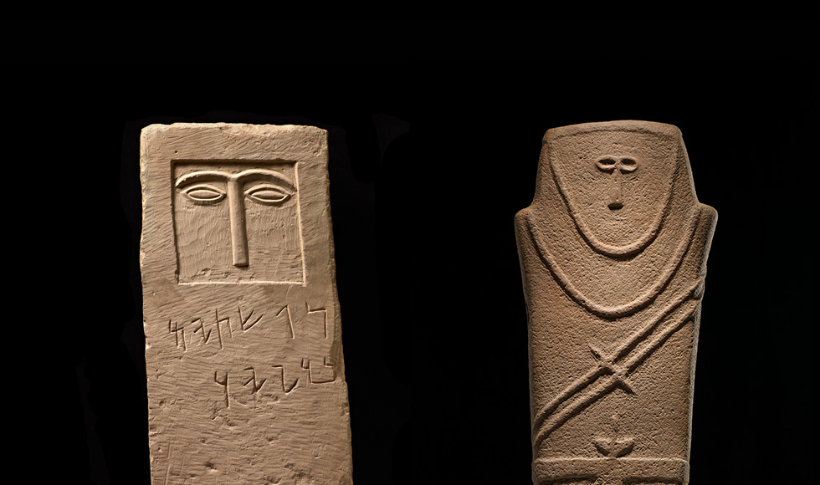
Notes:
Anthropomorphic stele
Arabian Peninsula, 4th Millennium BCER
Sandstone

Slide 16
Notes:
Anthropomorphic stele (location of)
Arabian Peninsula, 4th Millennium BCER
Sandstone

Slide 17
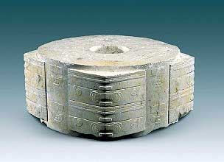
Notes:
Jade cong
Liangzhu, China
3300-2200 BCE
Carved Jade

Slide 18
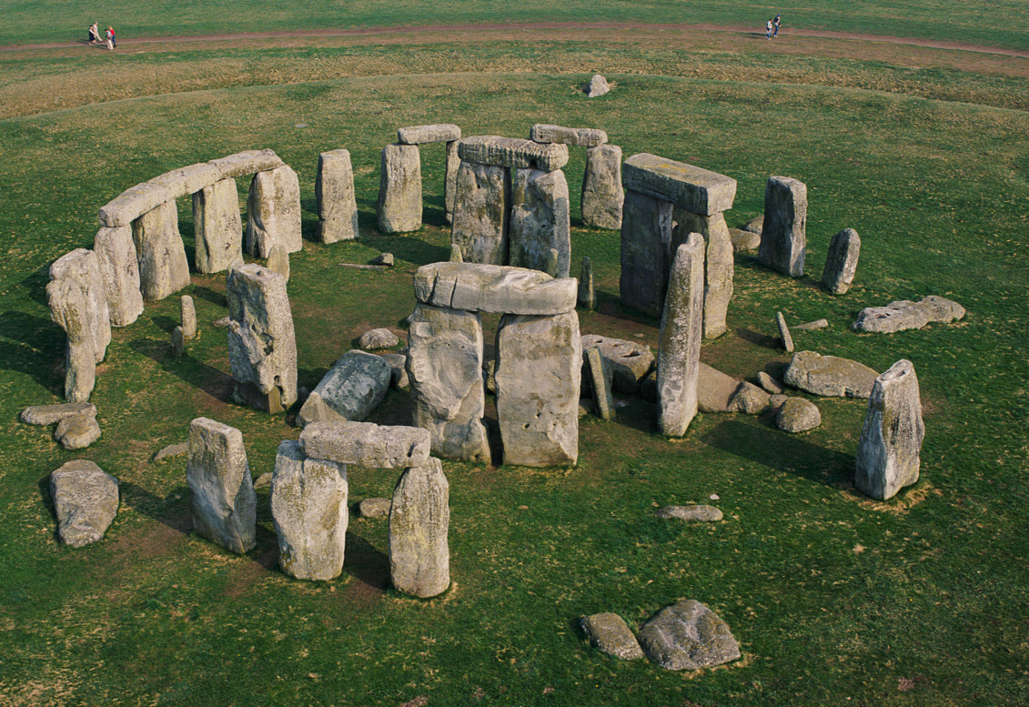
Notes:
Stonehenge
Wiltshire, England, Neolithic Europe
2500-1600 BCE
Sandstone

Slide 19
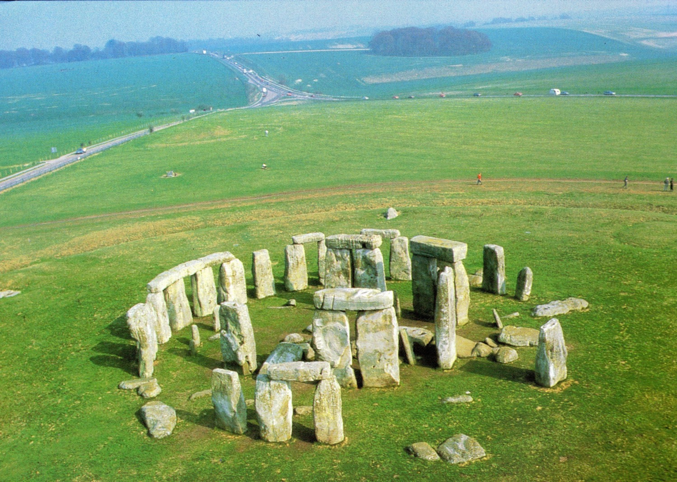
Notes:
Stonehenge
Wiltshire, England, Neolithic Europe
2500-1600 BCE
Sandstone

Slide 20
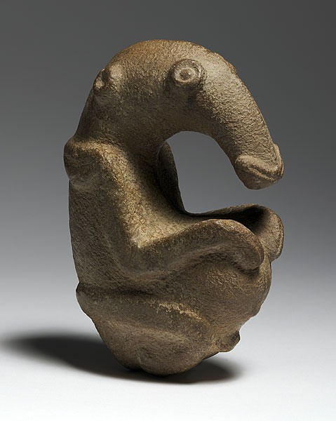
Notes:
The Ambum Stone
Ambum Valley
Papua New Guinea
C 1500 BCE
Greywacke

Slide 21
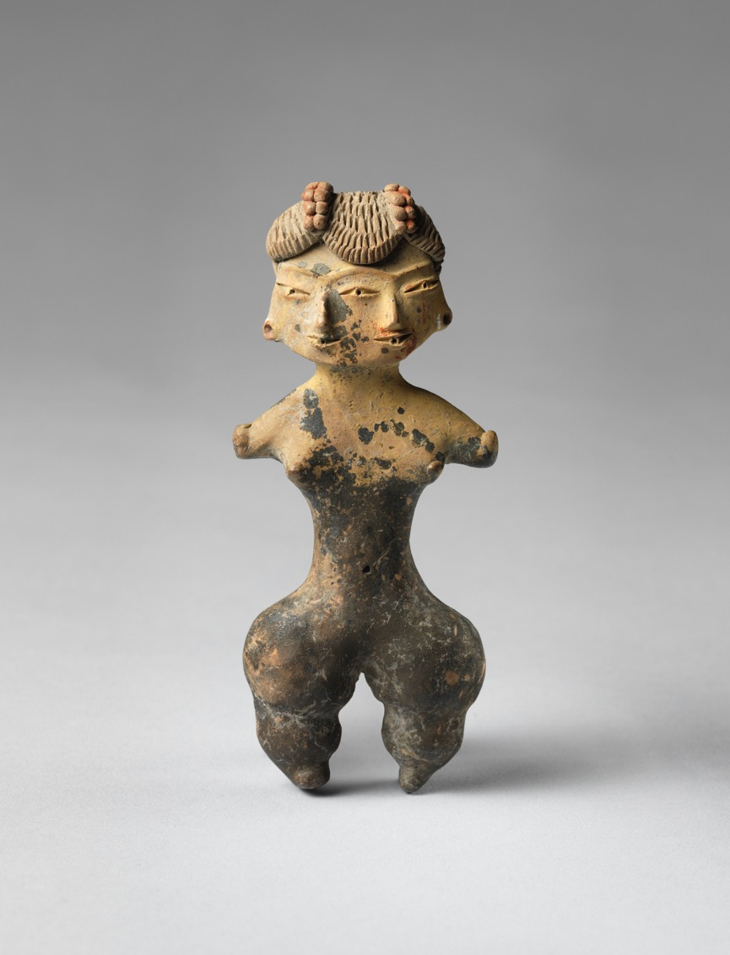
Notes:
Tiatilco female figurine
Central Mexico, site of Tiatilco
1200-900 BCE
Ceramic

Slide 22
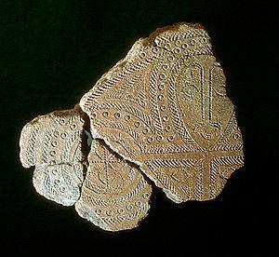
Notes:
Terra cotta fragment
Lapita, Solomon Islands, Reef Islands
1000 BCE
Terra cotta (incised)

Slide 23
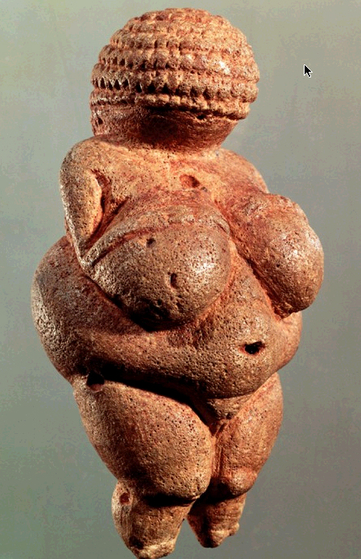
Notes:
Venus of Willendorf from Willendorf, Austria
ca. 28,000-25,000 B.C.E.
limestone
4 1/4 in. high

Slide 24
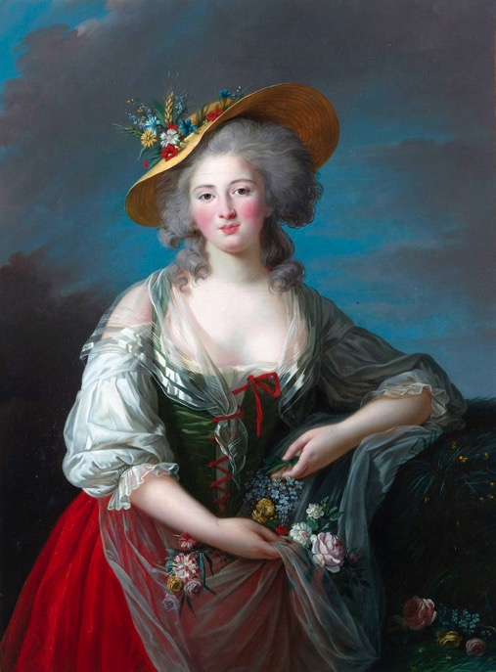
Notes:
L) Venus of Willendorf from Willendorf, Austria
ca. 28,000-25,000 B.C.E.
limestone
4 1/4 in. high
M) Elisabeth Vigee-Lebrun, Madame Elisabeth of France 1782
R) Rebellious Silence, from the Woman of Allah series. Shirin Neshat (artist) photo by Cynthia Preston. 1994 C.E. Ink on photograph

