Slide 1
Emphasis
contrast, isolation,
placement

Slide 2
contrast

Slide 3
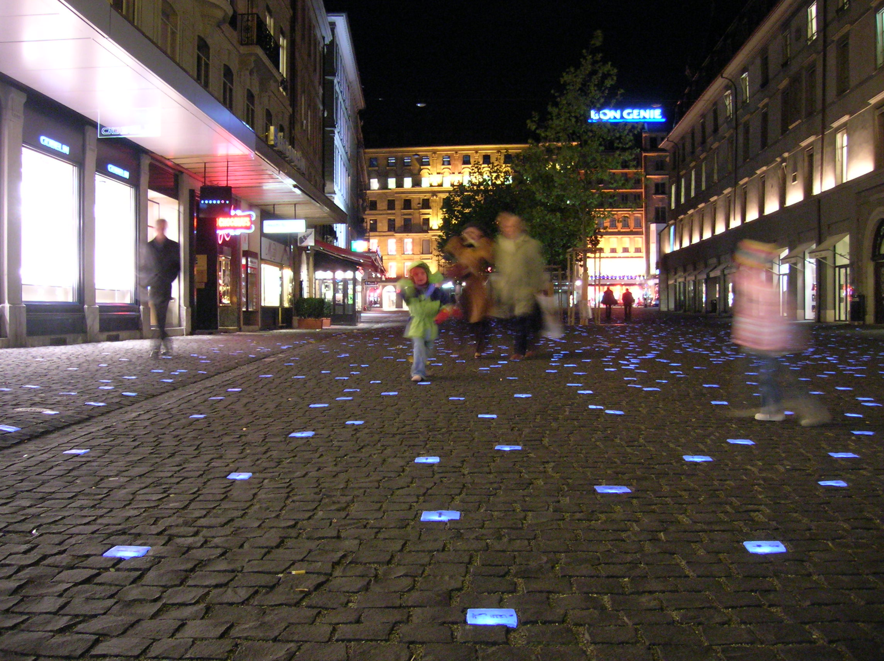

Slide 5
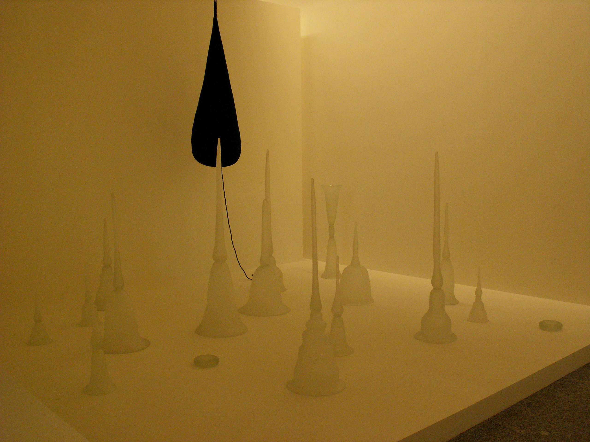

Slide 7
isolation

Slide 9
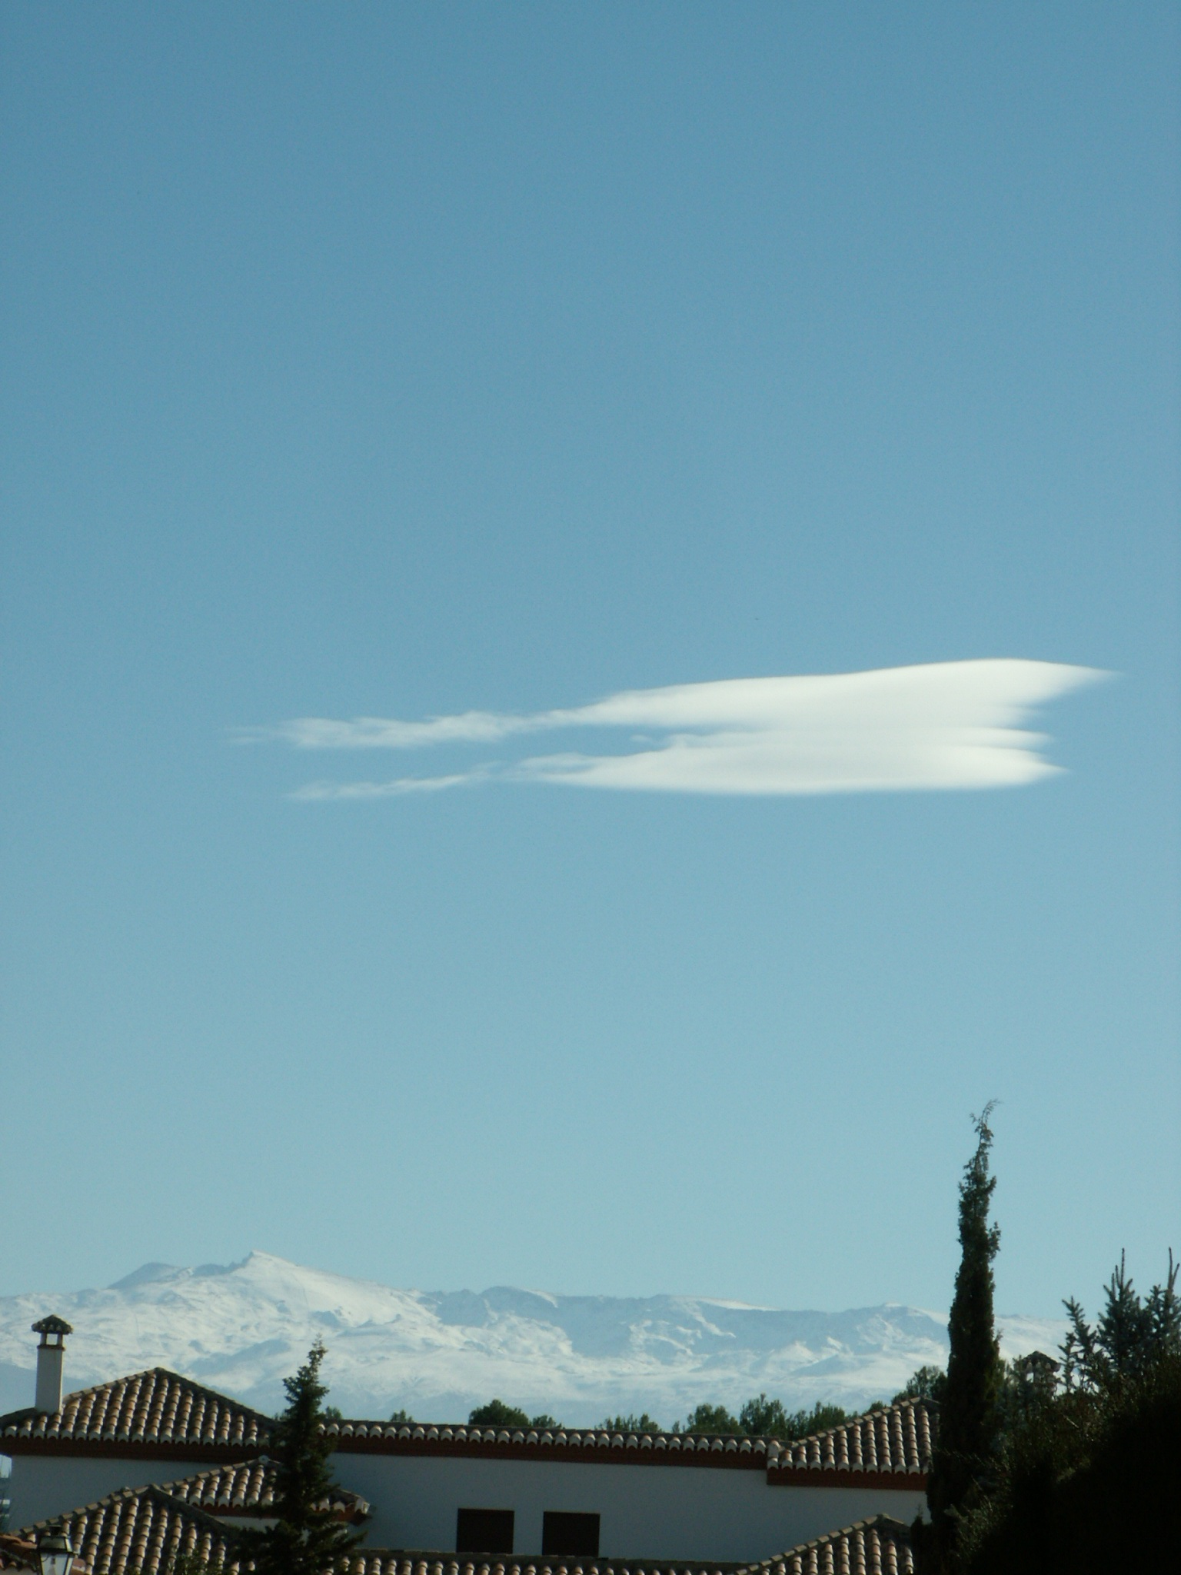

Slide 10
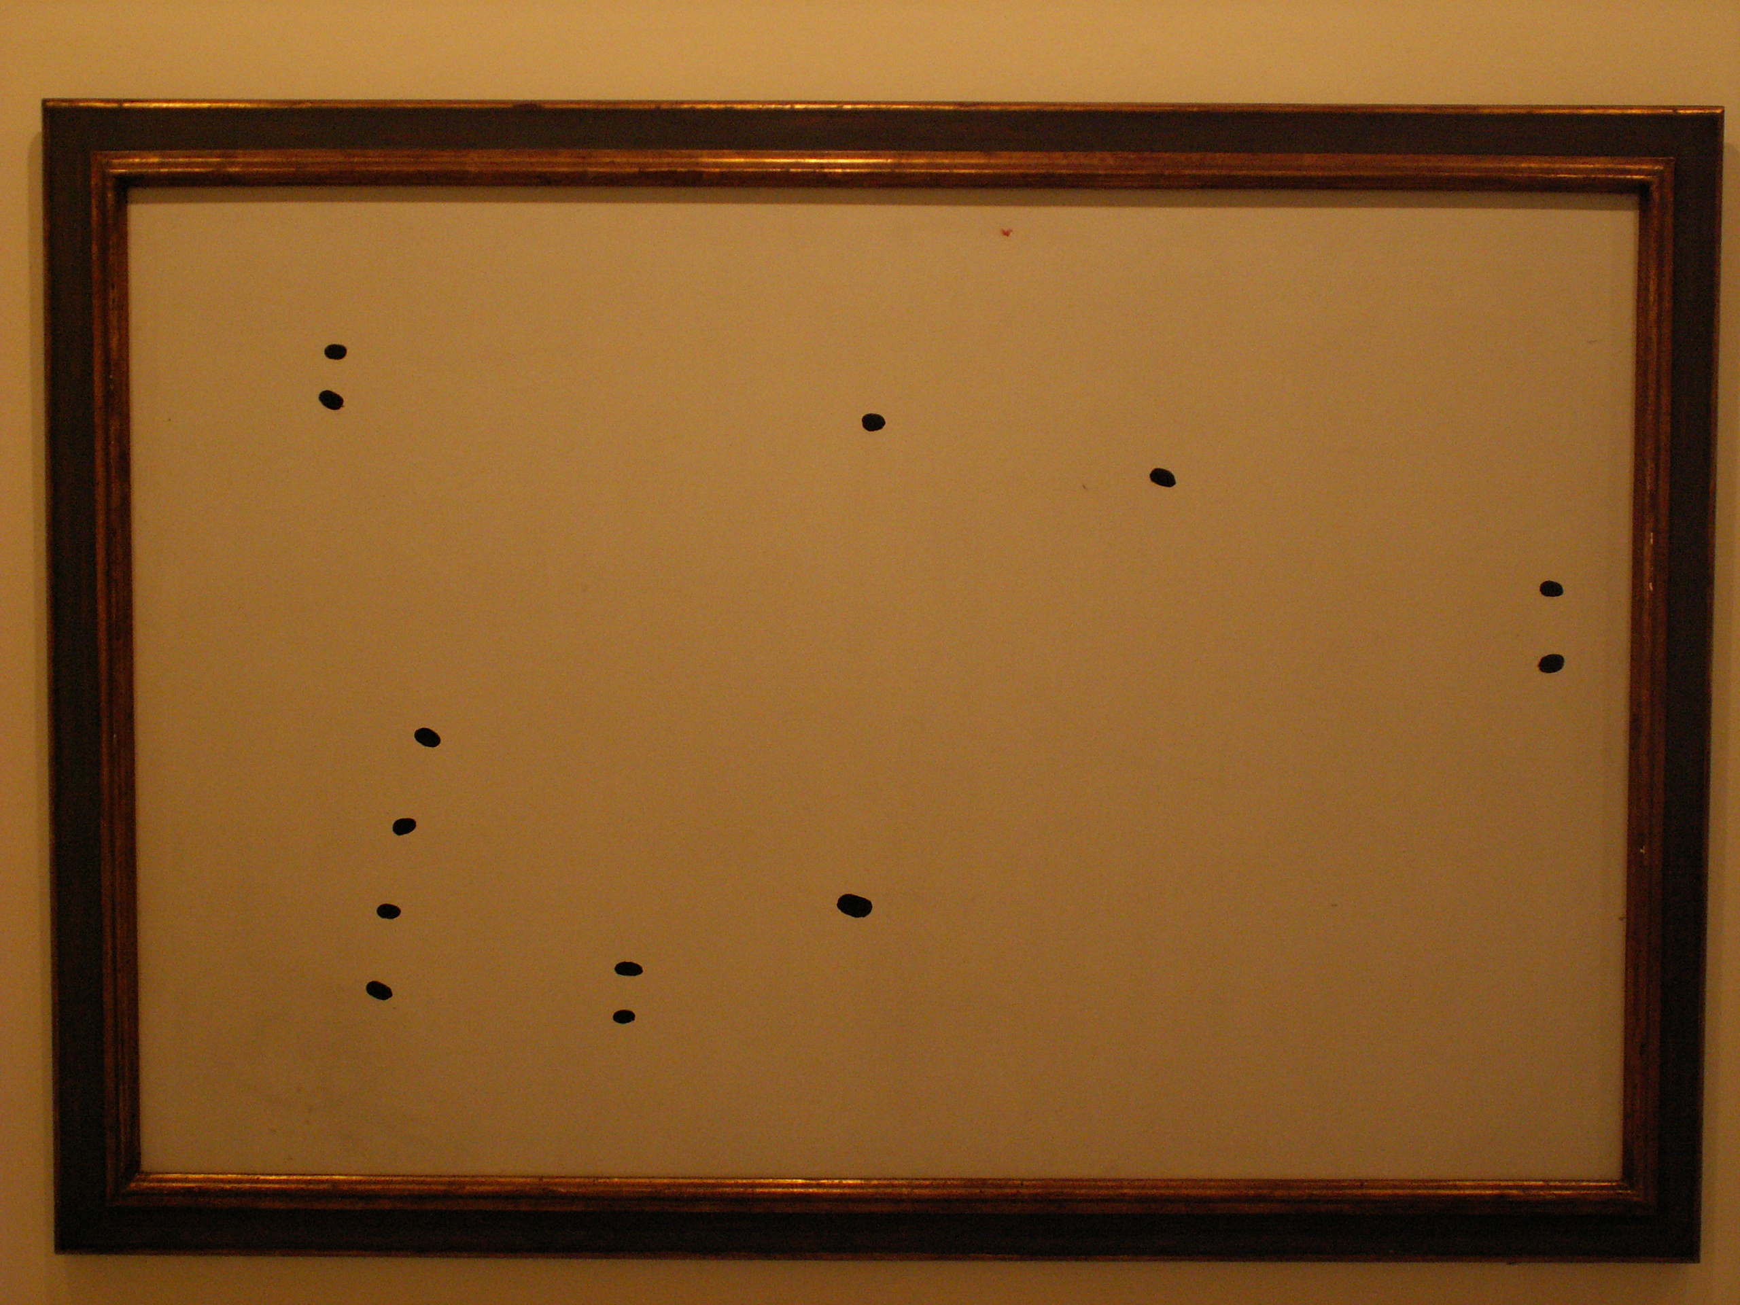

Slide 11
placement

Slide 13
