Slide 1
Still life composition
parts of a composition
Point of view
Light source
Number of objects
    Negative/positive space
Relationship of objects to each other
  Spacing between
  Overlapping & cropping
Use of space +, -

Slide 2
Building a composition-parts of

Slide 3
Line Direction

Slide 4
Line Direction

Slide 7
Line direction and depth

Slide 8
Shape relationships

Slide 9
Shape relationships

Slide 10
Shape relationships

Slide 11
cropping

Slide 12
depth

Slide 13
depth

Slide 14
depth

Slide 15
Still life composition
Point of view

Slide 16
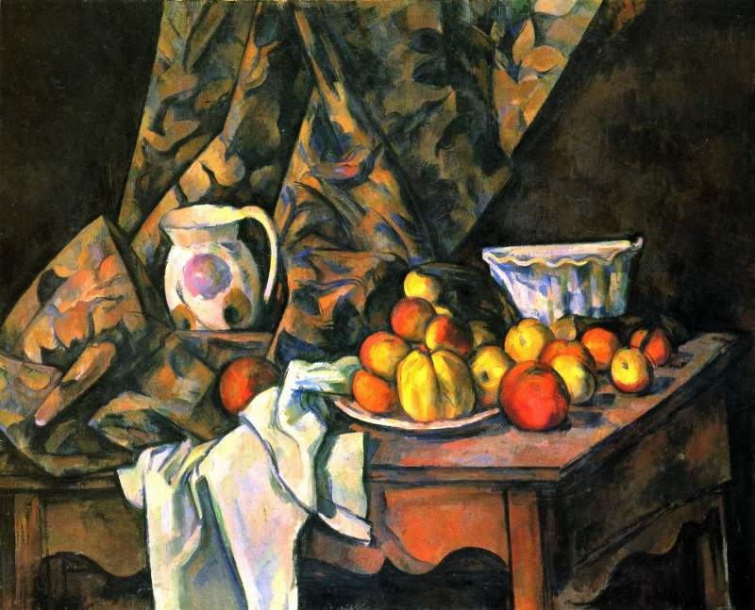
Point of View-farther away

Slide 17
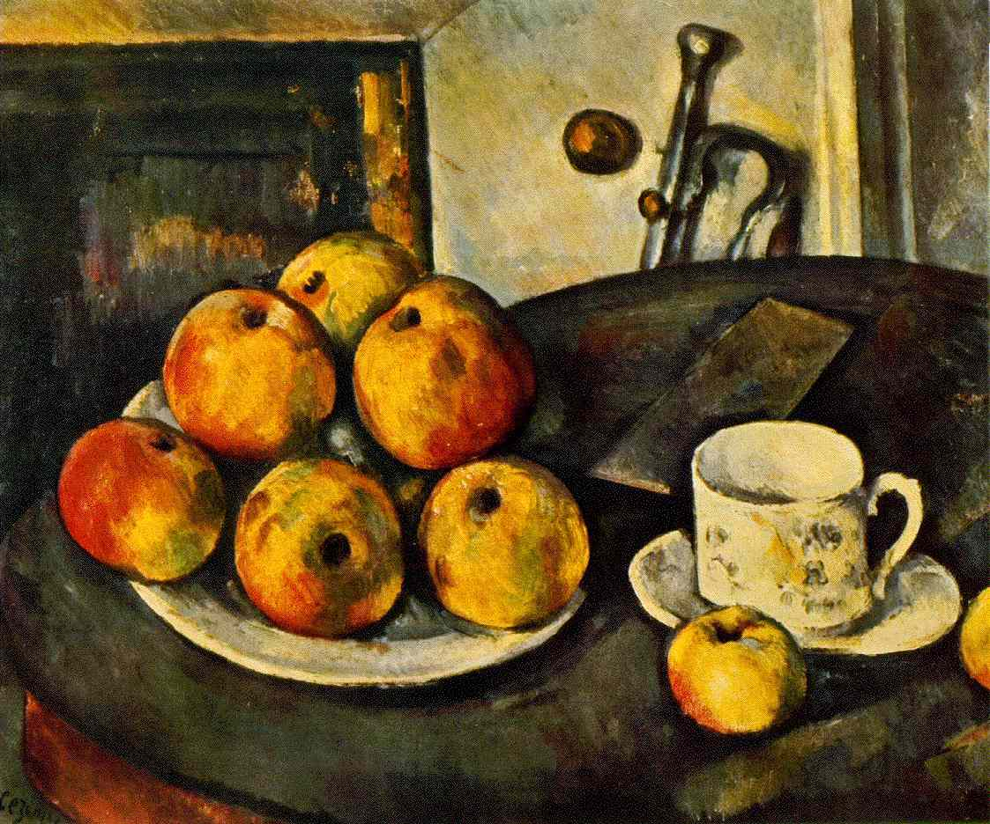
Point of View-close in

Slide 18
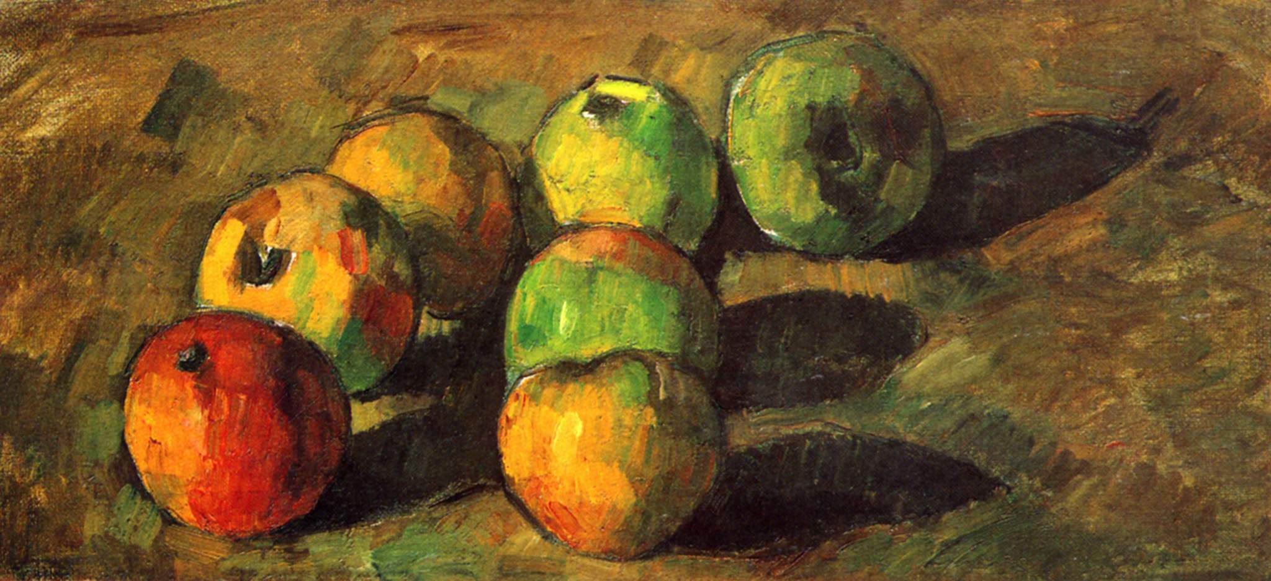
Point of View-very close in

Slide 19
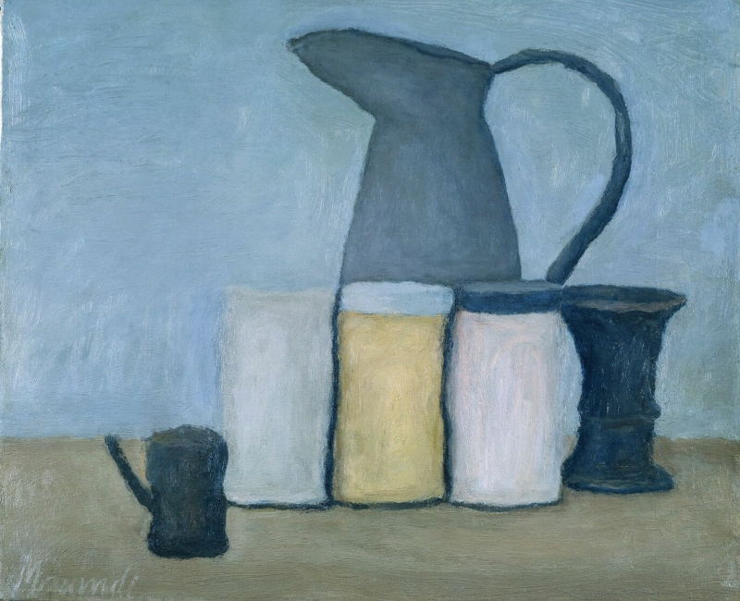
Point of View-eye level and up close

Slide 20
Still life composition
Light Source

Slide 21
Light Source – indirect, muted

Slide 22
Light Source – strong, directional

Slide 23
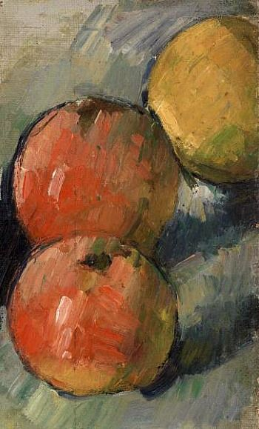

Slide 24
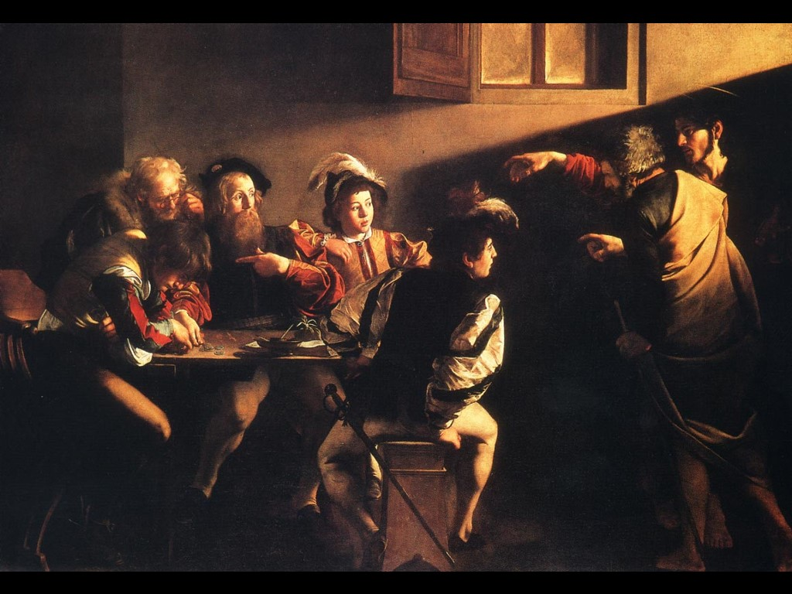
Light Source – very strong, directional

Slide 25
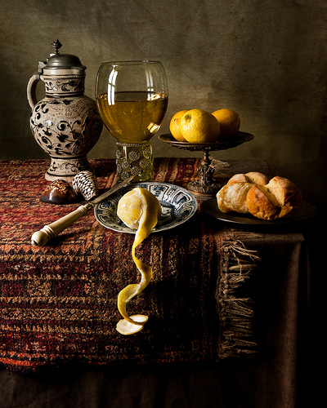
Light source-defined

Slide 26
Still life composition
Number of Objects

Slide 27
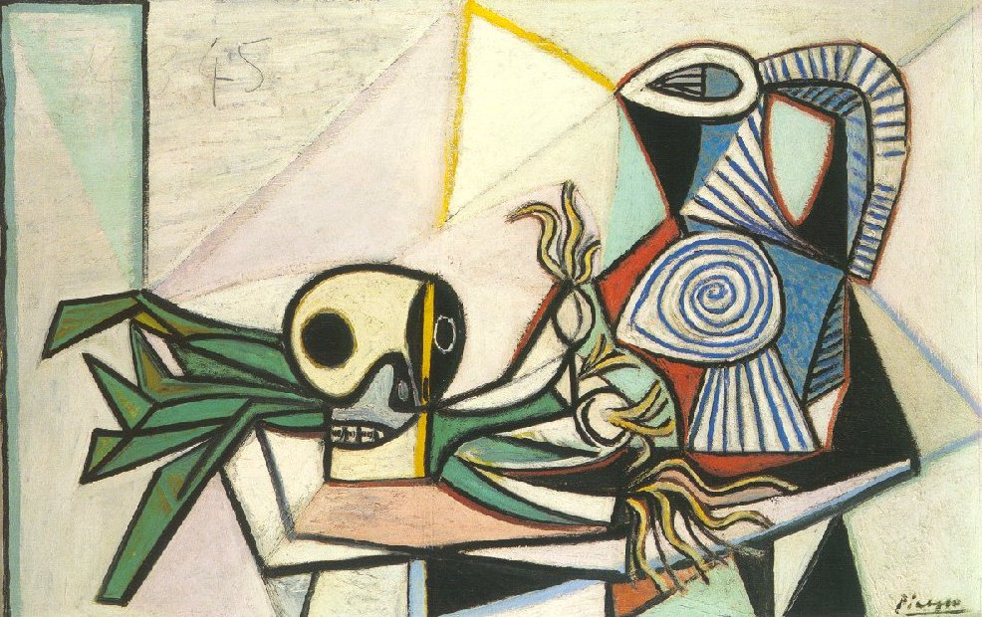
Number of objects-two or three only

Slide 28
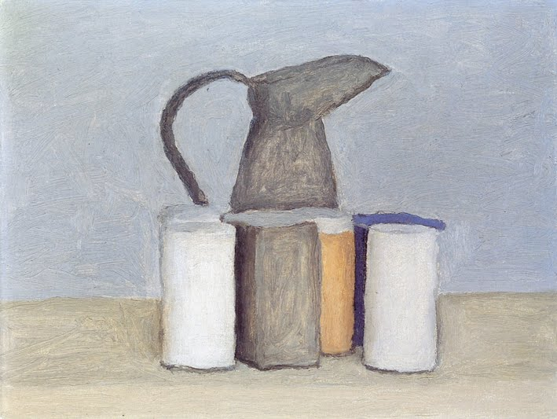
Few Objects

Slide 29
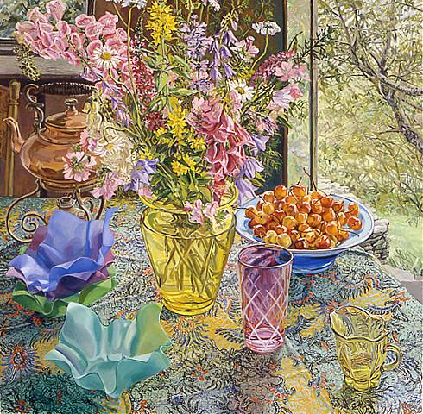
Number of objects-many objects

Slide 30
Still life composition
Use of Space + & -

Slide 31
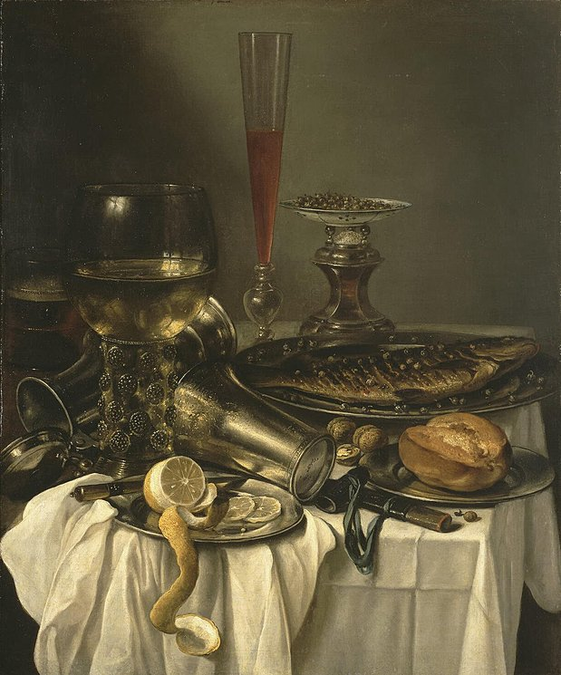
Negative space
negative space- a lot

Slide 32
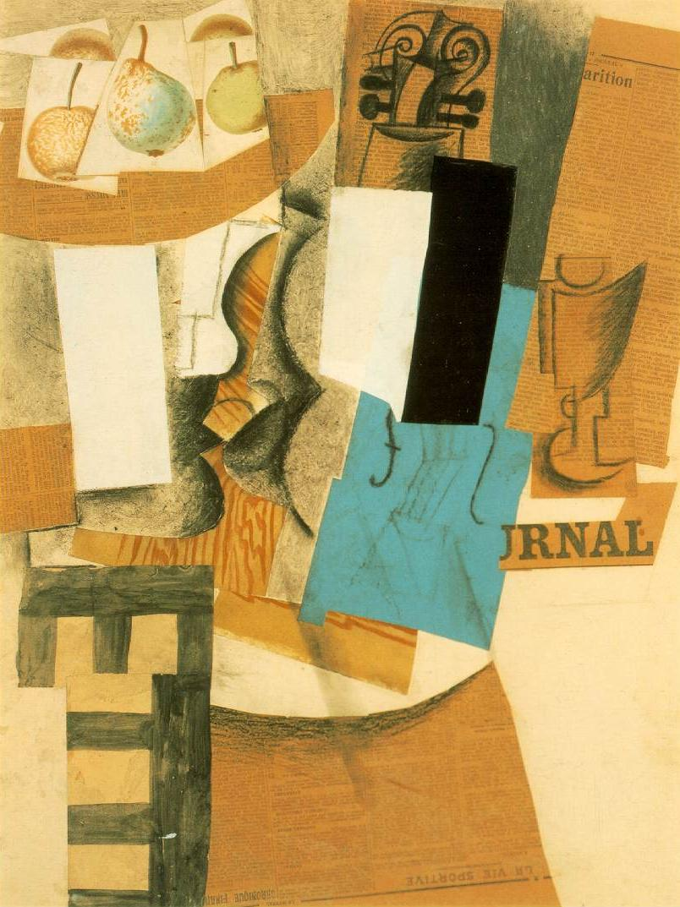
Negative space
negative space- a little

Slide 33
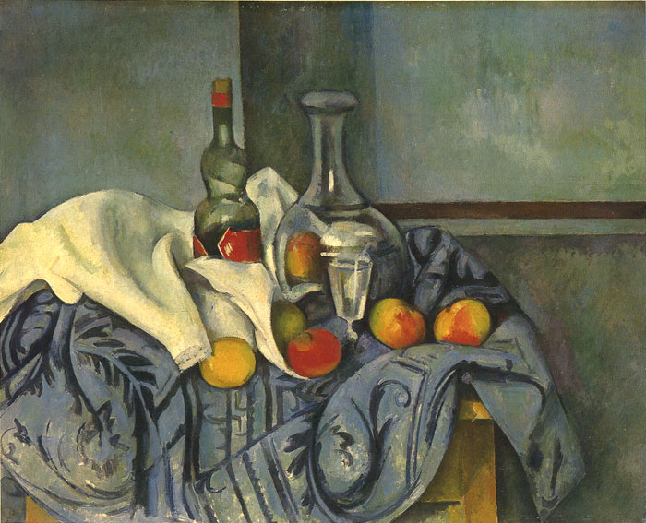
Horizon line-single

Slide 34
Still life composition
Creating Space-Horizon Line

Slide 35
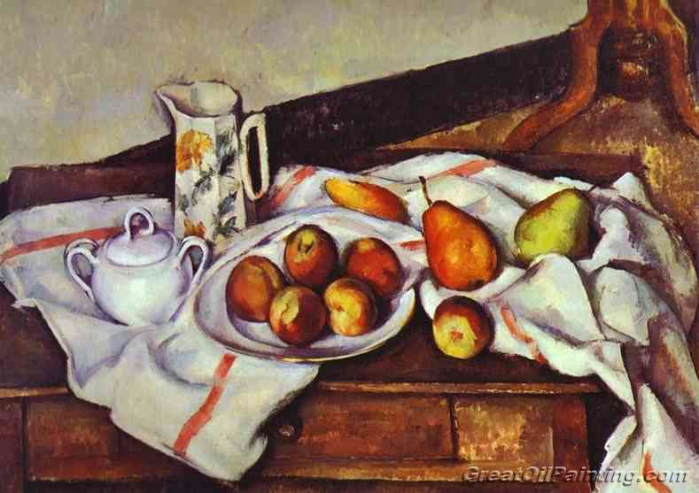
Horizon line

Slide 36
Horizon line-horizontal and diagonal

Slide 37
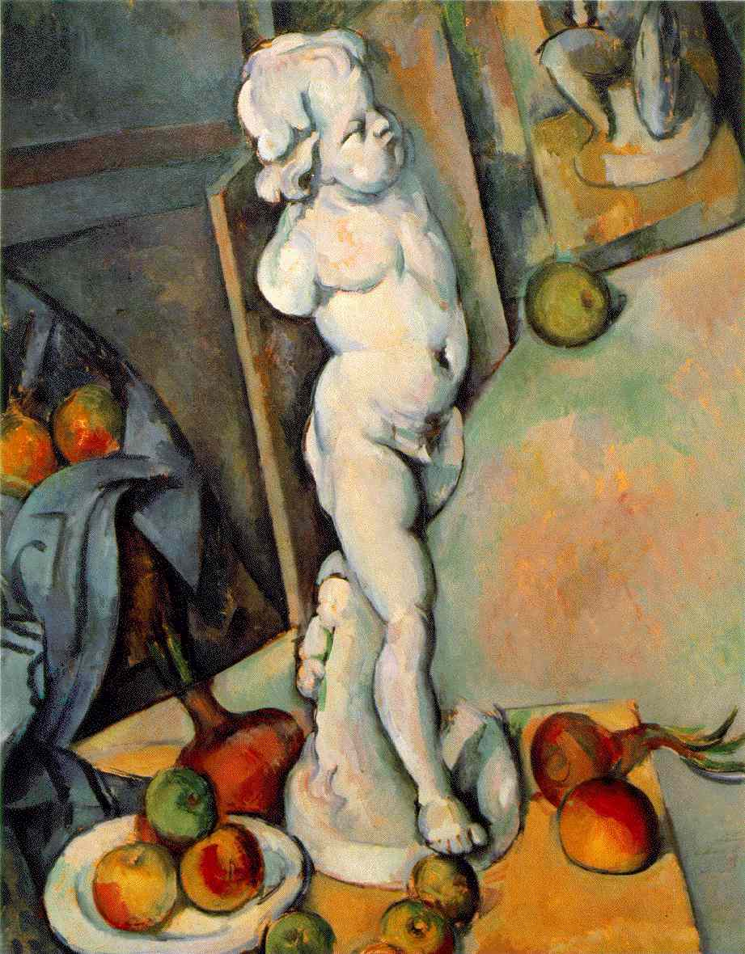
Directional Lines-numerous

Slide 38
Directional Lines-numerous

Slide 39
Still life composition
Objects cropped

Slide 40
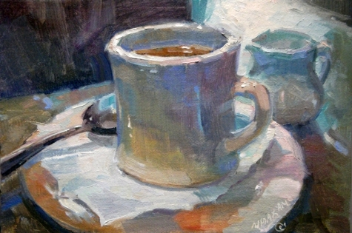
Negative space
Objects cropped

Slide 41
Cropping

Slide 42
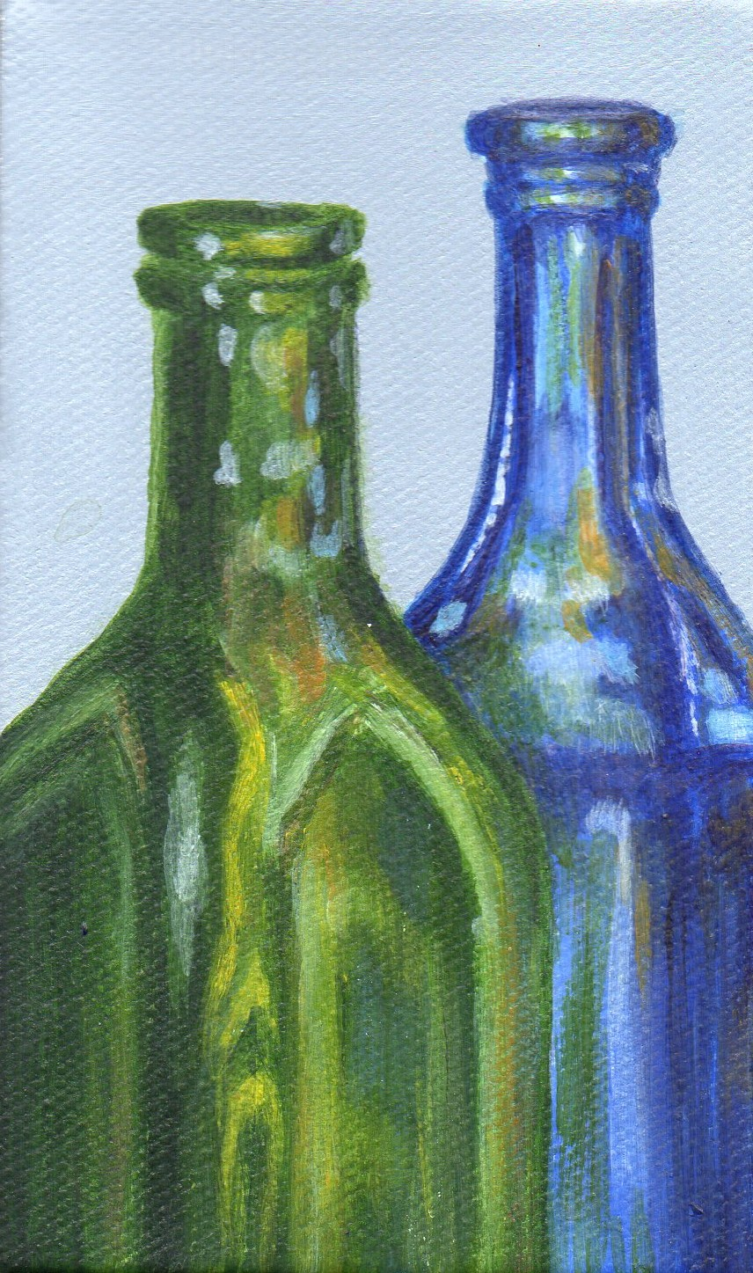
Cropping

Slide 43
No Cropping

Slide 44
Still life composition
Objects’ relationship to each other

Slide 45
Objects clustered with lots of (continuous) negative space

Slide 46
Objects spread out

Slide 47
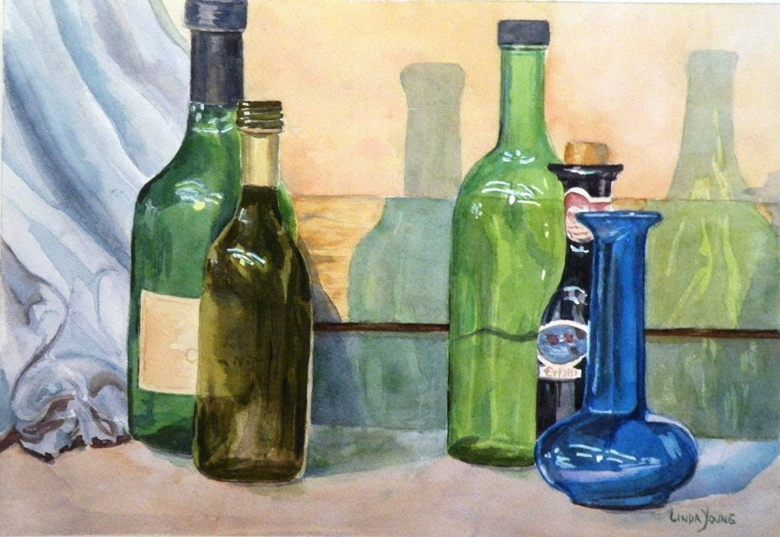
Groups of objects with negative space broken up

