Slide 1
Representational/Realism/Naturalism-portraying a subject-its color, form, space-as it would actually appear in nature

Slide 2
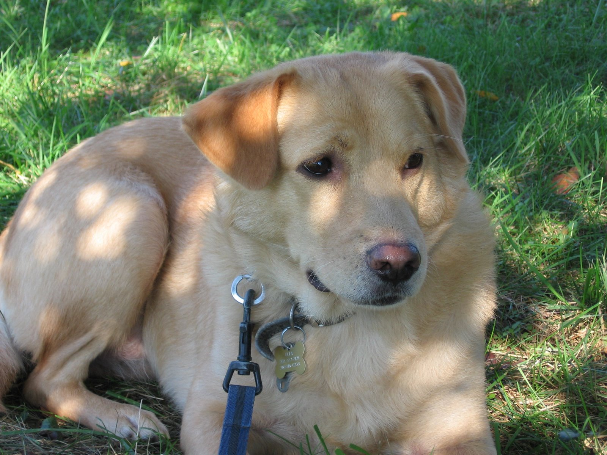
Figure Represented without alteration

Slide 3
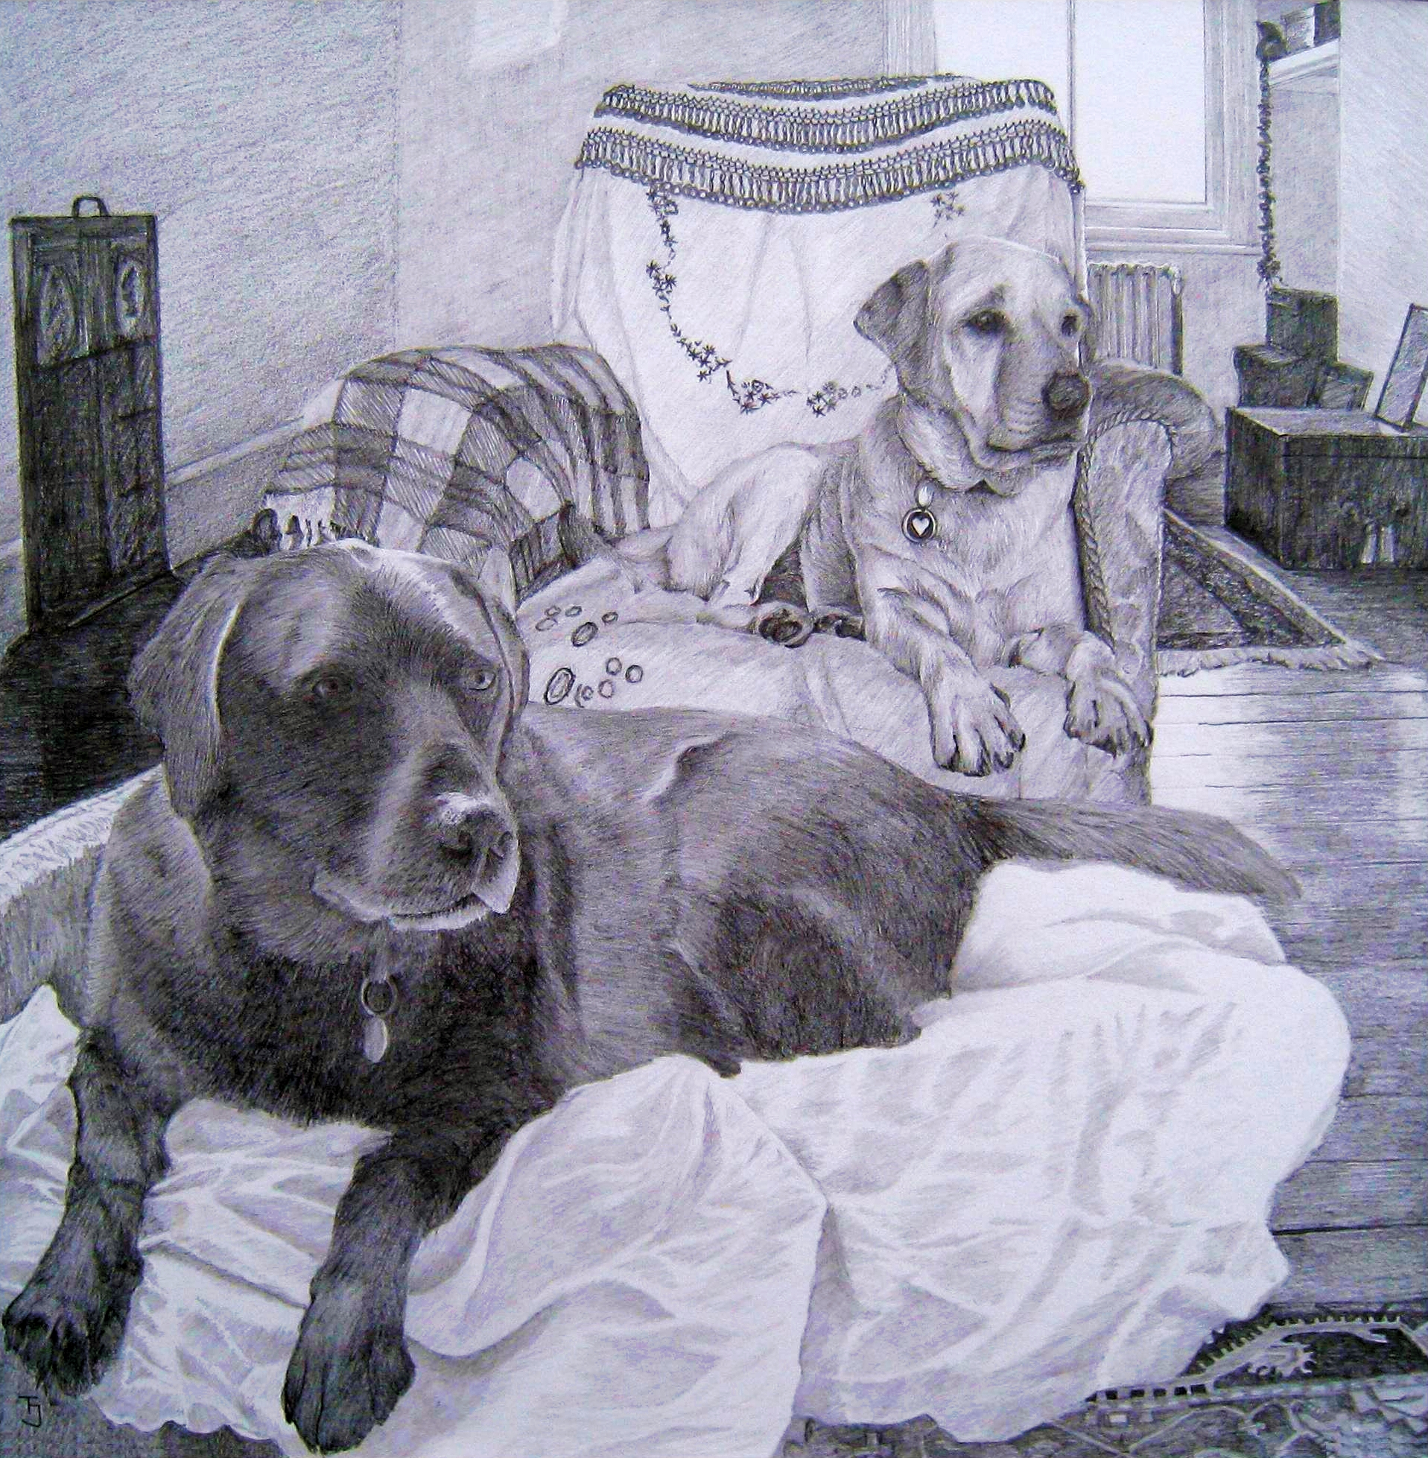
Figure Represented without alteration

Slide 4
Abstract art-art that is made based on a subject’s general qualities as opposed to its concrete characteristics

Slide 5
Figure Directly Represented

Slide 6
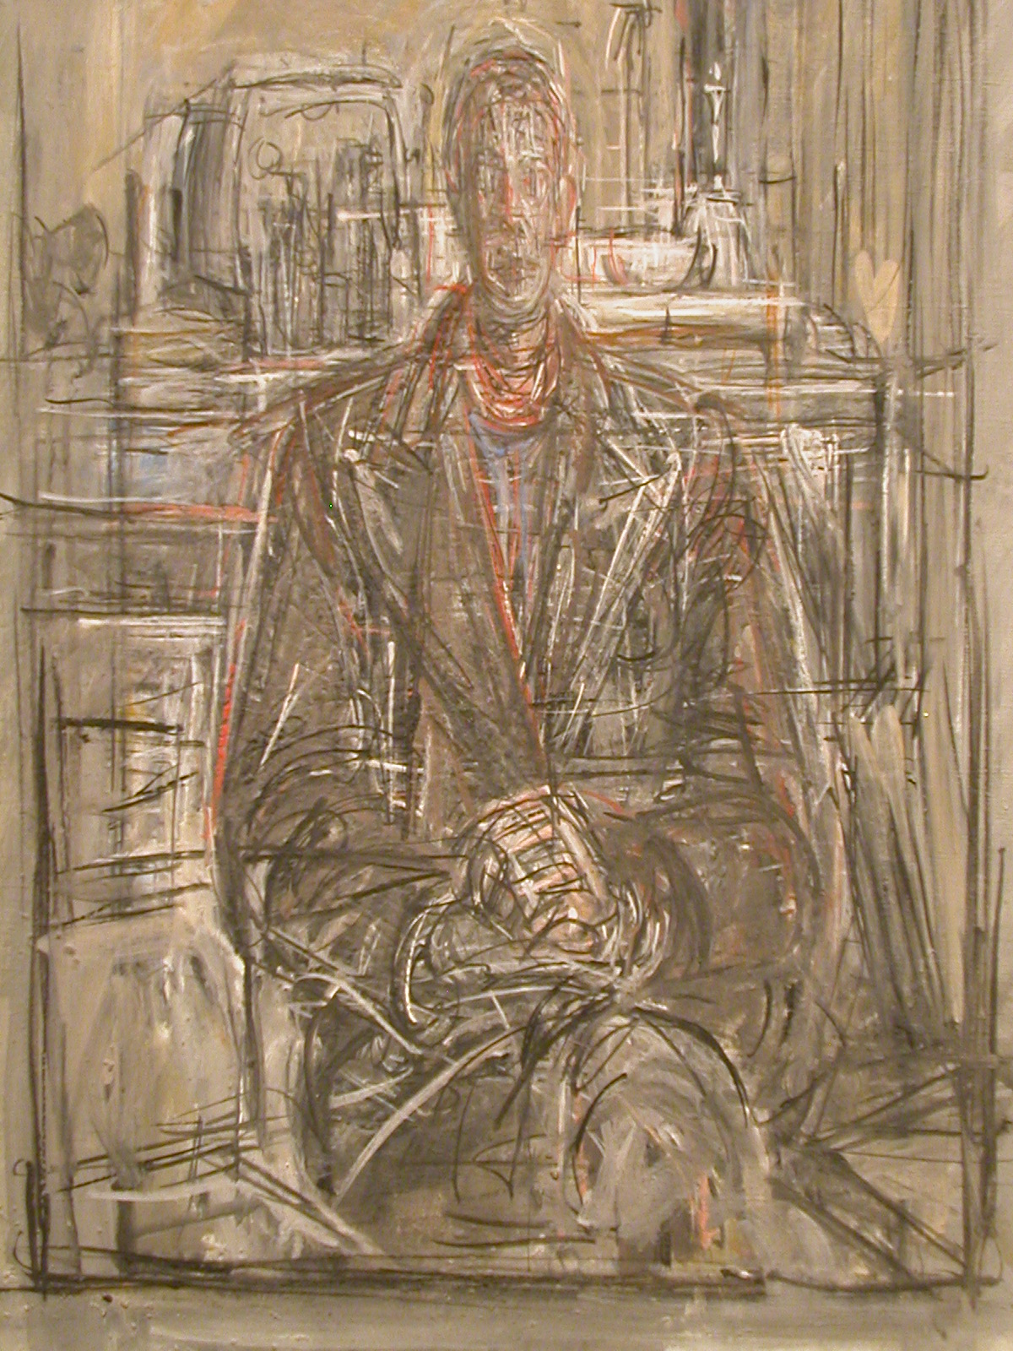
Figure Abstracted

Slide 7
Non Representational Art-
art that portrays something (object, idea, etc) in such a way that there is no recognizable sense of the actual physical qualities of the object

Slide 8
