Slide 1
Art Foundation -Comic strip

Slide 2
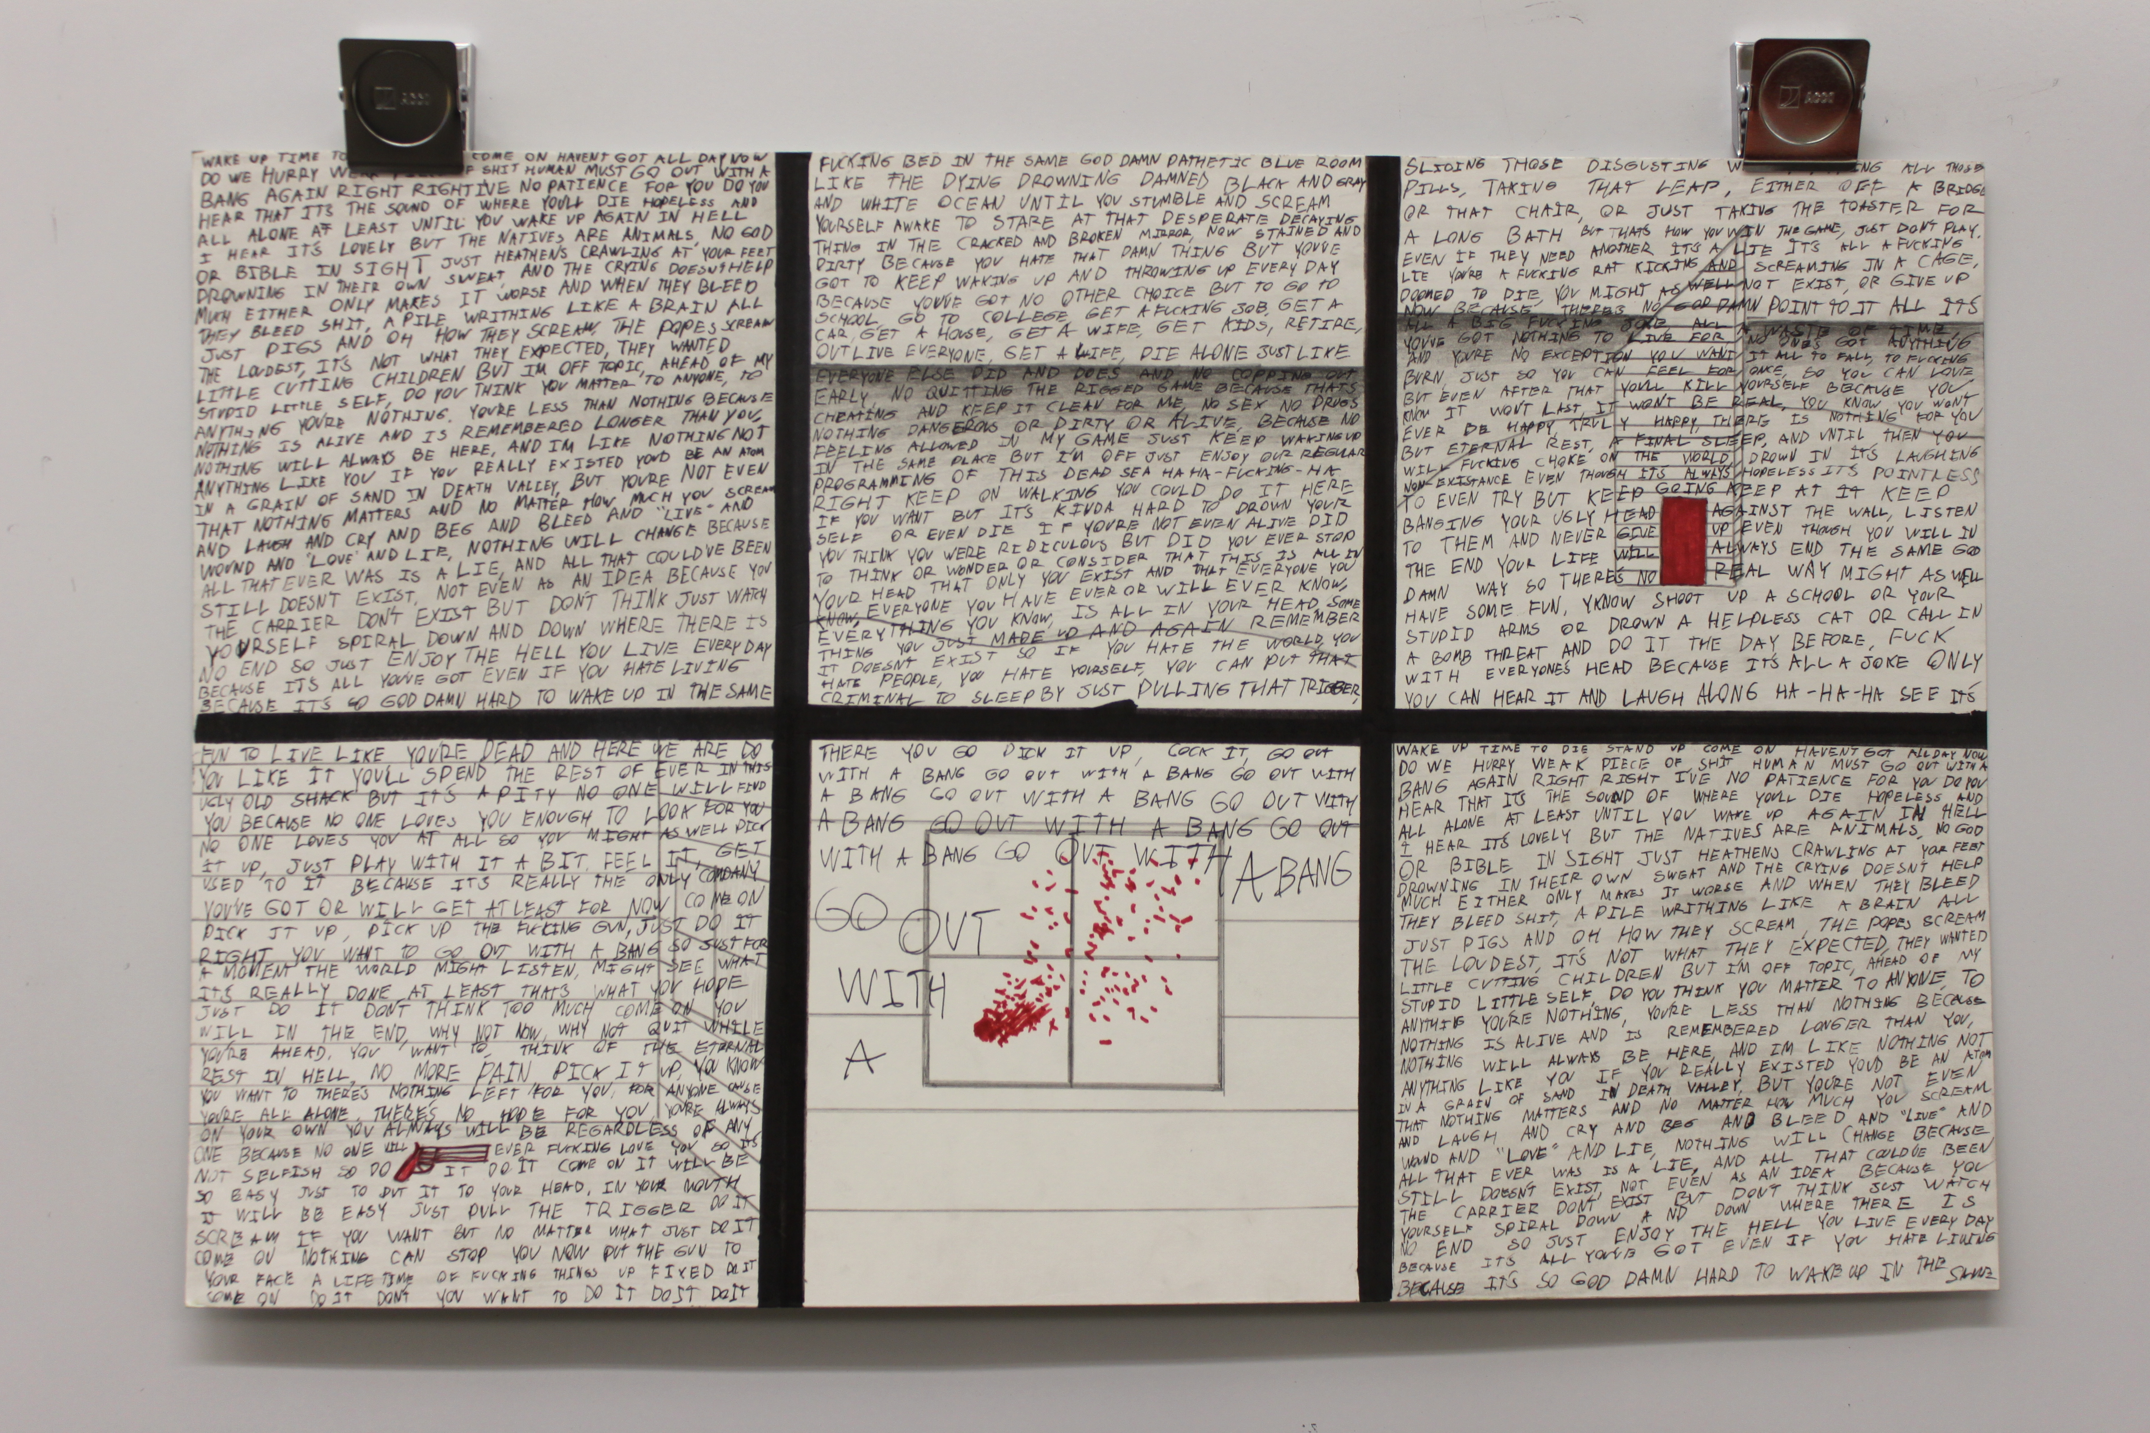

Slide 3
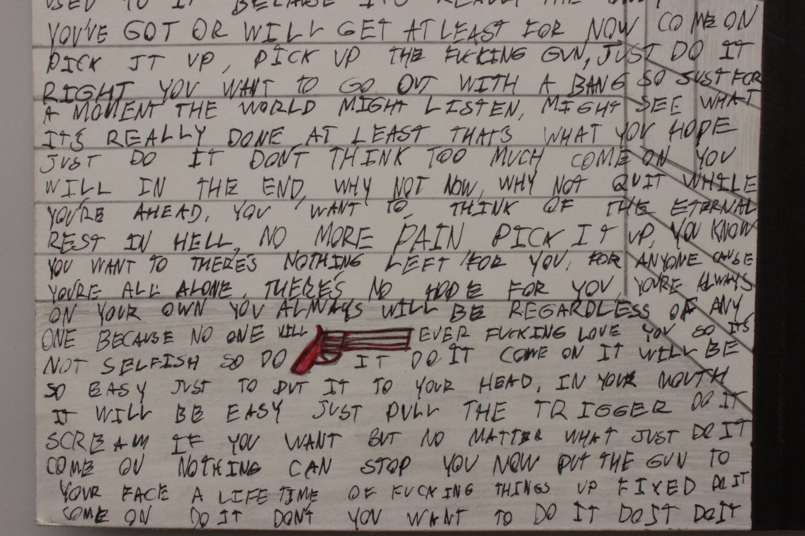

Slide 4
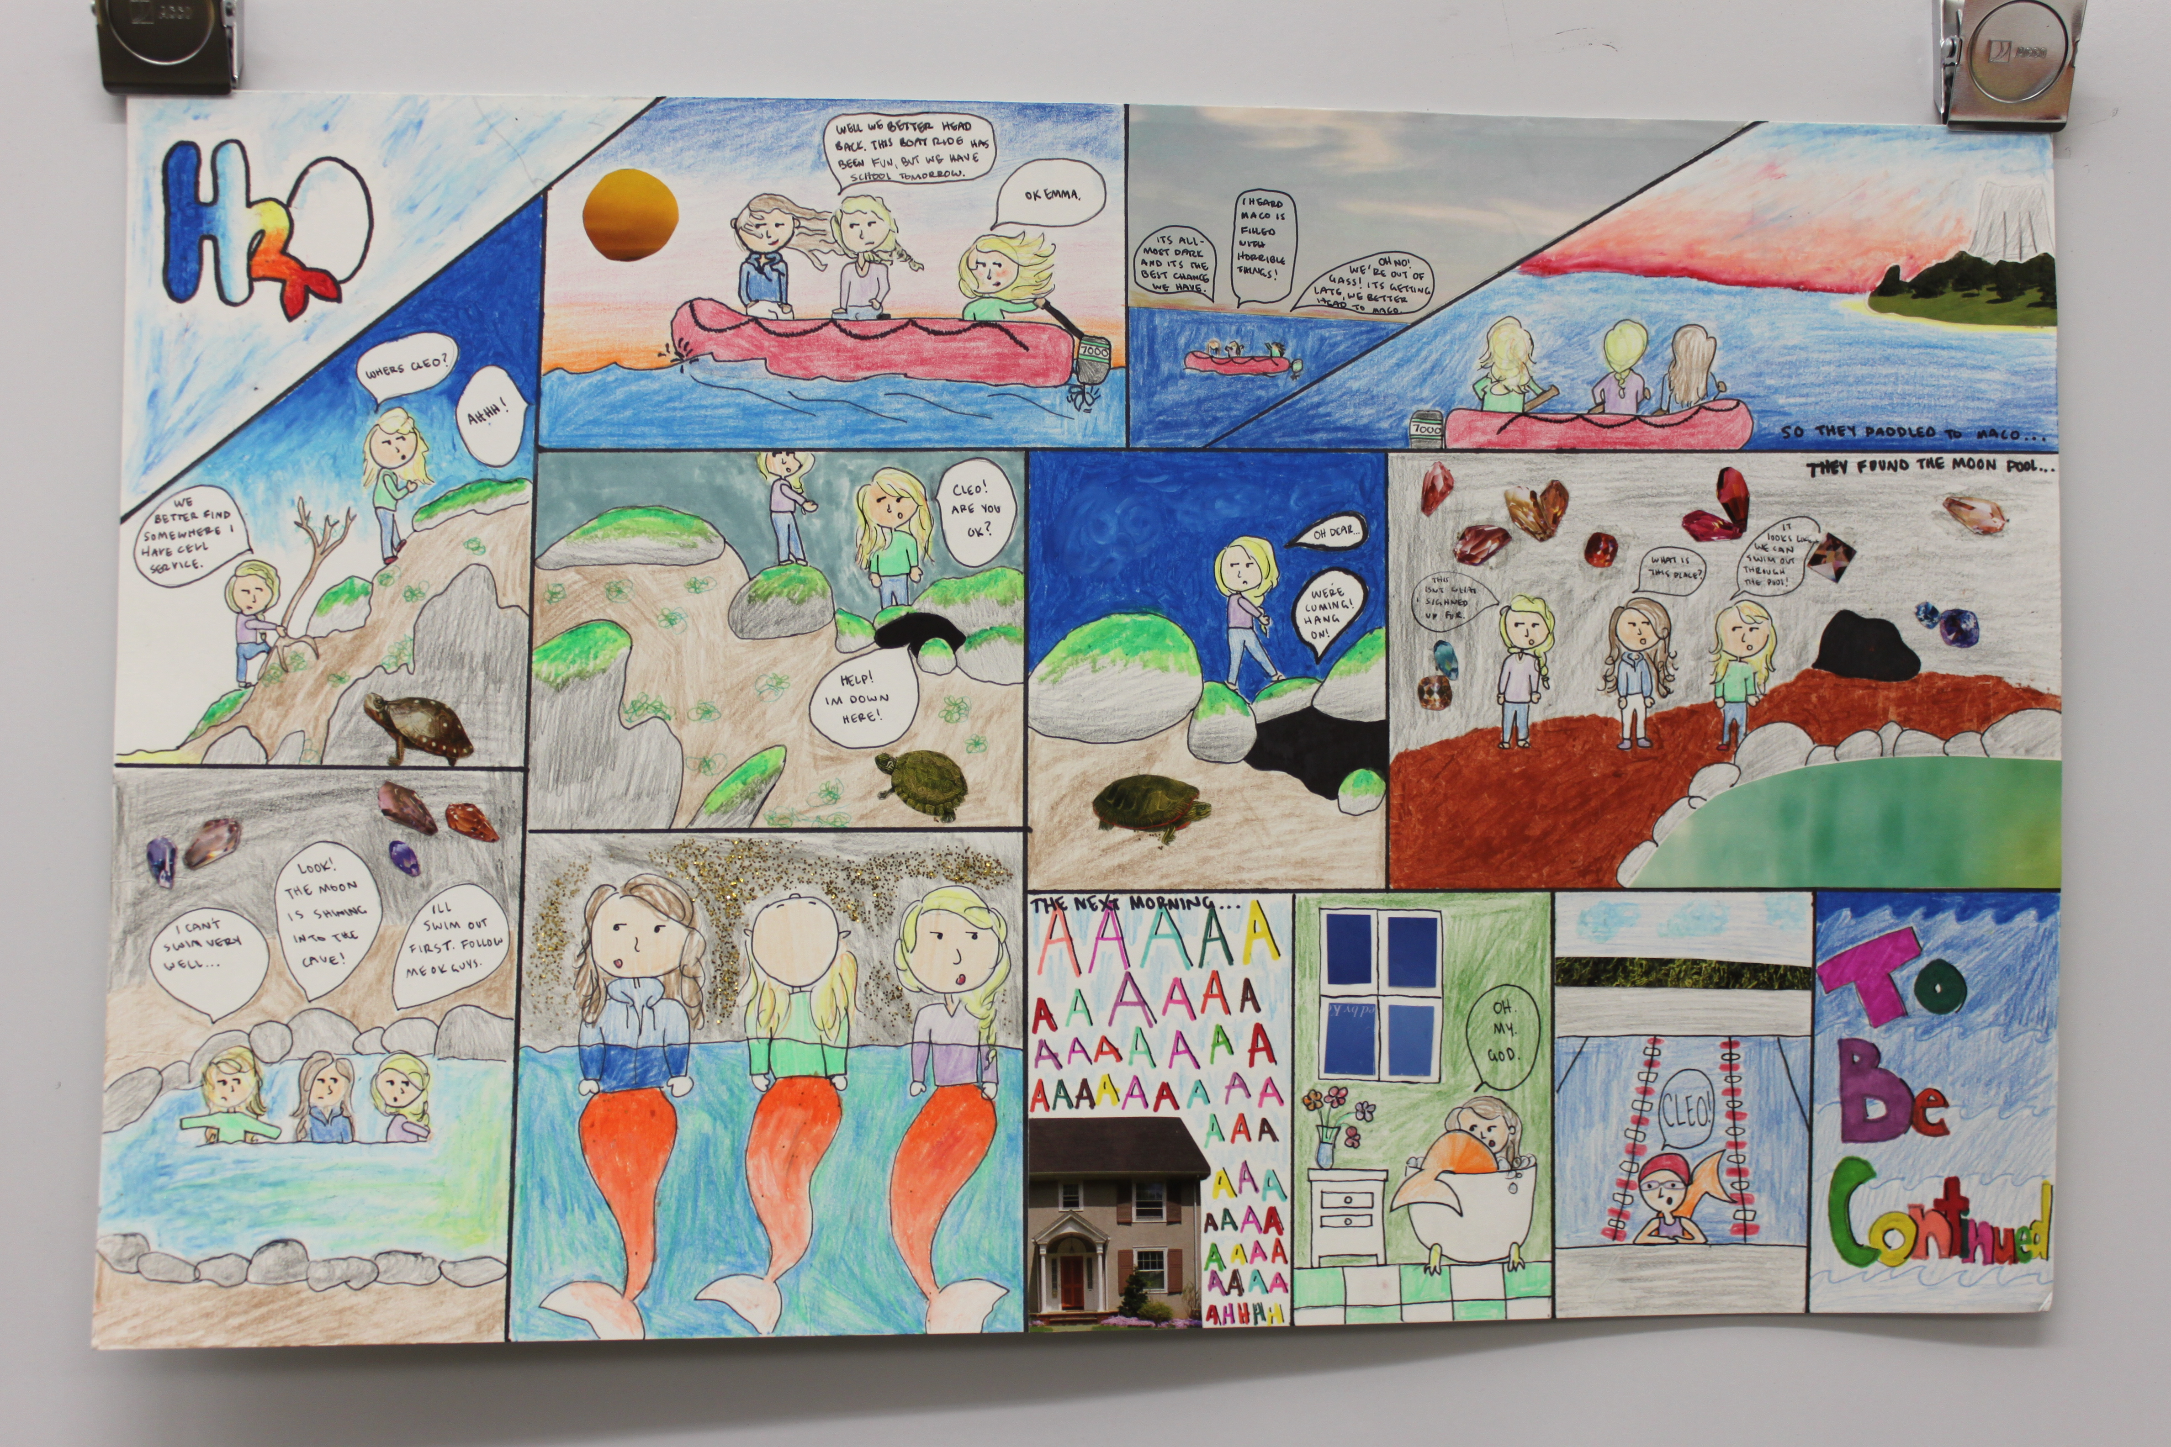
Very strong work
Full of information-color, words, images; storyline is evident; obvious time and effort

Slide 5
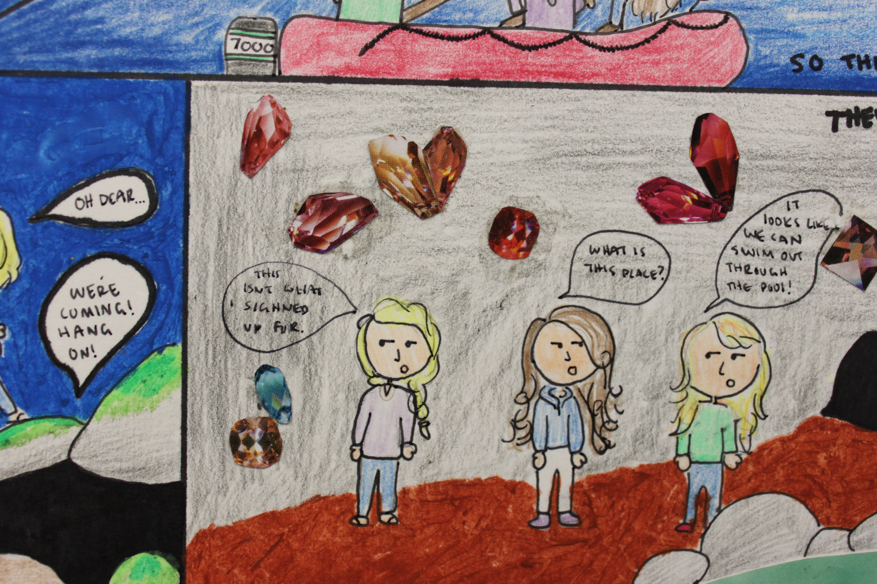
Detail from previous image

Slide 6
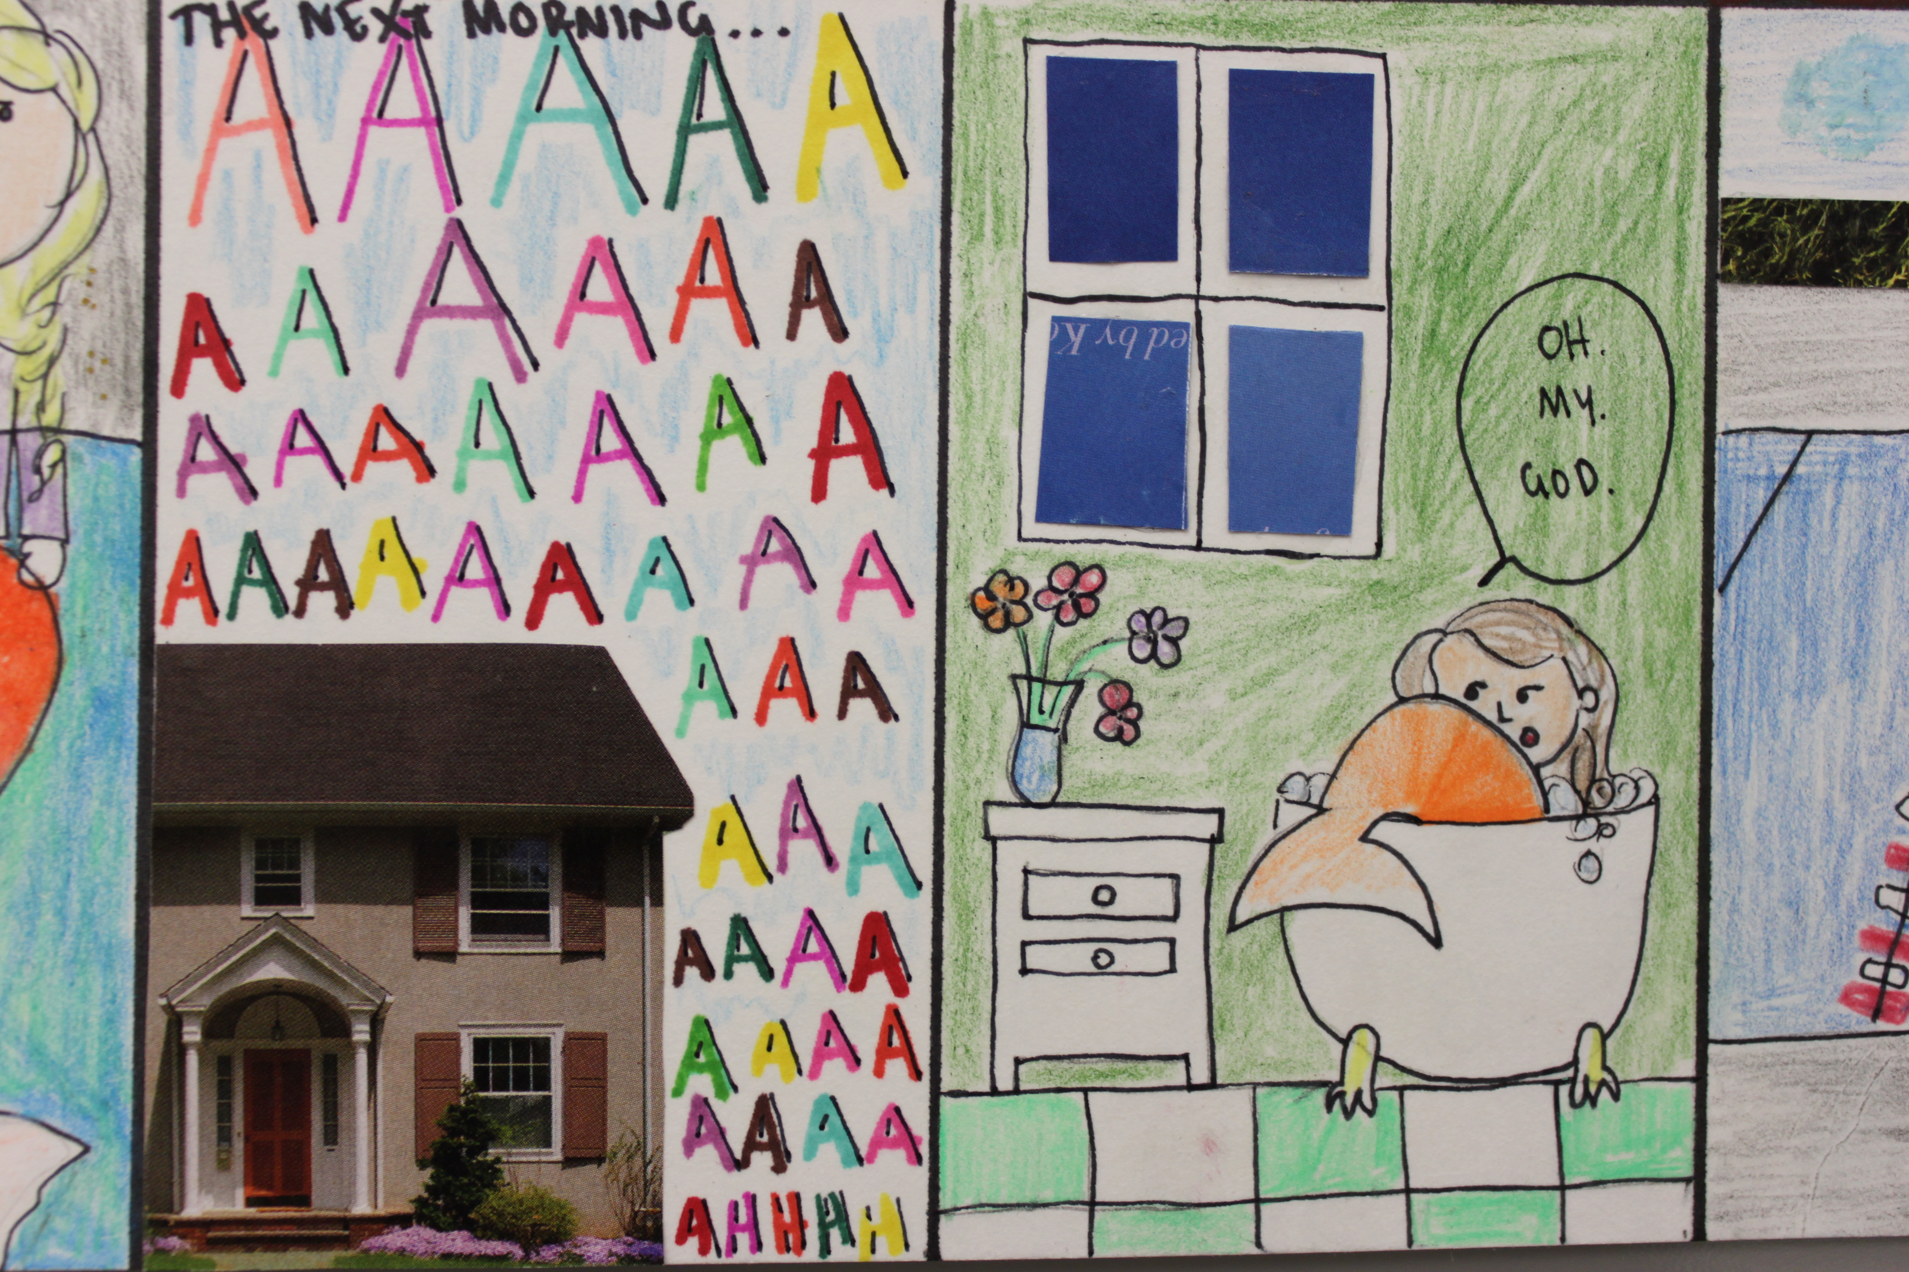

Slide 7
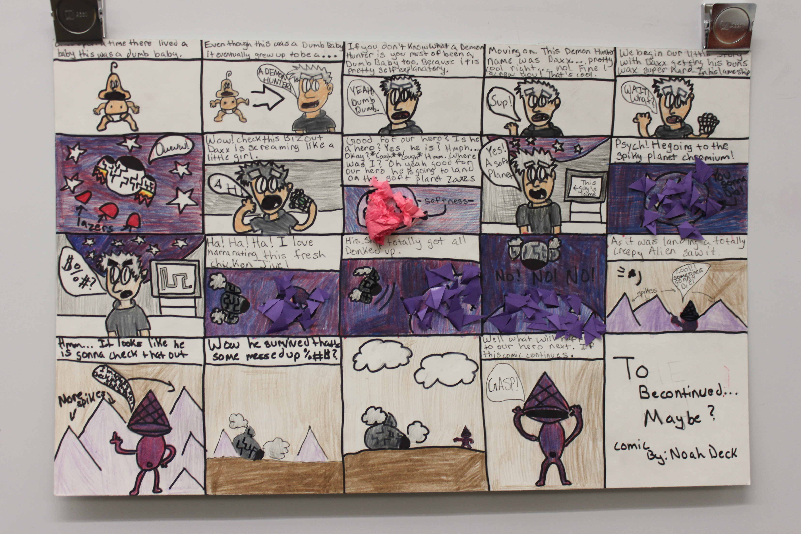
Very strong work
Full of information-color, words, images; storyline is evident; obvious time and effort

Slide 8
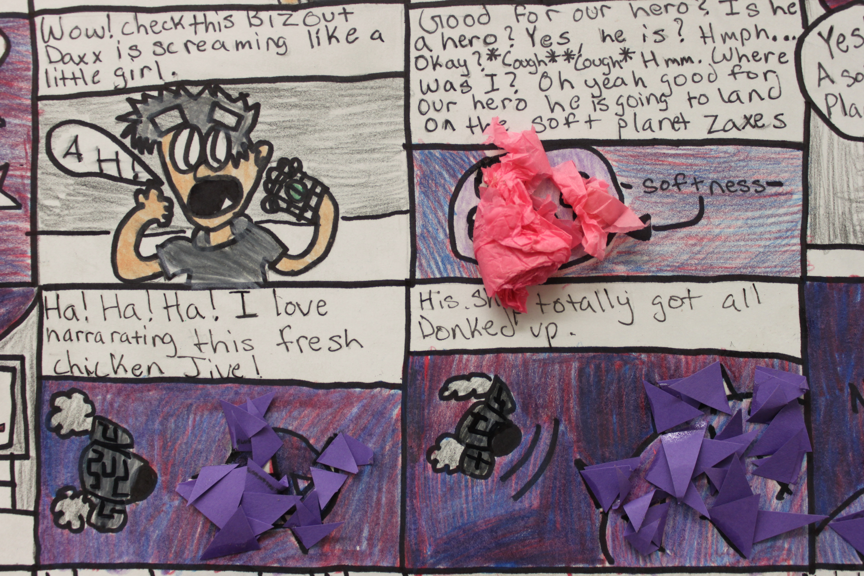
Detail from previous image

Slide 9
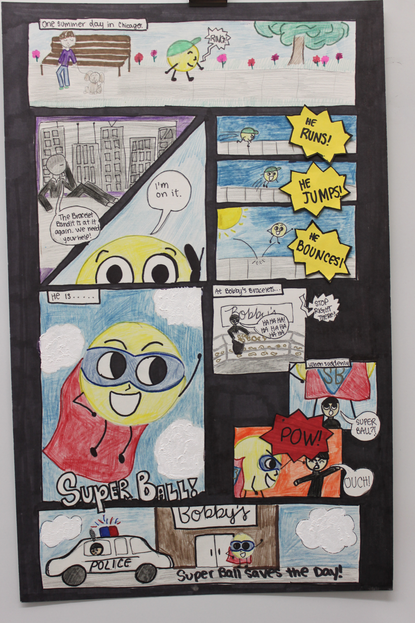

Slide 10
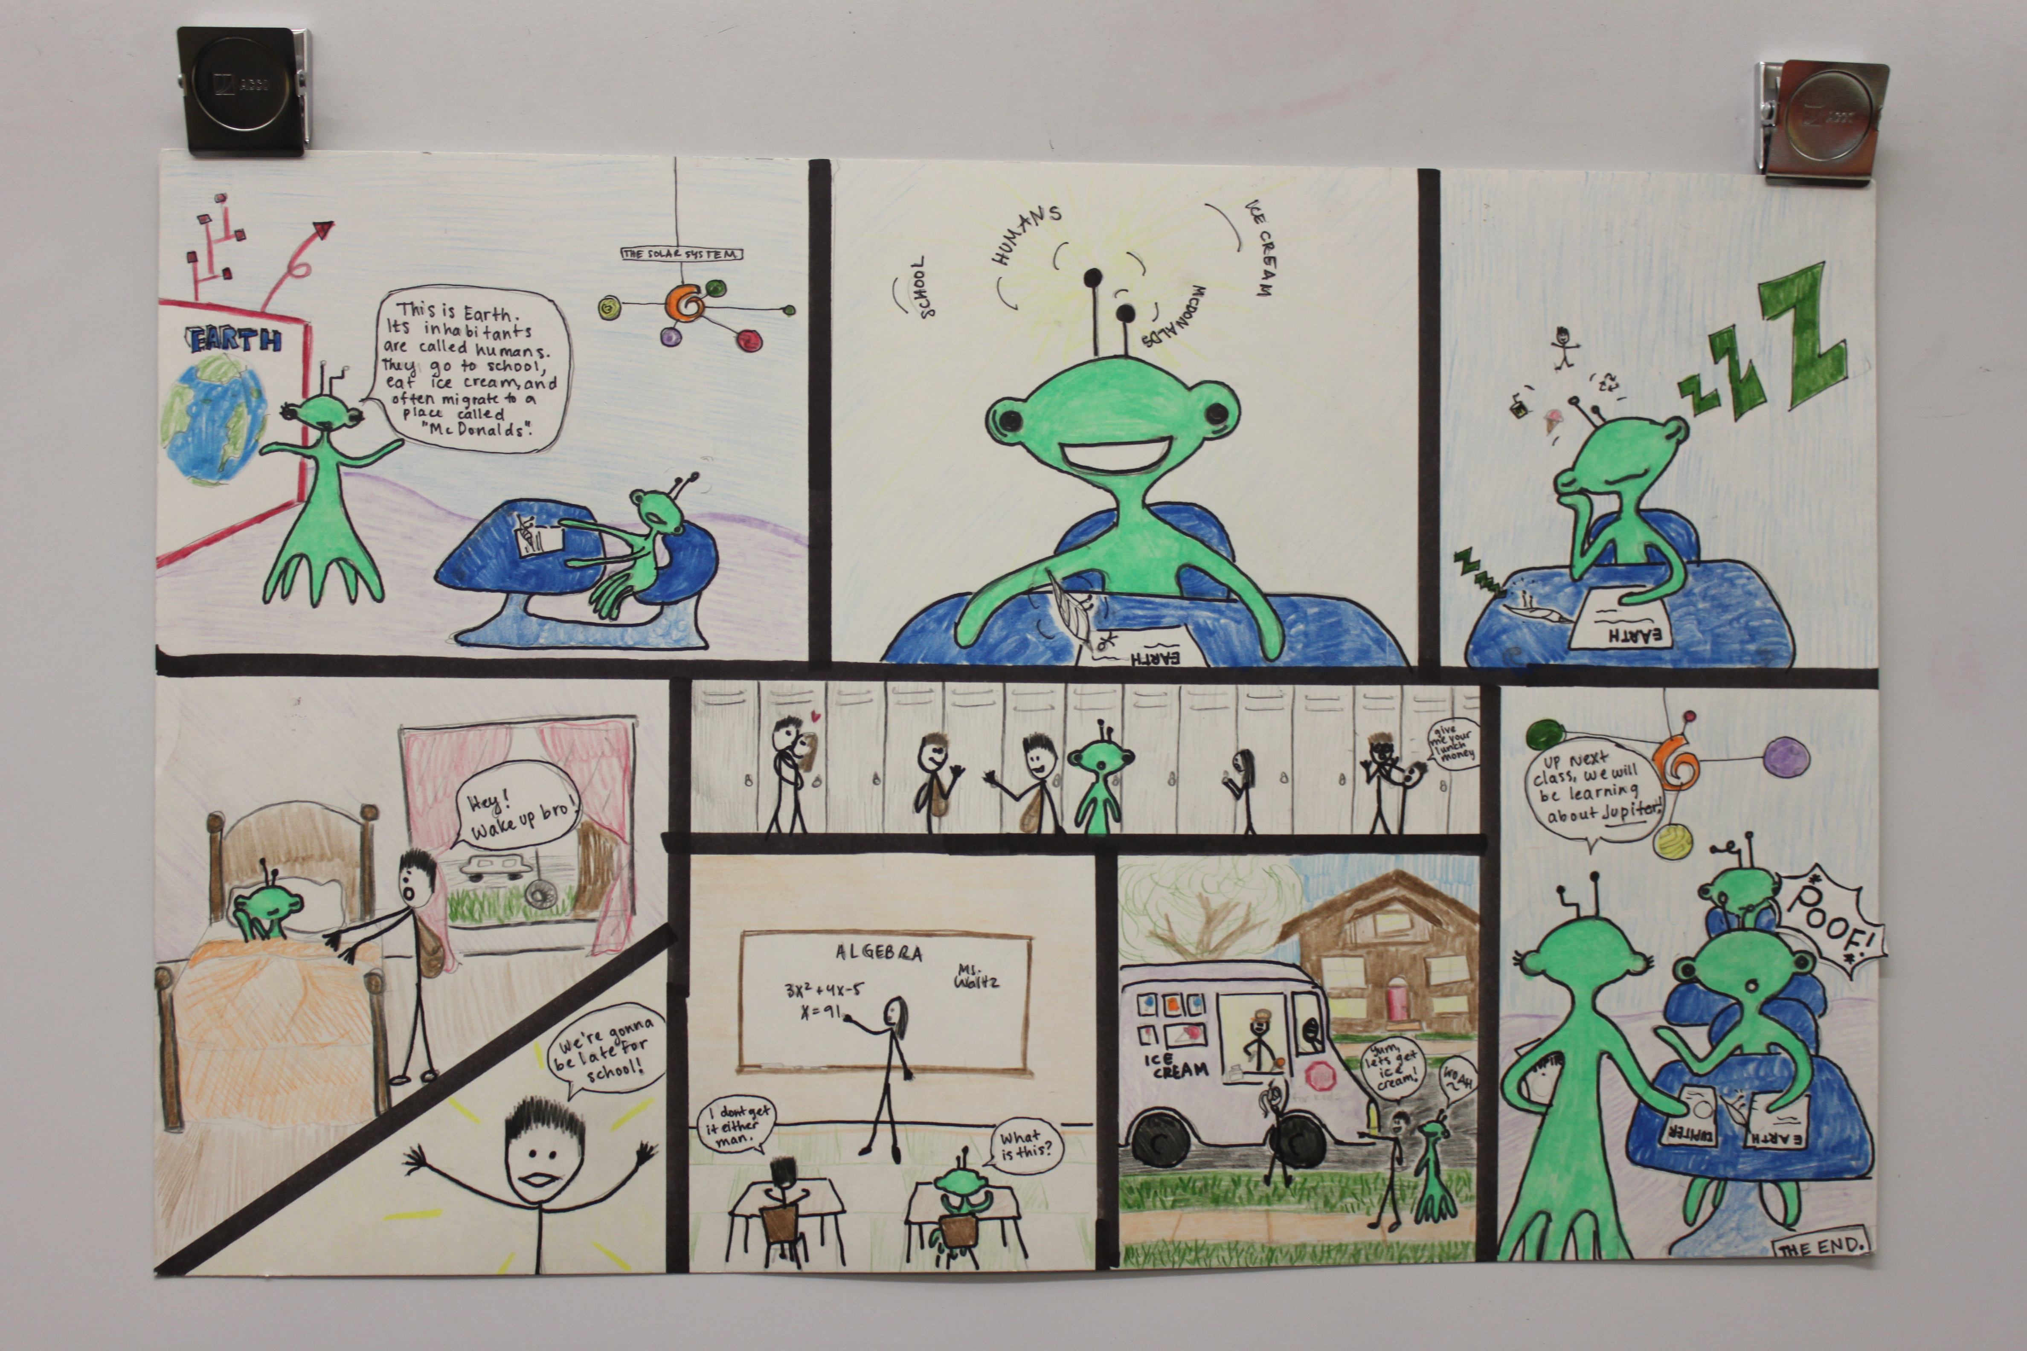

Slide 11
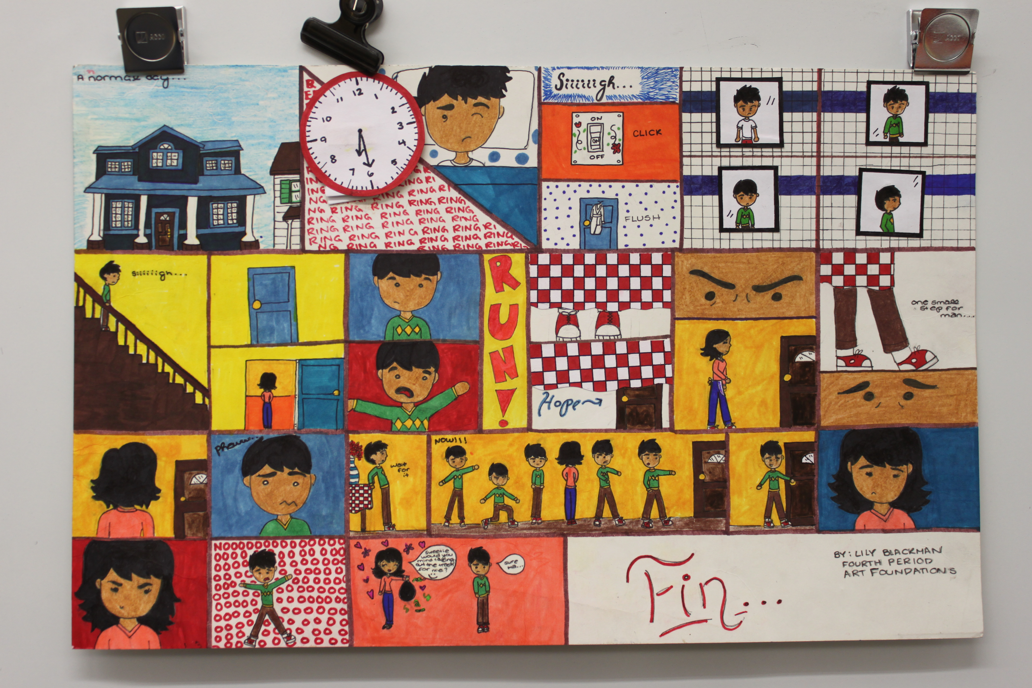

Slide 12
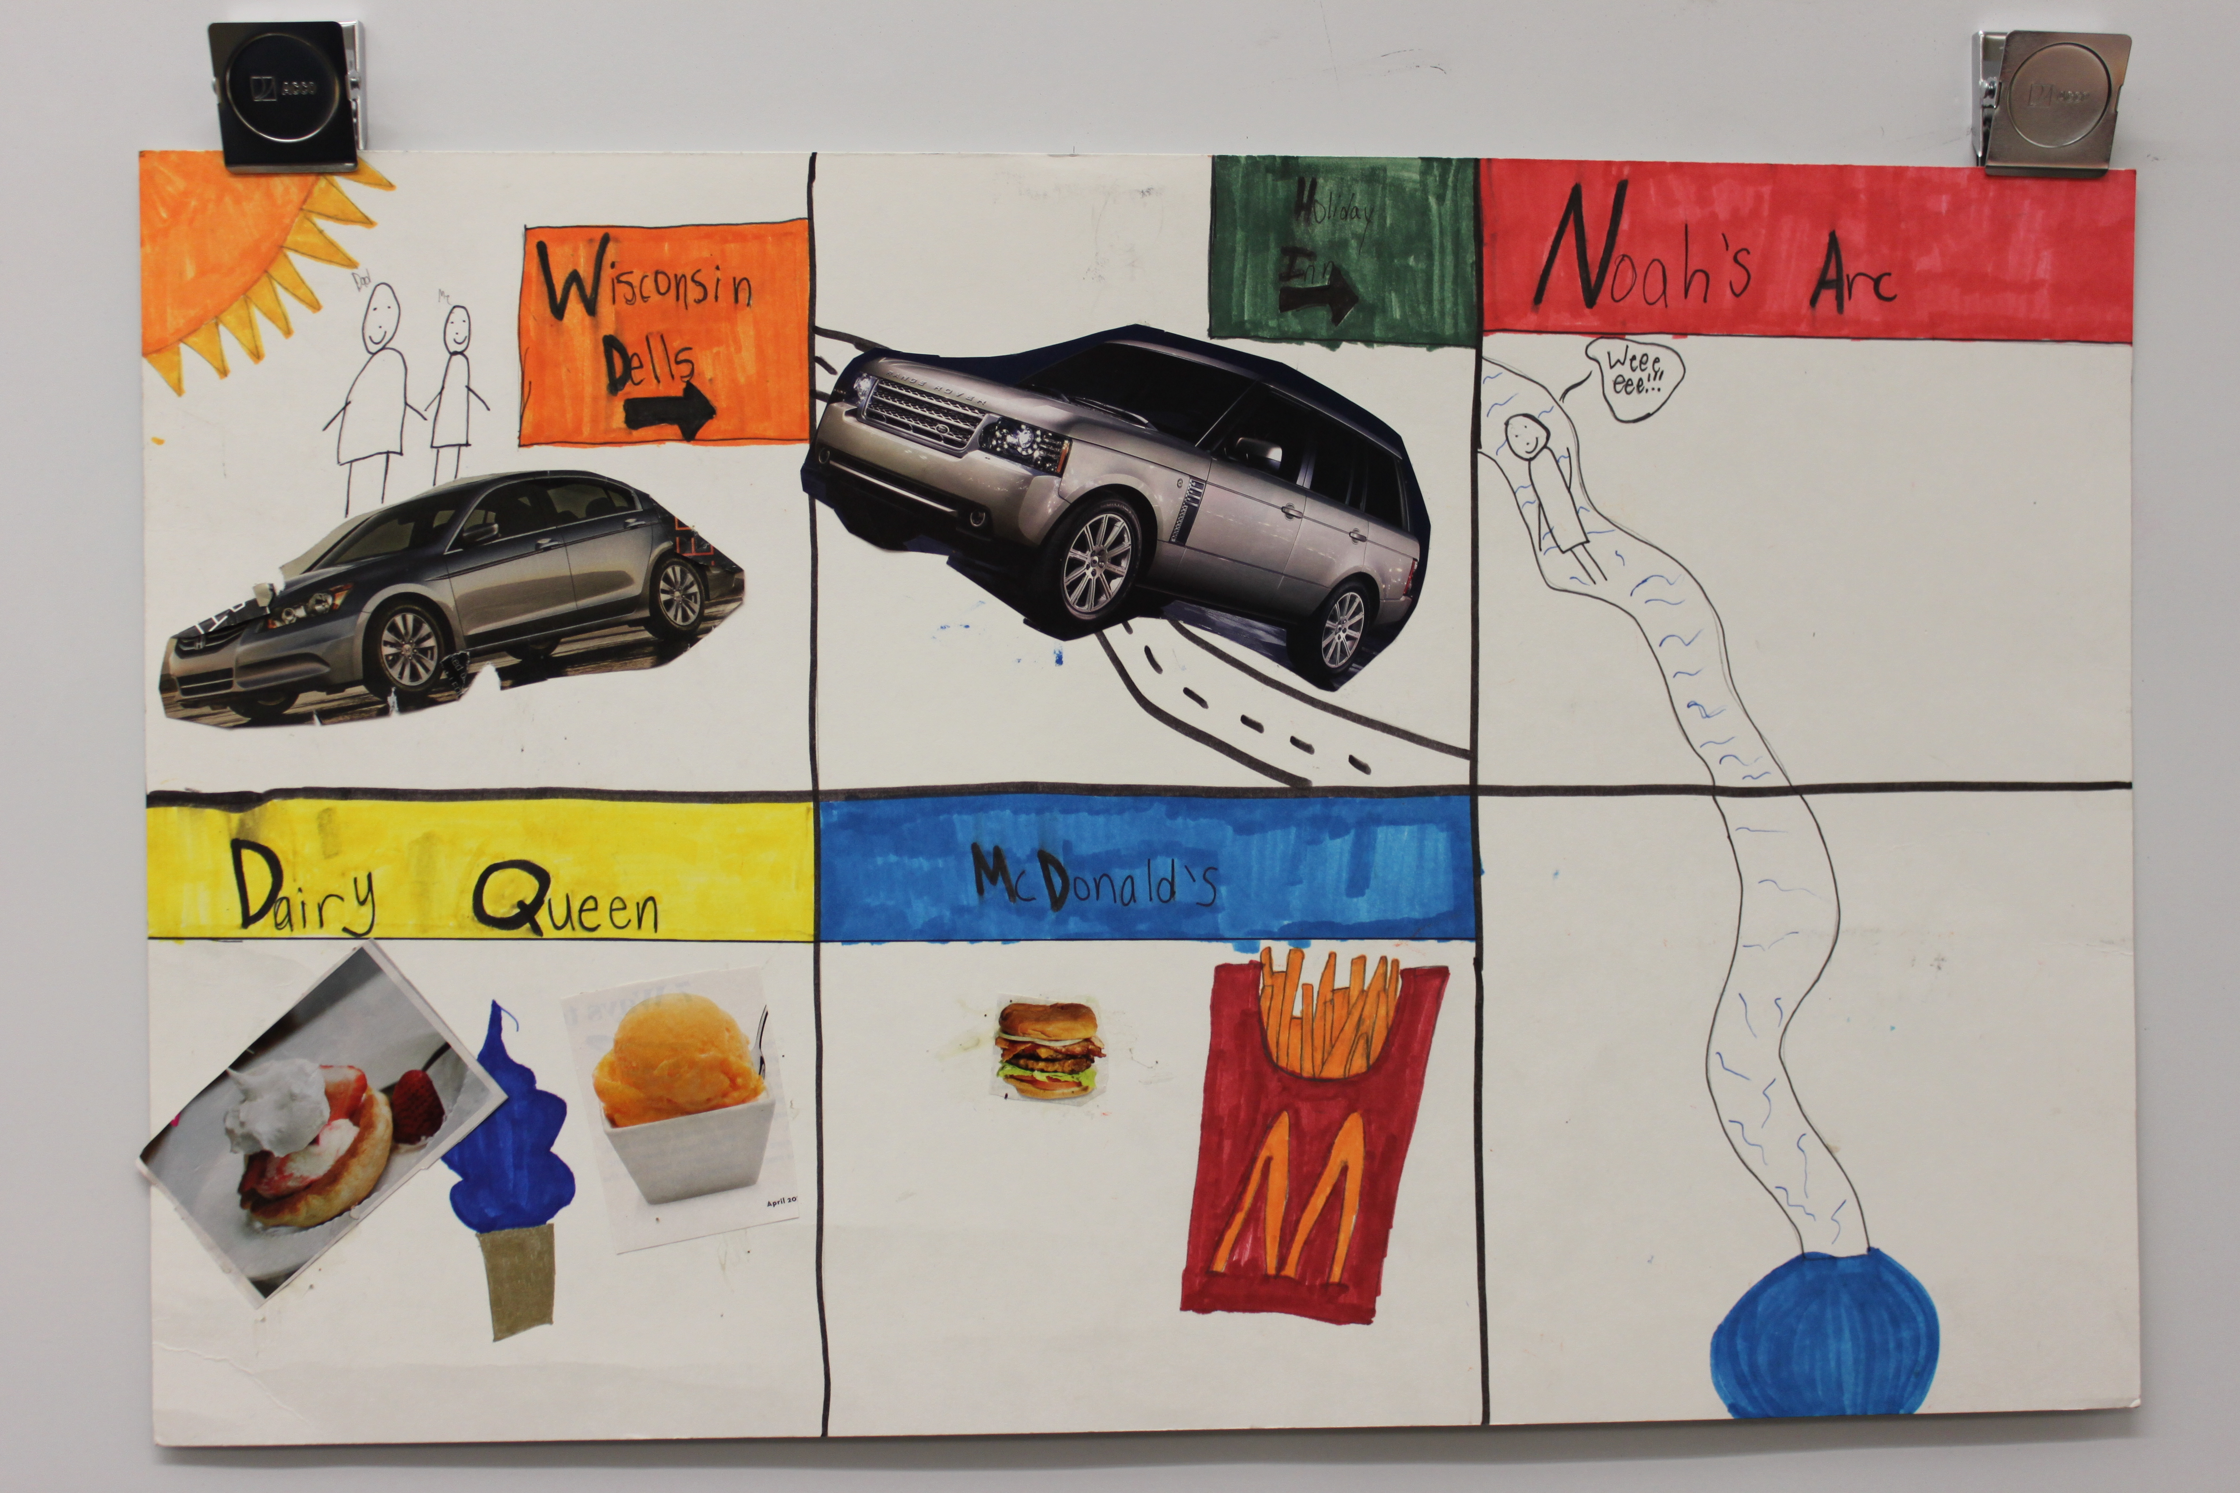
Incomplete and looks rushed – hard to read, lots of empty space, confusing story

Slide 13
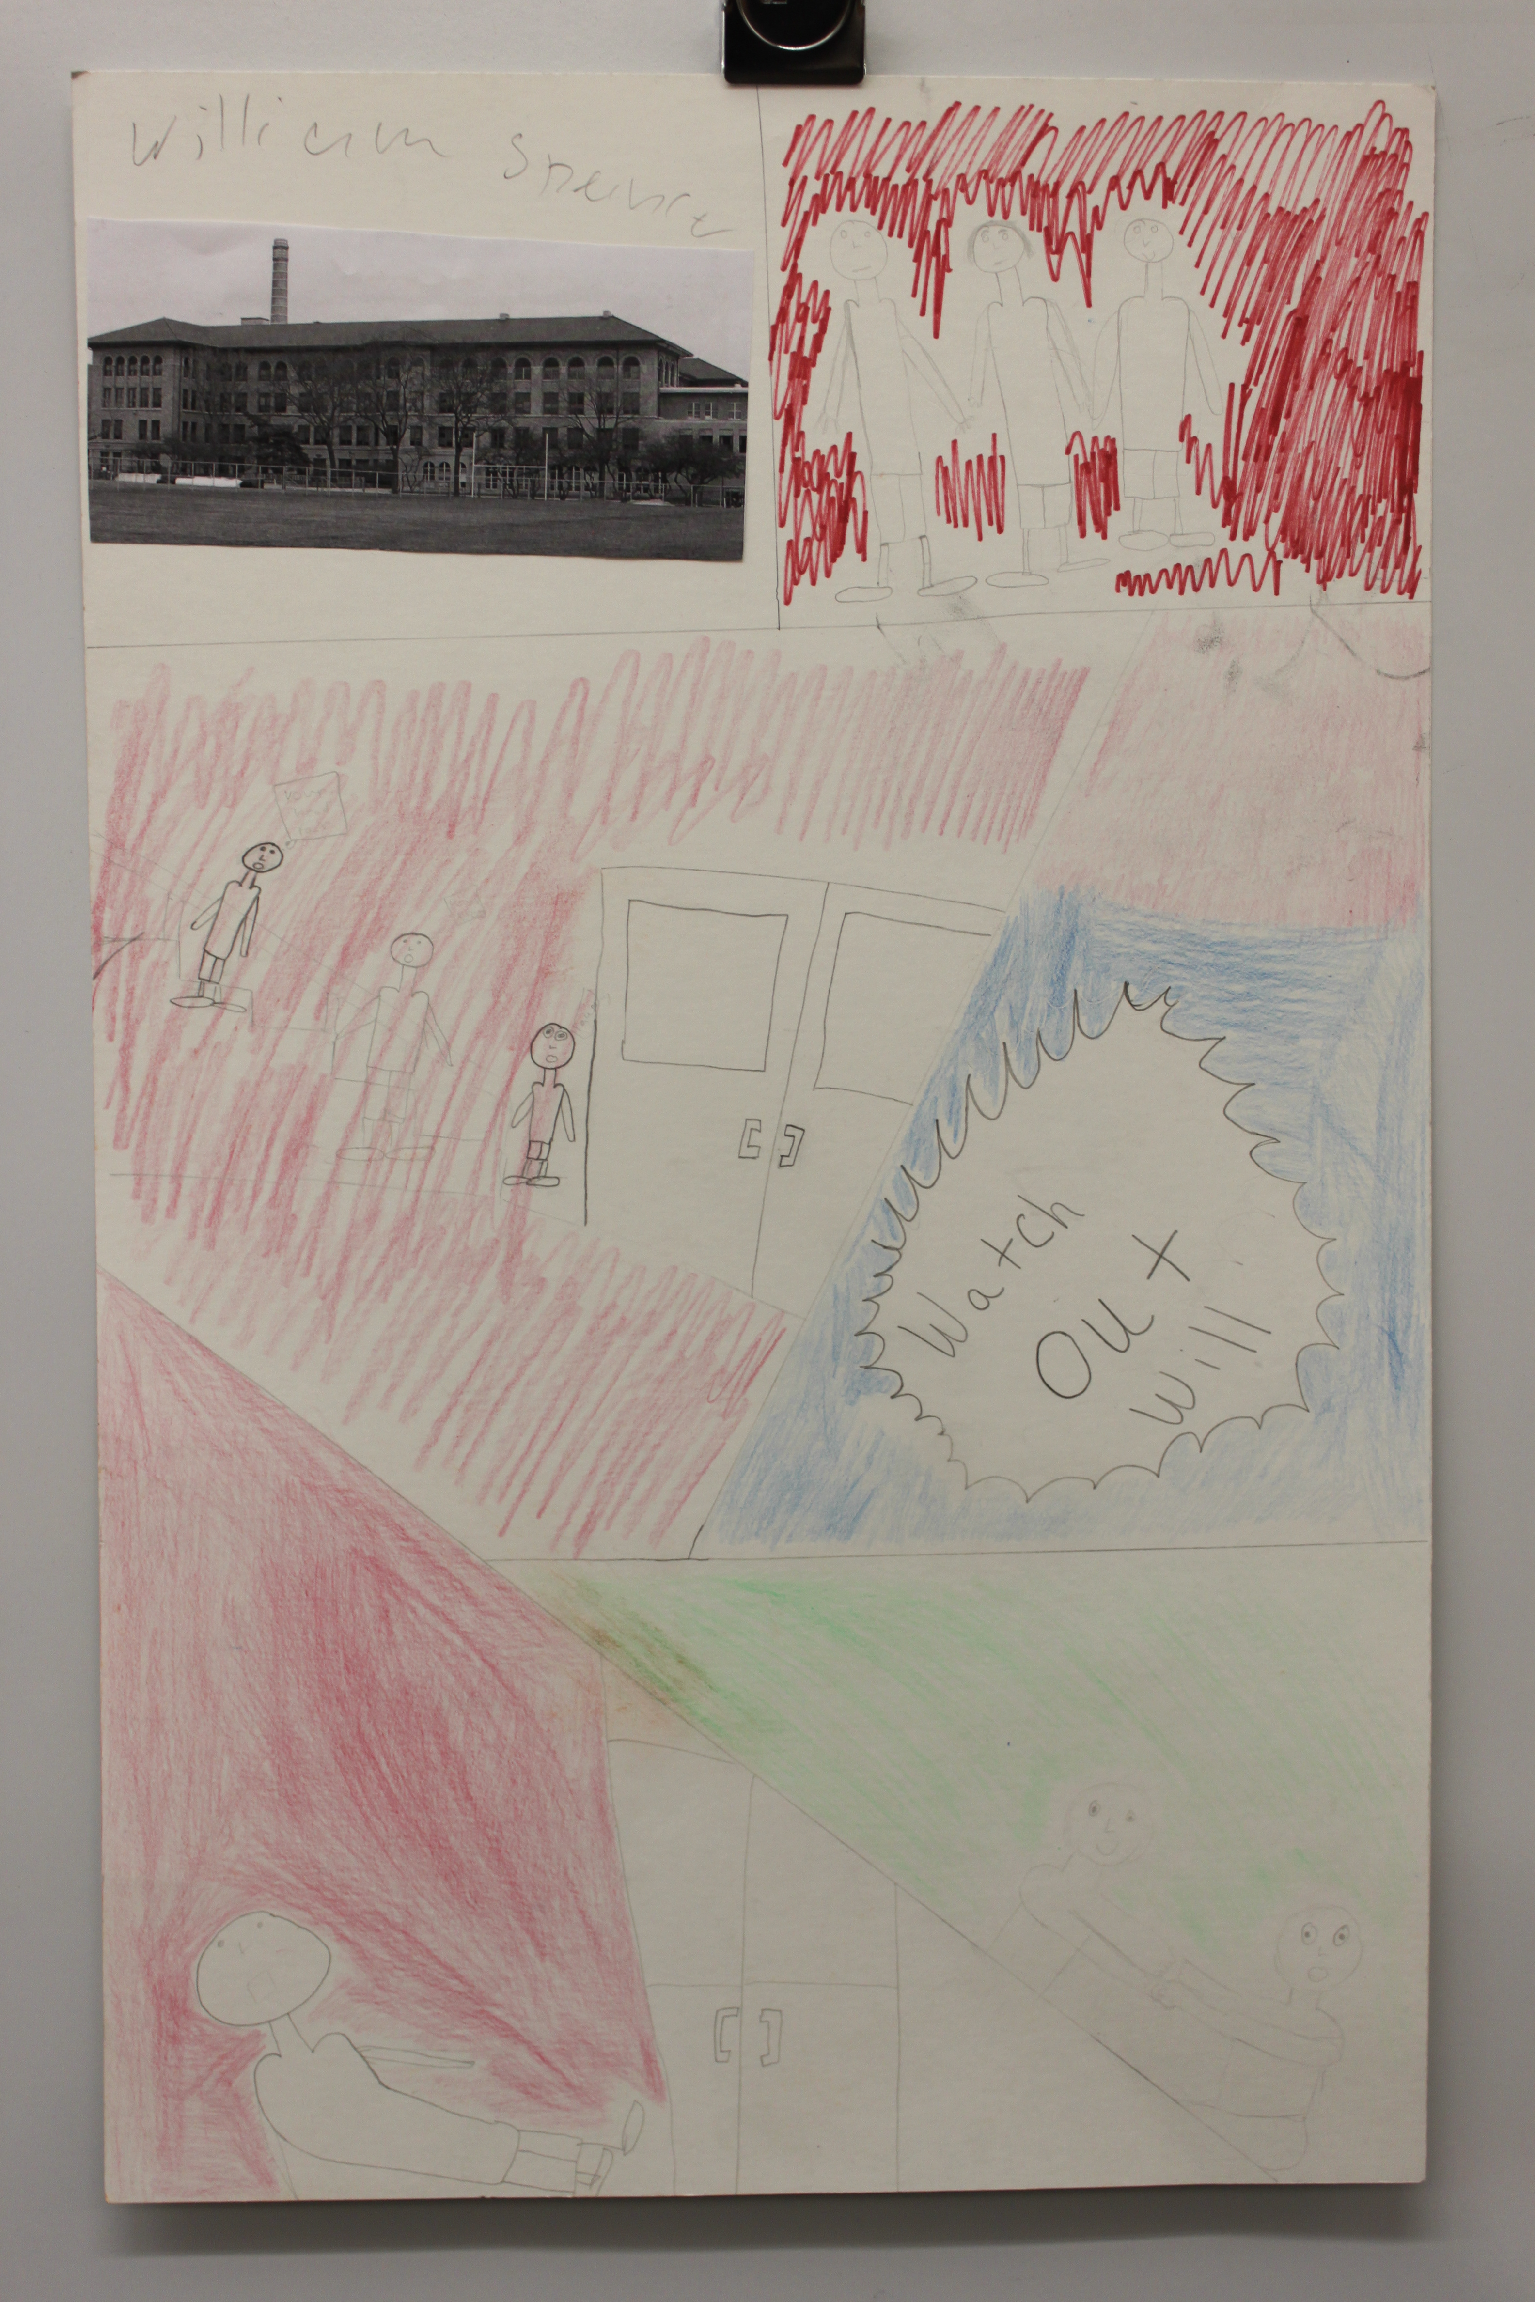
Needs improvement!!
Incomplete and looks rushed – hard to read, lots of empty space, confusing story, where are the individual frames?

